Slide 2
Juggling the IB and the OSSD
July 17, 2016
Chestnut West
9:00am-10:15am

Slide 3
Session Panelists
Anne Dale, Weston Collegiate Institute, IB Coordinator
Lewis Harthun, Colonel By Secondary School, International Baccalaureate Coordinator
Kirk Mitchell, Ridley College, HS Guidance and College Counsellor
Katherine Ridout, Upper Canada College, Director of University Counselling

Slide 4
Advantages of two programs/two diplomas:
Students benefit from richness of two curricula: International Baccalaureate and Ontario Secondary School Diploma
Many shared philosophies and approaches to learning in IB and OSSD (e.g. ATL/Growing Success)
Students apply to post-secondary institutions with two strong credentials; broadens their options around the world
IB stresses value of liberal arts education and international perspective; OSSD offers additional flexibility in terms of individual interests

Slide 5
Challenges of two programs/two diplomas:
Answering to two “masters”—inspection by Ontario MoE and 5 year self evaluations by IB
Students have to meet requirements of two programs rather than one
Meshing of one year (or semestered) Ontario credits with two-year courses in IB; matching Ontario credits with IB diploma program
Timetabling to meet hour requirements for MoE and IB
Timetabling to accommodate IB core (TOK and EE)

Slide 6
Challenges of two programs/two diplomas (con’t):
Different measurements of achievement (4 level MoE percentage grades vs. 1-7 IB scale); had to establish table of equivalence
Six IB diploma subjects over final two years of high school does not allow for as much elective choice as does OSSD
Discrepancies in IB conditions and OSSD requirements at many Canadian and UK universities; sense of resentment that often OSSD requirements are less onerous
Perception among families that IB is much more challenging than OSSD and not worth the extra effort (especially an issue at schools that offer both IB diploma and OSSD alternative)

Slide 7
Strategies for addressing challenges: Role of IBSO

Slide 8
Role of IB Schools of Ontario
IBSO is the local association for IB schools in the province
One of the goals of IBSO is to come together with schools to develop documents of best practice while understanding that each school has a unique set of circumstances
IBSO liaises with universities on behalf of membership
IBSO formulates the Table of Equivalence which is applied across all IB Diploma schools with an investigation to come about its use in MYP
7 = 97–100
6 = 93–96
5 = 84–92
4 = 72–83
3 = 61–71
2 = 50–60
1 = Failing Grade

Slide 9
Strategies for addressing challenges: Models at different schools

Slide 10
Upper Canada College

Slide 11
School Profile:
Independent, all boys, K-12 school, currently offering PYP and DP, moving to add MYP
Multicultural day population; boarding population hails from more than 20 countries
19% of students from Grade 5 up receive financial assistance
5-year high school, offering OSSD courses Grade 9-11 (taught to students one year ahead)
750 students in Upper School (Grades 8-12)
In last 2 years of high school, all students enrolled in both IB and OSSD (average of 2-6 students with special circumstances take IB courses rather than full diploma)
Typically, approximately 150 students in each graduating class; 25-30% class matriculates at universities outside Canada

Slide 12
Nature of the Academic Program:
All IB courses run 2 years, with affiliated OSSD credits and final grades awarded at end of 2-year program
TOK is delivered through class time equivalent to half instructional time for SL subjects over the two years of the program; IDC4U credit awarded
Aside from one or two classes devoted to "inquiry," there is currently no formal link between TOK and EE
EE is stand-alone exercise with workshops on various topics run by library, centre for learning and subject departments; students receive equivalent of 1 week relief from class time to undertake final stages of research and writing; EE completed by end of DP1
No OSSD credit awarded for EE; biggest challenges faced are a) finding enough supervisors for in-demand subjects b) ensuring that students find time in their busy schedules to devote time needed to produce work commensurate with their ability

Slide 13
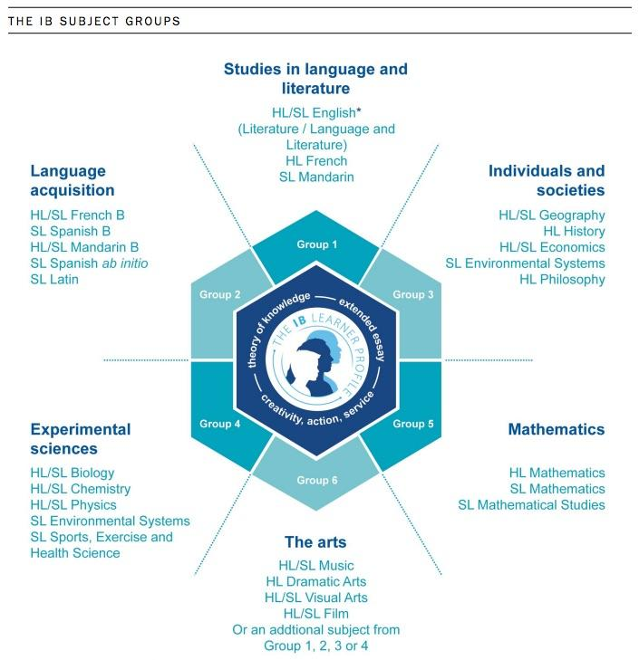

Slide 14
Reporting
All documents for DP courses honour content and approach required by IB while also conforming to expectations outlined in "Growing Success“
Interim reports to parents use blend of MoE and IB learning skills; January and June reports show achievement using both IB and percentage grades
Reporting Year 1-2 grades follows MoE percentage grades; in last 3 years of high school, grades reported in both 7 point scale and percentage grades using ToE
For reporting interim grades in DP to universities, our transcripts show performance in IB and OSSD courses (1-7; 1-100) in June of DP1, January and April of DP2
Grades sent to UK and US universities in fall and winter are based on record of achievement in program to that point (no adjustment to "predict" performance); predicted grades sent to IB in April based on record of achievement to that point (April report card)
70% of final OSSD grade based on April report card in DP2; 30% on final IB results in July

Slide 15
Biggest Challenges and Solutions at UCC
5 year high school program creates OSSD challenges for students admitted after Year 1 (Have developed individualized program that allows students to challenge for additional credits)
Extensive extracurricular commitments of students makes balancing 2 curricula difficult (Provide support in time management through house advising and Centre for Learning)
Timing of IB exams compromises extracurricular activities, especially athletics, in spring term (Athletic director tries to schedule to reduce impact when possible)
Limited understanding of the IB Diploma requirements by some parents (Offer detailed explanation through academic program guide and various parent information evenings)

Slide 16
Weston Collegiate Institute

Slide 17
School Profile
School Type:
Public Day School – Toronto District School Board (TDSB)
Full Year (Non-Semester)
Demographics:
900 students (225 IB students)
Cultural Diversity (> 80 different cultures)
60% family primary language other than English
15% have lived in Canada less than 5 years

Slide 18
School Profile
School Pathways:
International Baccalaureate (IB)
Two Specialist High School Major (SHSM)
manufacturing and sports broadcasting
Literacy Enrichment Academic Program (LEAP)
Special Education – Autism program
Co-operative Education (Co-op)
Dual Credit
e-Learning

Slide 19
School Profile
Graduation Requirements:
Ontario Secondary School Diploma (OSSD - 4 years)
- 30 credits (18 compulsory, 12 choice)
- completion of 40 hours of community involvement
- completion of Ontario Literacy component (OSSLT)
IB Diploma (DP – 2 years)
- Subject requirements - 6 subject areas – 3 SL, 3 HL
- Core requirements - Theory of Knowledge (ToK),
Extended Essay (EE),
Creativity, Action, Service (CAS)

Slide 20
Weston Collegiate Institute – Nature of Program
WESTON COLLEGIATE INSTITUTE
INTERNATIONAL BACCALAUREATE
FOLLOWING IB PATHWAY
225 Weston students
Group 1
Language A
English Literature HL
ENG3U7
ENG4U7
Group 2
Language Acquisition
French B HL/SL
FSF3U7
FSF4U7
Group 3
Individuals & Societies HL/SL
History/ITGS/Anthropology
CHW3M7, CHY4U7/
IDC3U7, IDS4U7/
HSP3U7, HSB4U7
CORE
Theory of Knowledge (HZT4U7)
Extended Essay
Creativity, Action, Service
Group 4
Experimental Sciences HL/SL
Biology/Chemistry/Physics SL
SBI3U7, SBI4U7/
SCH3U7, SCH4U7, SES4U7/ SPH3U7,SPH4U7
Group 5
Mathematics SL Mathematics/Math Studies
MCR3U7, MHF4U7, MCV4U7/
MCR3U7, MDM4U7
Group 6
The Arts/Electives Theatre Arts HL/SL
ADA3U7
ADA4U7
For IB Diploma – 3 Higher Level (HL) and 3 Standard Level (SL) HL = 240 hrs, SL = 150 hrs
For University Admission – 8-10 Ontario Grade 12 Credits TOP 6 AVERAGE (including ENG4U7)

Slide 21
Juggling the IB and OSSD
Challenges:
Timetabling to accommodate the IB core
- EE (no credit assigned, time)
- ToK (non-semester/semester, time)
Subject choice reduction
- Balancing OSSD requirements and IB requirements
(6 IB Diploma subjects over final 2 years of high school,
meeting hour requirements, matching credits/subjects)
Student Pressures
- Time
- Student/Parent/Peer expectations

Slide 22
Ridley College

Slide 23
School Profile
Independent co-ed IB Continuum school
450 students in Upper School (9-12) with 40% international from 45 countries.
60% live in boarding in the Upper School.
30-40% of students do full IBD and rest do a hybrid mix.
Ridley has school specific requirements for graduation that include cadet service, 2 Foreign Language credit and sports participation every season.
We have Saturday school.

Slide 24
Nature of the Academic Program
All IB courses run 2 years with OSSD credit awarded at the end of each year.
TOK is full time in first year, then night seminars in the fall of year two. EE workshops are offered during this class but are not included in the grade for TOK. Starting this year we will offer IDC4U credit.
Next year, we will offer an ICD3O credit that will include hours from EE, Residential Life seminars, and co-curricular activities that are assessed.
We offer our strongest gr. 8 math students the Math 9 course so they have finished Functions by gr. 11 and can do Math SL or HL.
Many of our students do a summer Functions course in August at Ridley to get into Math SL or HL.
Currently we are only offering Functions and Applications as the Math Studies Y1 credit. However, this is going to change where stronger Studies students can do enrichment hours to earn the Functions credit instead. It will then allow them to do a summer Advanced Functions credit before graduation.

Slide 25
Nature of the Academic Program:
We offer our strongest gr. 8 math students the Math 9 course so they have finished Functions by gr. 11 and can do Math SL or HL.
Many of our students do a summer Functions course in August at Ridley to get into Math SL or HL.
Currently we are only offering Functions and Applications as the Math Studies Y1 credit. However, this is going to change where stronger Studies students can do enrichment hours to earn the Functions credit instead. It will then allow them to do a summer Advanced Functions credit before graduation.

Slide 26
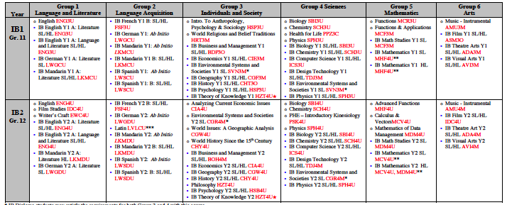

Slide 27
Reporting
Grades reported in both 7 point scale and percentage grades using ToE
For reporting interim grades in DP to universities, our transcripts show performance in IB and OSSD courses (1-7; 1-100) in June of DP1, January and April of DP2
Grades sent to UK and US universities in fall and winter WERE based on record of achievement in program to that point (no adjustment to "predict" performance); however, this is under review.
We will send a Ridley transcript in June to universities that require a final transcript before July 1.
Students can choose which qualifications they wish to present to universities.

Slide 28
Biggest Challenges and Solutions at Ridley College
Not burning out our students.
  Balancing Ridley requirements with rigor of IB. (Master schedule changes and PE/Reslife credit)
  Making EE and CAS manageable and fun. (EE out of TOK and aligning CAS with IBO)
  Making sure full IB diploma students do not have to take an extra course to gain 30 credits. (IDC30 to gain credit for EE, service work and reslife curriculum)

Slide 29
Biggest Challenges and Solutions at Ridley College
Working with math sequence to make Math SL/HL or Adv. Functions easily accessible to our students in gr. 11. (Summer school at Ridley and earning Gr. 10 Math in Gr. 9).
Accurately handling our anticipated and predicted scores for university reporting. (Assess as IB then translate to OSSD).

Slide 30
Colonel By Secondary School

Slide 31
School Profile
Public school
1100 students, 675 of those students are full DP students (9th - 12th grade)
pre-DP track in 9th and 10th grade
153 full diploma students this past year
over 300 students writing examinations from this past year
both a system/magnet school for the OCDSB in the City of Ottawa for IB as well as a community school
non-semestered
incredibly varied in terms of ethnicity and socio-economics

Slide 32
Offerings
Group 1 - English A: Literature (HL & SL)
Group 2 - French B (HL & SL), Spanish B (HL & SL) **ab initio by request and by consultation with teacher
Group 3 - History (HL & SL), Geography (HL & SL), ITGS (SL)
Group 4 - Biology (HL & SL), Chemistry (HL & SL), Physics (HL & SL), SEHS (SL)
Group 5 - Mathematics HL, Mathematics SL, Math Studies SL
Group 6 - Visual Arts (HL & SL), Music (SL), Film (SL)
Because of the wide variety of courses, we are able to construct a schedule that allows many pathways and alternative pathways to our students throughout their DP journey

Slide 33
Challenges, Opportunities, and Success
Extended Essay Supervision
Retention > Grades
Altering the perception of “success”
Focus on the development of appropriate learning skills
Building appropriate scaffolding in the 9th and 10th grade for success in the DP

