Slide 2
Creating a Makers’ Lab
Anne Grisham,Principal
Lene Muth, Assistant Principal
Bonnie Hughes, Second Grade Teacher

Slide 3
How It Started
Clue: Never send teachers to something if you are not interested in implementing it.
Tinkering Labs or Makers’ Labs are a buzz almost everywhere.
A few teachers requested to go and visit a school with a Maker’s Lab and the Exploratorium.

Slide 4
How much money is this going to cost?
We apply for $100,000 grant
3-D printers
Professional Development
Lots of stuff and tools!

Slide 5
BUT….no grant! We are not funded!
Now what?
Can we do this on our own?
Let’s be Risk-takers and see what we can do!
Step 1:
Re-purpose a room

Slide 6
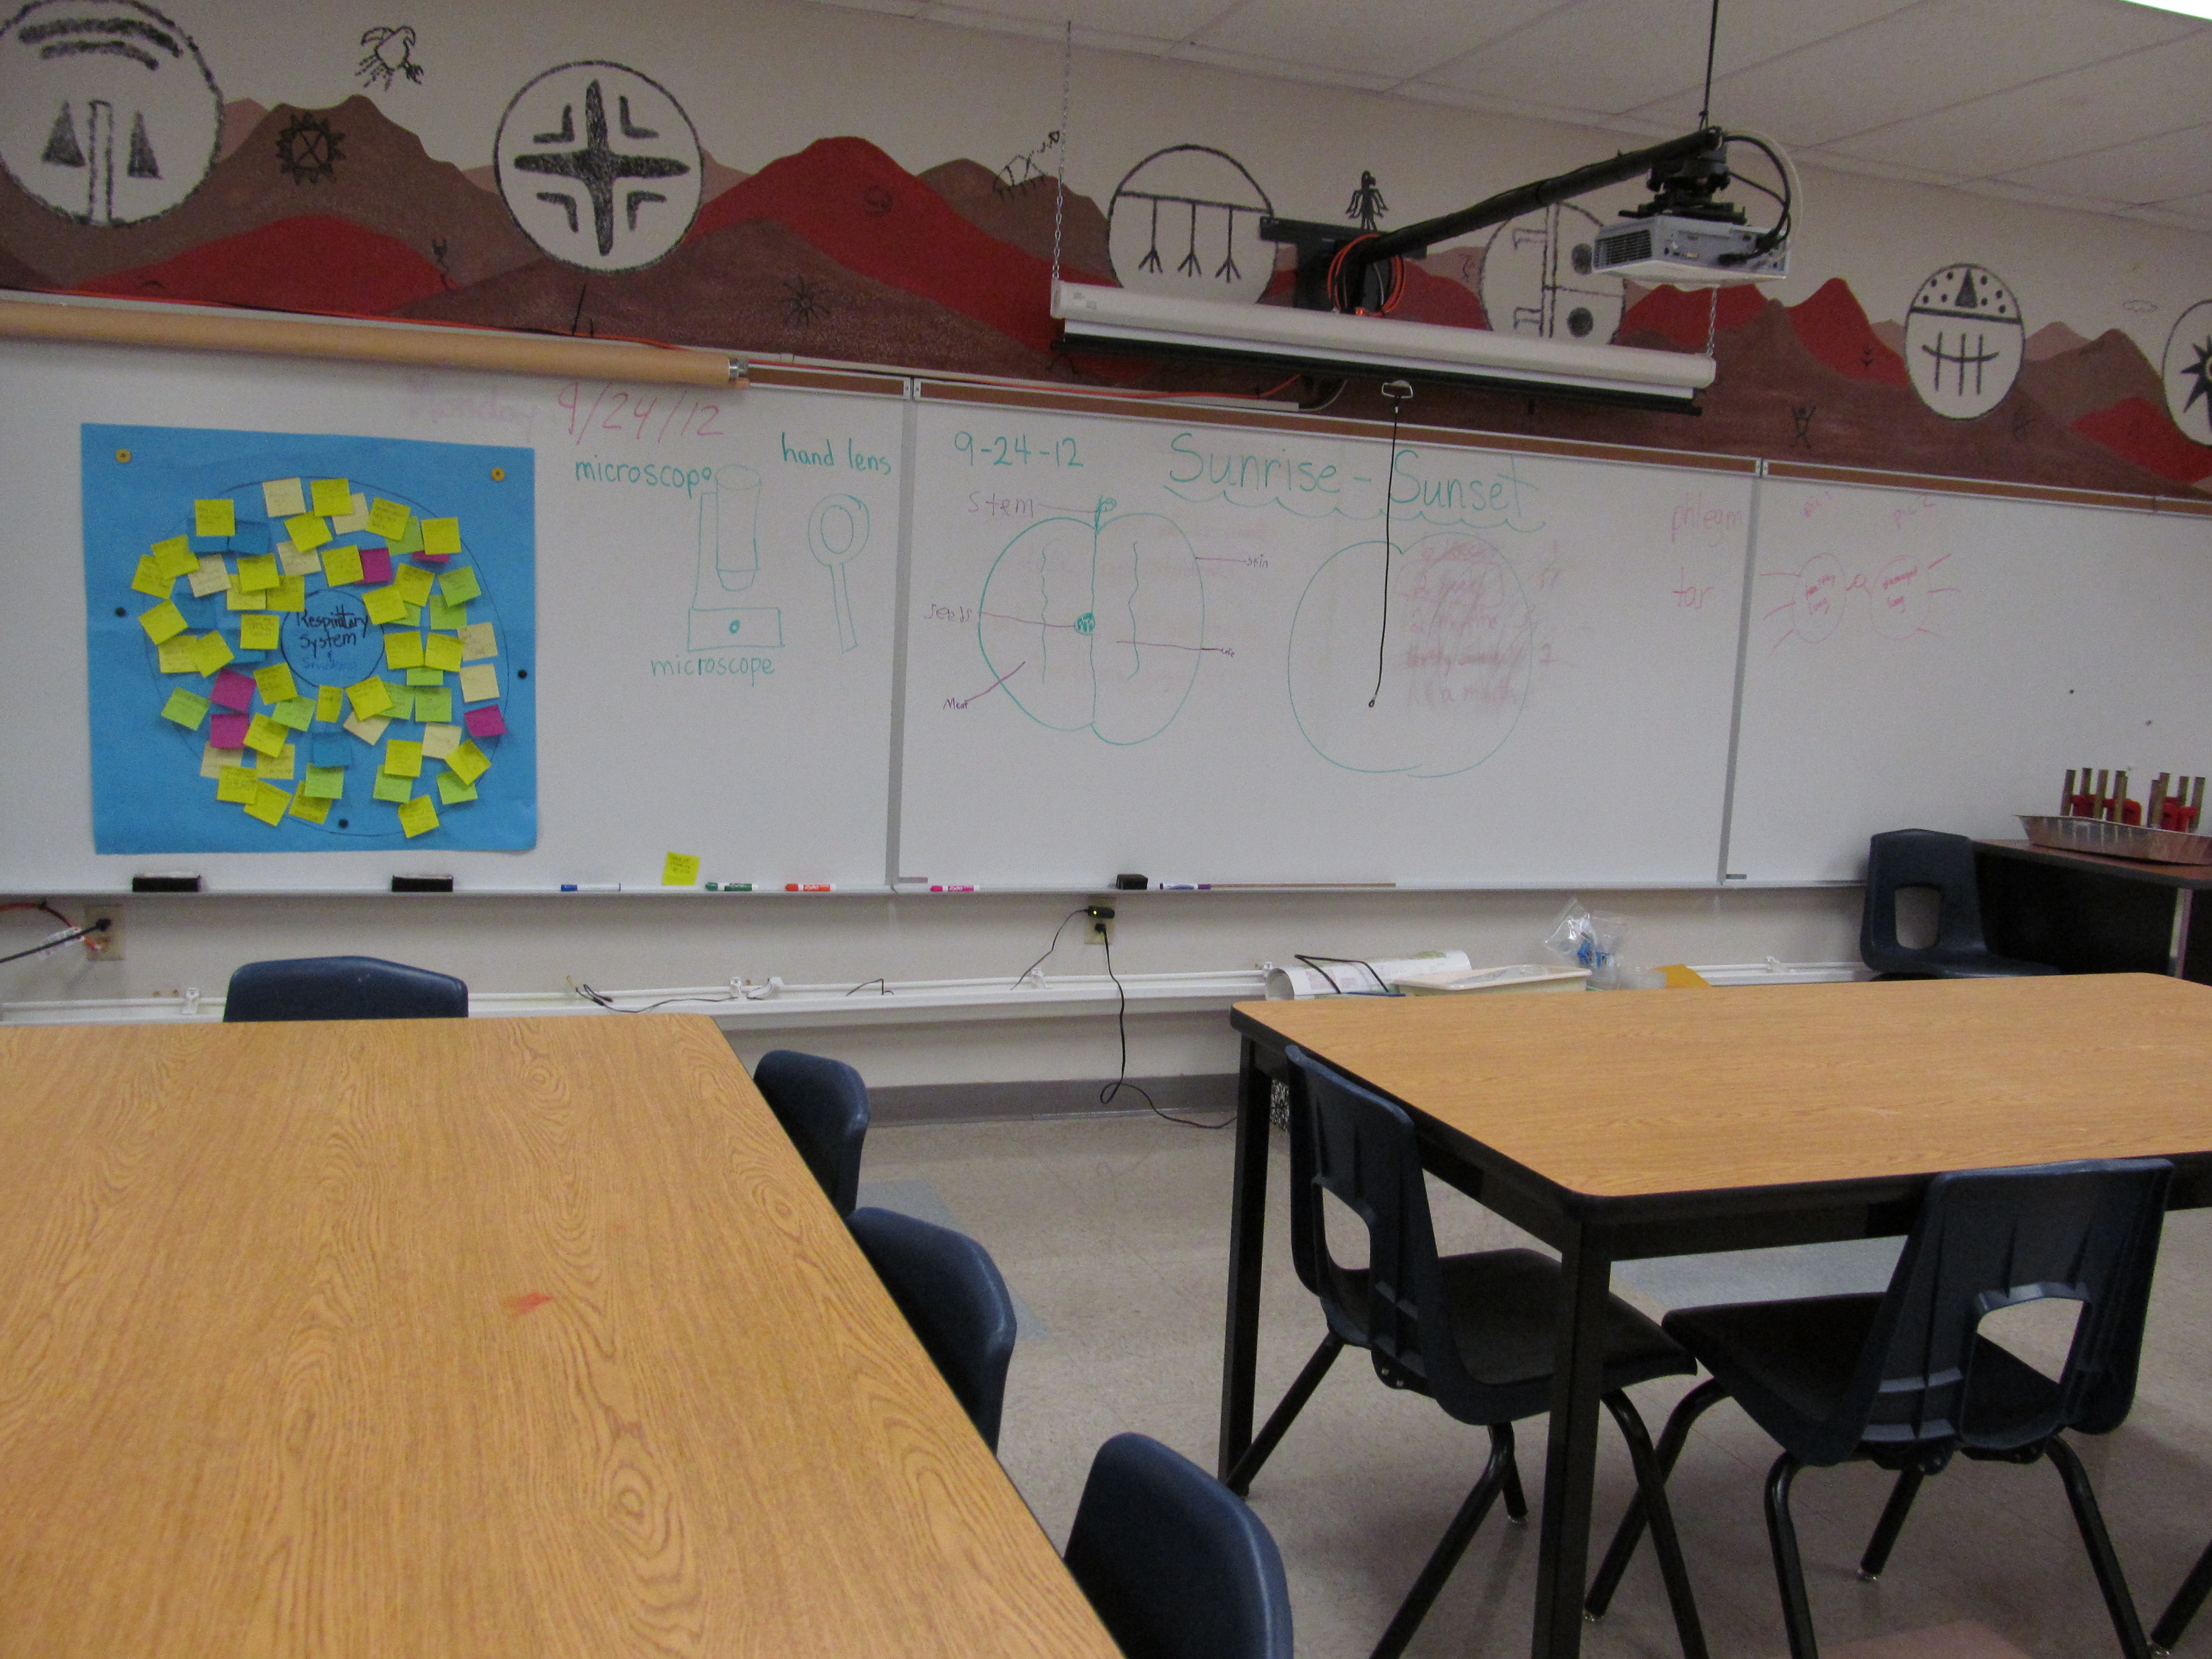

Slide 7
Add a bunch of stuff
We asked for tools such as hammers, screw drivers, pliers
We asked for hot glue guns, nails, screws
Recycle items
Plastic fruit baskets
Paper cups
We also had a list such as toilet paper tubes
Buttons and beads
Straws
Balloons
Fabric scraps
Yarn
String
Cardboard boxes
Corks

Slide 8
We have stuff all over…now what!
This is where we stumbled. We got lots of stuff…but we were not wise enough to really know what we needed.
Lots of trips to IKEA for storage compartments

Slide 9
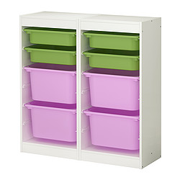
Sorting the stuff took hours
Lots of trips to IKEA for storage compartments

Slide 10
PD for teachers
Comfort level has to build or teachers won’t use it or become frustrated
Don’t make assumptions about skills and ability level

Slide 11
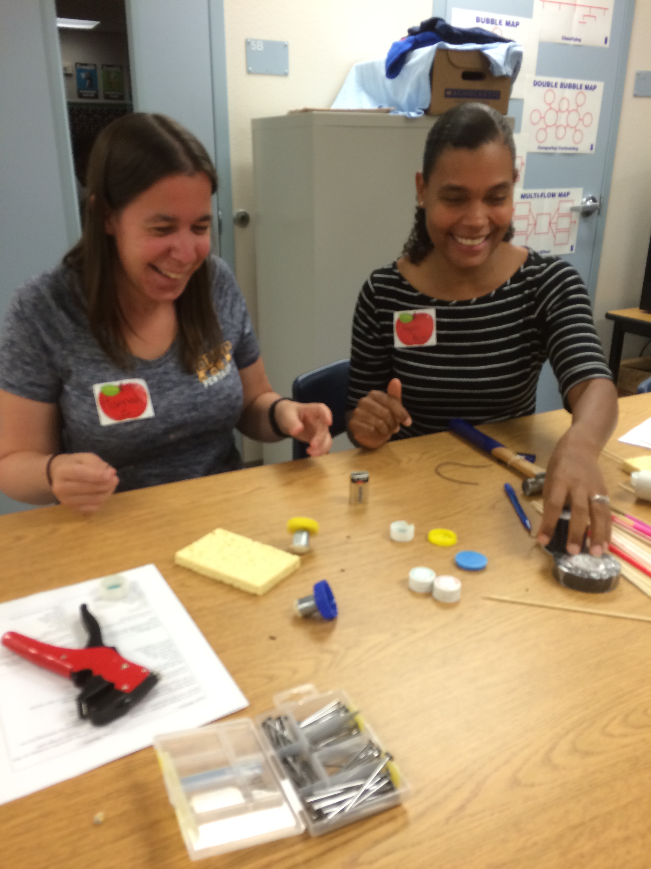
Don’t forget to give teachers time to learn and play…

Slide 12
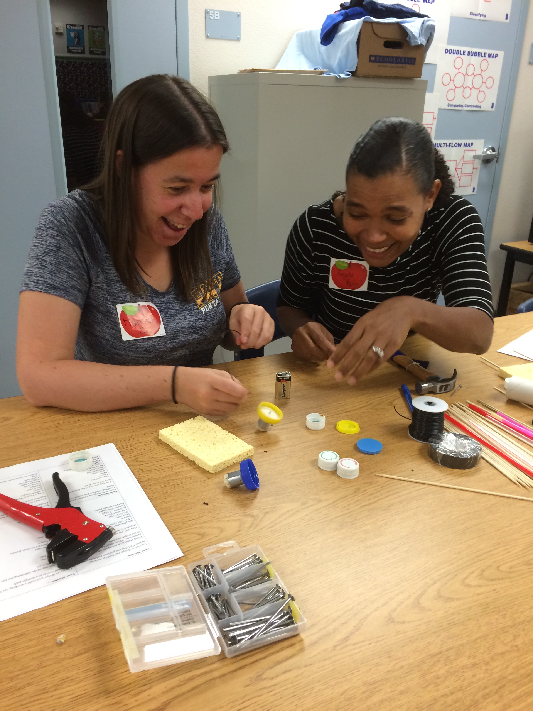

Slide 13
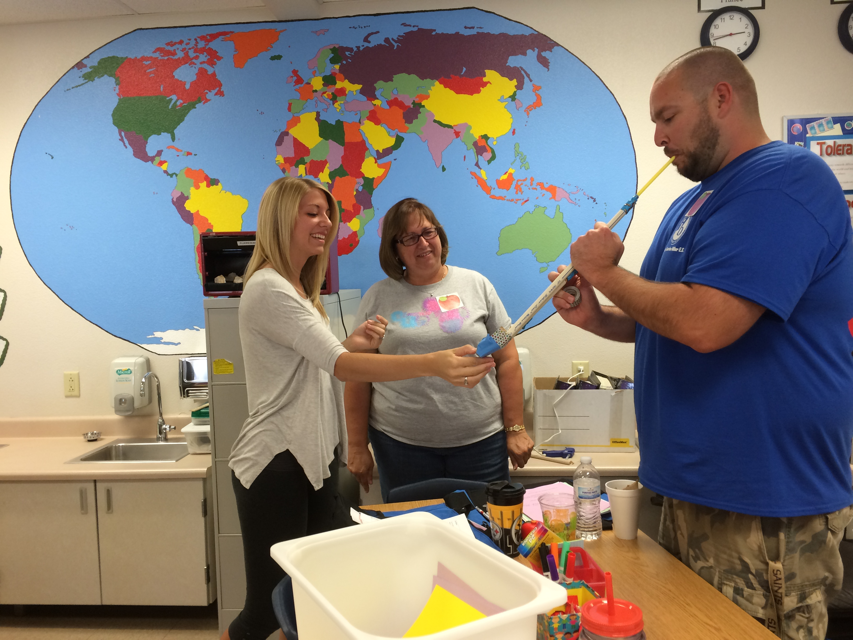

Slide 14
Now it’s your turn
There are three different Maker’s Lab activities
These are open, guided and structured inquiry activities
Make a Catapult that will fling the ping pong ball the farthest
Make a realistic sounding Moose Call (after all we are in Canada!)
Make a Scribbler Machine using motors and batteries
Be a risk-taker, thinker, communicator, and inquirer!
Have fun

Slide 15
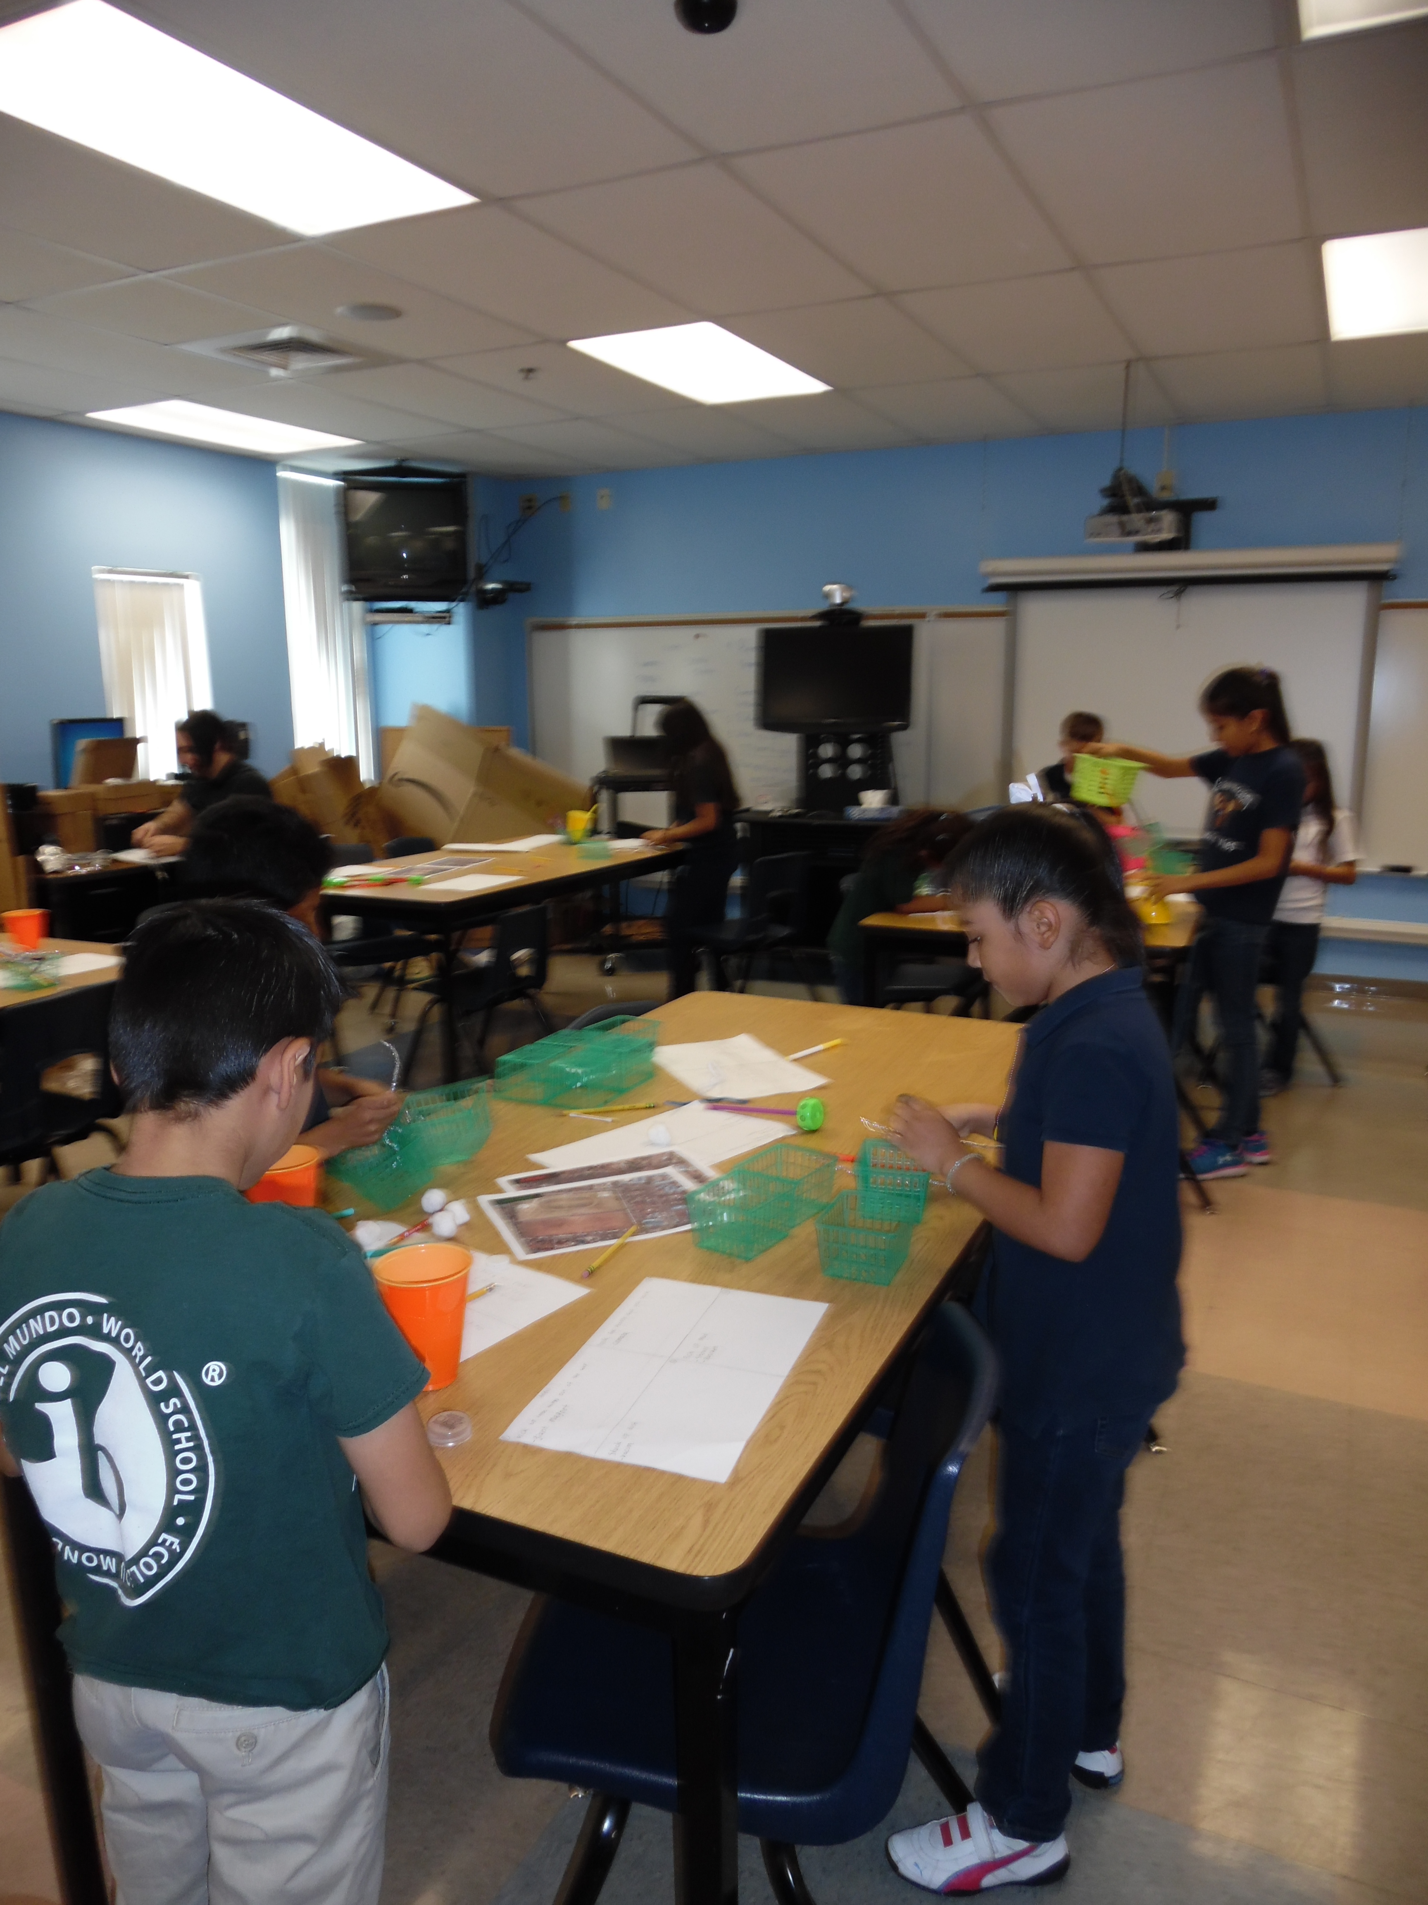
Kids using the design cycle

Slide 16
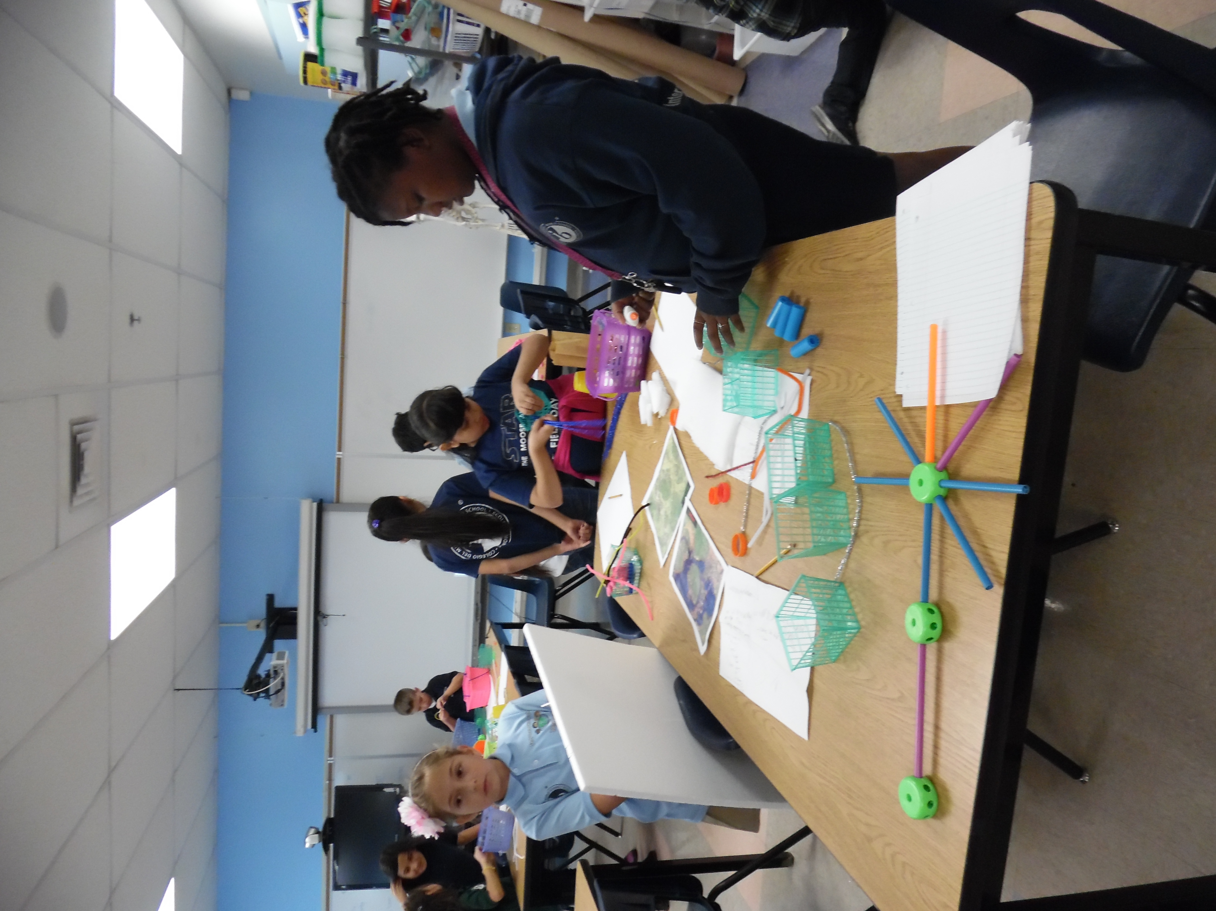
All kids can be engineers!

Slide 17
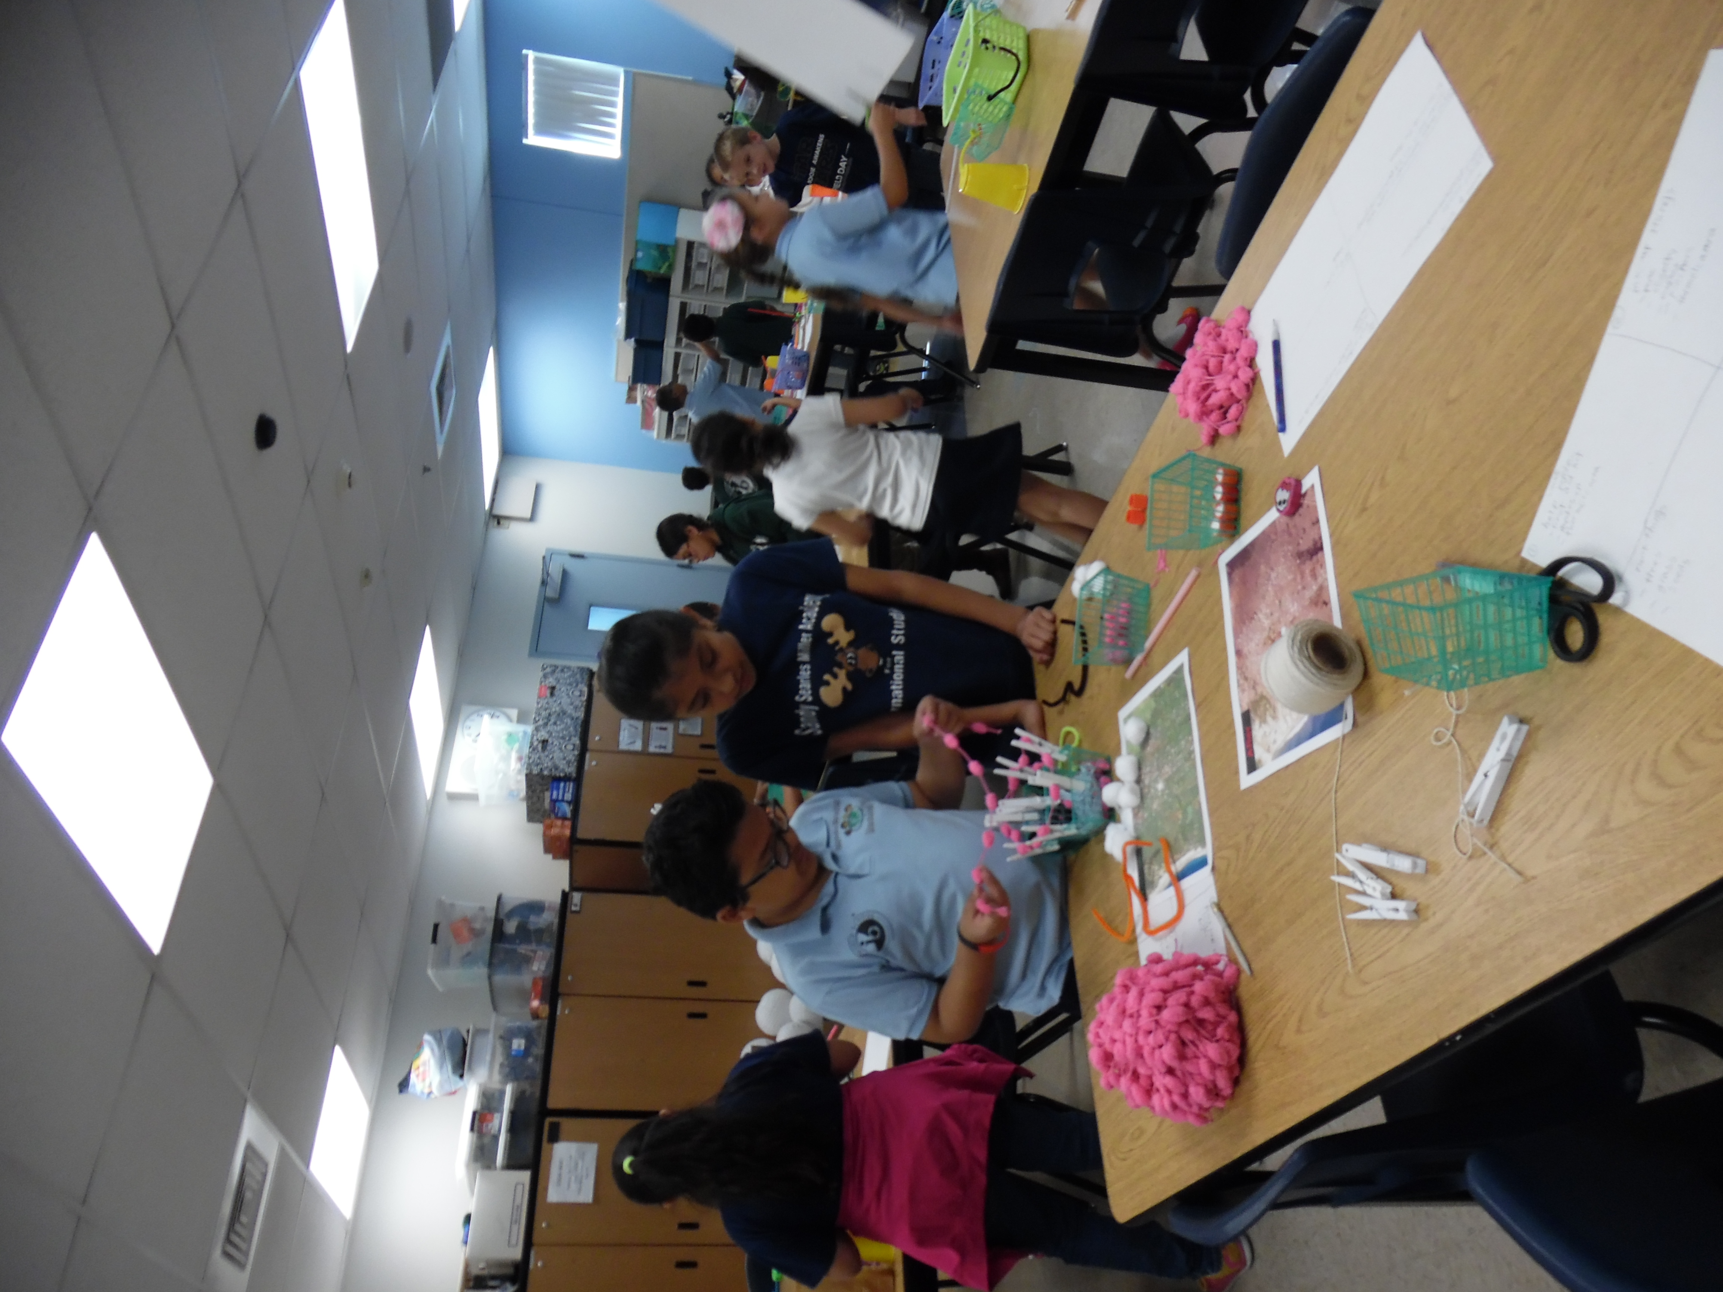
21st century skills requires the Approaches to Learning Skills! Students have to use these skills to be good researchers and good collaborators.

Slide 18
Next Steps…
We purchased 2 small 3D printers. We need to teach the teachers how to use them.
We have sent our coordinator to a training in Boston on Elementary Engineering to be trained as a trainer using the Boston Museum materials. ( We bought the binders last year with some limited usage)
We need to figure how what we really need and want so that we don’t just get stuff that we can not use or store.
Connect more to units of Inquiry so that it is not an add-on.

Slide 19
Questions?
Thanks for participating!
We hope you had some fun!
Enjoy the rest of the
conference!
Feel free to contact us!
amg304@interact.ccsd.net

