Slide 2
The Quest to Become a
Rockstar Coordinator
Chelsea East, Shawn Reed Parsons, Sheree Lynn
PYP, MYP, and DP Coordinators
from Academy District 20 in Colorado
Notes:
All introduce: Rock Music medley is playing. Ask participants how they start a staff meeting, professional learning, or professional development. Let them know that everything we do in this 90 minutes is a tip or trick for them to take away. If any of you would like to be our screaming fans, feel free. ☺

Slide 3
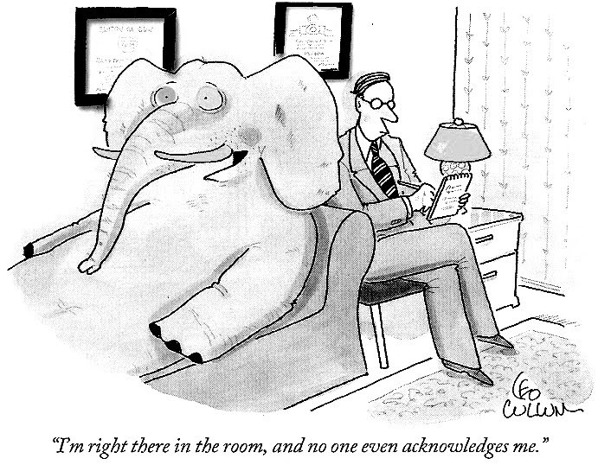
Who is in the room?
Get your phones ready to answer some questions using Kahoot
http://blog.do.com/post/97581227109/the-3-elephants-in-your-conference-room
Notes:
Shawn: Remind participants that Kahoot is a great tool to take the temperature of the room. What other tools do they use? Let people know that as they choose people to chat with during the session, they may want to choose people who have a similar situation to them.

Slide 4
Why are WE here?
Inspiration
Organization
Collaboration
Notes:
Shawn: Although we thought we would organize the presentation under each of these topics, what you will probably see is a blending of these big ideas. This is also a time to introduce ourselves and share with them why we wanted to do this presentation: to encourage collaboration and a sharing of best practices. Everyone in this room has some rockstar qualities and in the spirit of IB, we can learn from each other.

Slide 5
Why are YOU here?
Why are you in the role of IB Coordinator?
Collaborate with a fellow artist:
Turn and talk:
  Who are you as a musician (coordinator)?
  What are your hopes for your band (school)?
Notes:
Sheree

Slide 6
“It is not the critic who counts; not the man who points out how the strong man stumbles, or where the doer of deeds could have done them better. The credit belongs to the man who is actually in the arena, whose face is marred by dust and sweat and blood; who strives valiantly; who errs, who comes short again and again, because there is no effort without error and shortcoming; but who does actually strive to do the deeds; who knows great enthusiasms, the great devotions; who spends himself in a worthy cause; who at the best knows in the end the triumph of high achievement, and who at the worst, if he fails, at least fails while daring greatly.” Teddy Roosevelt
Notes:
Sheree! Remind participants that they are in a difficult role. We are often the lone believers. How do we gain more groupies, how can we make our band bigger?

Slide 7
Daring greatly in your IBC role.
Turn and talk
Think of a time when you have dared greatly, even if you may have stumbled?
Notes:
Sheree

Slide 8
Do you rock the IB mission?
Remind yourself of the IB mission statement and reflect on your school.
Notes:
Chelsea: Remind participants that this is a question they could ask every teacher in the school? How would it help their school?

Slide 9

Mission Statement
The International Baccalaureate Organization aims to develop inquiring, knowledgeable and caring
young people who help to create a better and more peaceful world through intercultural understanding and respect.
To this end the IBO works with schools, governments and international organizations to develop challenging programmes of international education and rigorous assessment.
These programmes encourage students across the world to become active, compassionate and lifelong learners who understand that other people, with their differences, can also be right.

Slide 10
Thinking about the IB mission…
  If you had to write a song about the most important values of your school, what would your song be titled?
  Jot it down
  Then share

Slide 11

Notes:
Sheree: One of the things we needed to ROCK THE MISSION was….

Slide 12
Why are you here?
Dare greatly with us! What is your IBC philosophy?
Use this starter:
I am IB because…

Slide 13
With so many things to do, where do you start?
PYP | MYP | DP/CP
Programme of Inquiry organization & cross-walking Inquiry, research, and summative assessments for young children IB Portfolios Exhibition | Projects CP or PP Sending in units for building quality curriculum E-assessments portfolios | Internal assessments CAS Extended Essay Registering for exams Leveraging a sense of community
Writing unit planners Trainings Vertical articulation Collaboration Self-study
Notes:
Shawn We do so many different things; how do we stay on track. How do you write the songs about the most important things for the year. Etc.

Slide 14

How do you make sure you’re not a one hit wonder?
Know your history – What works? What doesn’t?
Learn from a master
Practice makes perfect
…BUT change is constant…be flexible
Experience is an excellent teacher – Choose, Act, Reflect
We all have struggles. What are yours?
As we share our own struggles and solutions, what “strikes a chord” with you?
Notes:
Chelsea

Slide 15


Tips and tricks
Some will be golden oldies
Others will be today’s hits
Notes:
Chelsea

Slide 16
They’re Golden Oldies for a reason…
Backward by Design
Inquiry-driven instruction
Consistent collaboration and hard work
Student-centered and flexible – let feedback and inquiry guide you
Vertical and Horizontal Articulation
Action Cycle - Try it and see!
Notes:
Chelsea:
BBD - What is your goal for this song? This album? Set it, then decide the process
Inq - Everyone has a voice in the band
Collab - Creating, writing, and recording the music
St - Practice sessions and creativity
Vert - Band meetings, producer meeting
Act - Play for an audience

Slide 17
Today’s Hits
Technology
21st Century skills
Streamlining
Tips and Tricks from the field
Notes:
Chelsea: Tech aids instruction, organization, and research
Collaborative groupings
BYOD
Real Time collaboration
Padlet – idea generation and parking lot
Google Docs - collaboration

Slide 18

PYP struggles
http://static1.squarespace.com/static/525dafc8e4b038a108be9a38/t/5622349ae4b02346886557ba/1445082267573/

Slide 19
PYP Standards & Practices - we struggled with…
C1 Collaborative Planning
  Vertical and horizontal (classroom – specialists)
  All teachers have an overview of learning experiences
C2 Written Curriculum
  Builds on previous learning
  Knowledge, Concepts, Skills, Attitudes developed over time
C3 Teaching and Learning
  Students reflect on how, what, and why they are learning
C4 Assessment
  Students participate in and reflect on assessment of work
  Students demonstrate learning...through PYP Exhibition
Notes:
Elementary students do not understand most terms (and some concepts)
TIME to teach and reinforce
Large # of terms to know
Students need to be “fluent” in these terms by Exhibition
Also – see above for staff knowledge too

Slide 20
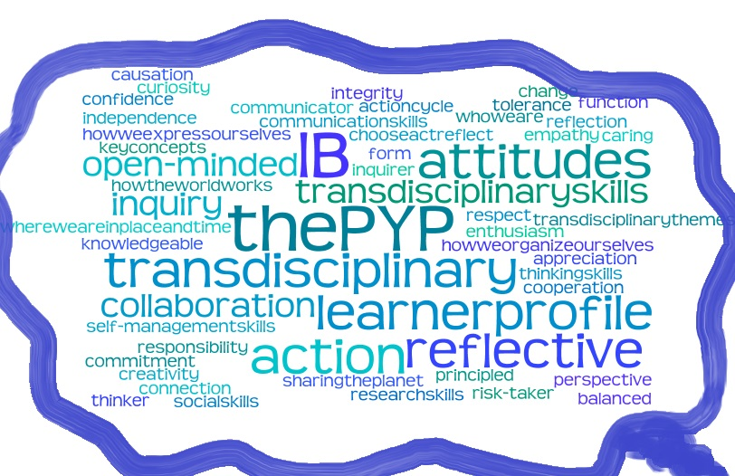
Struggle - How the IB terms can feel to an elementary student… (or teacher)
Wordle.com

Slide 21
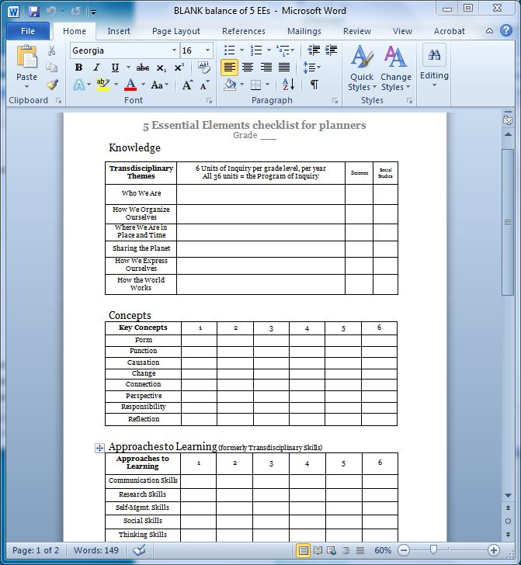
Balance of LP and 5 EEs– solved!

Slide 22
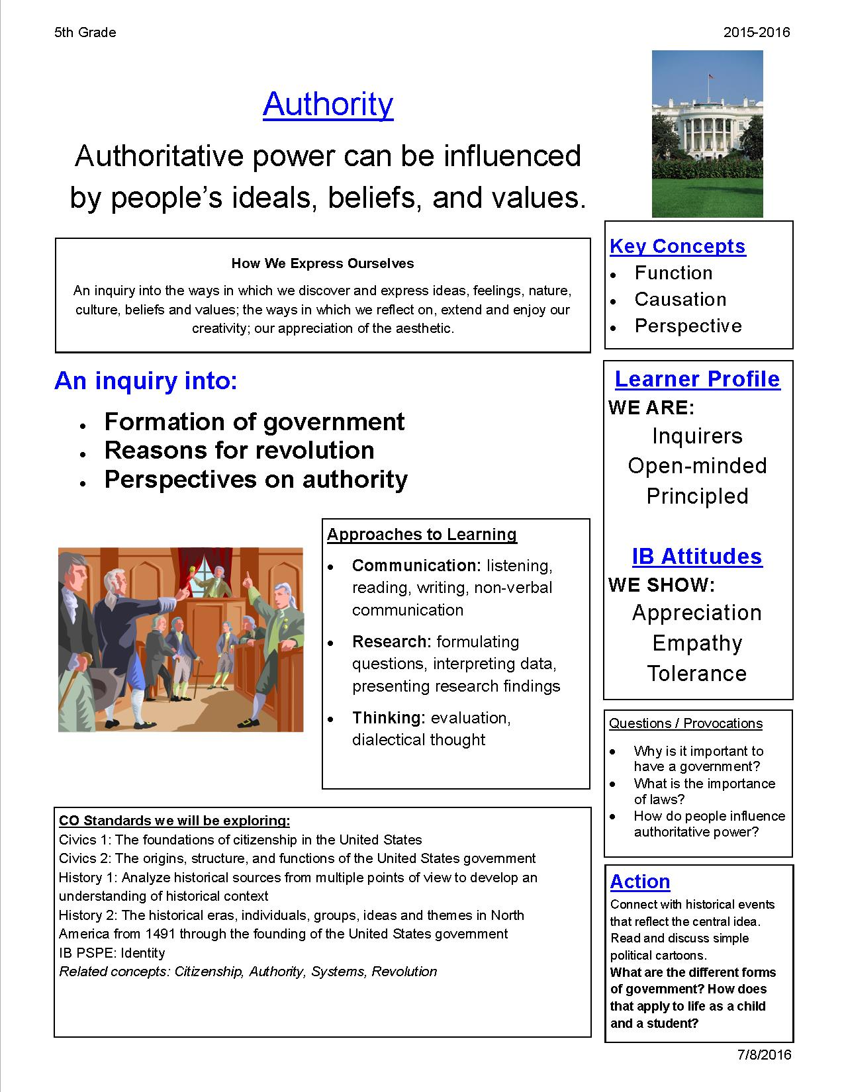
Solution – the PCD
Parent Communication Document
Created as a “one-page newsletter” for each unit of inquiry
Sent home at the beginning of each unit (Essential Agreement at AIES)
Notes:
S&S love – easy (6 at same time!)
Quick view - verify and complete the 5EEs and “detail” parts of planners
Also poster in the classroom, cover for the homework binder.
Unpack the CI, Student Q&As, home connections, research Qs

Slide 23
PYP struggle - Exhibition
Each student will record their Exhibition process as a planner document
Need solid knowledge of the IB terms in preparation for Exhibition
Need TIME to understand and complete the planner document

Slide 24

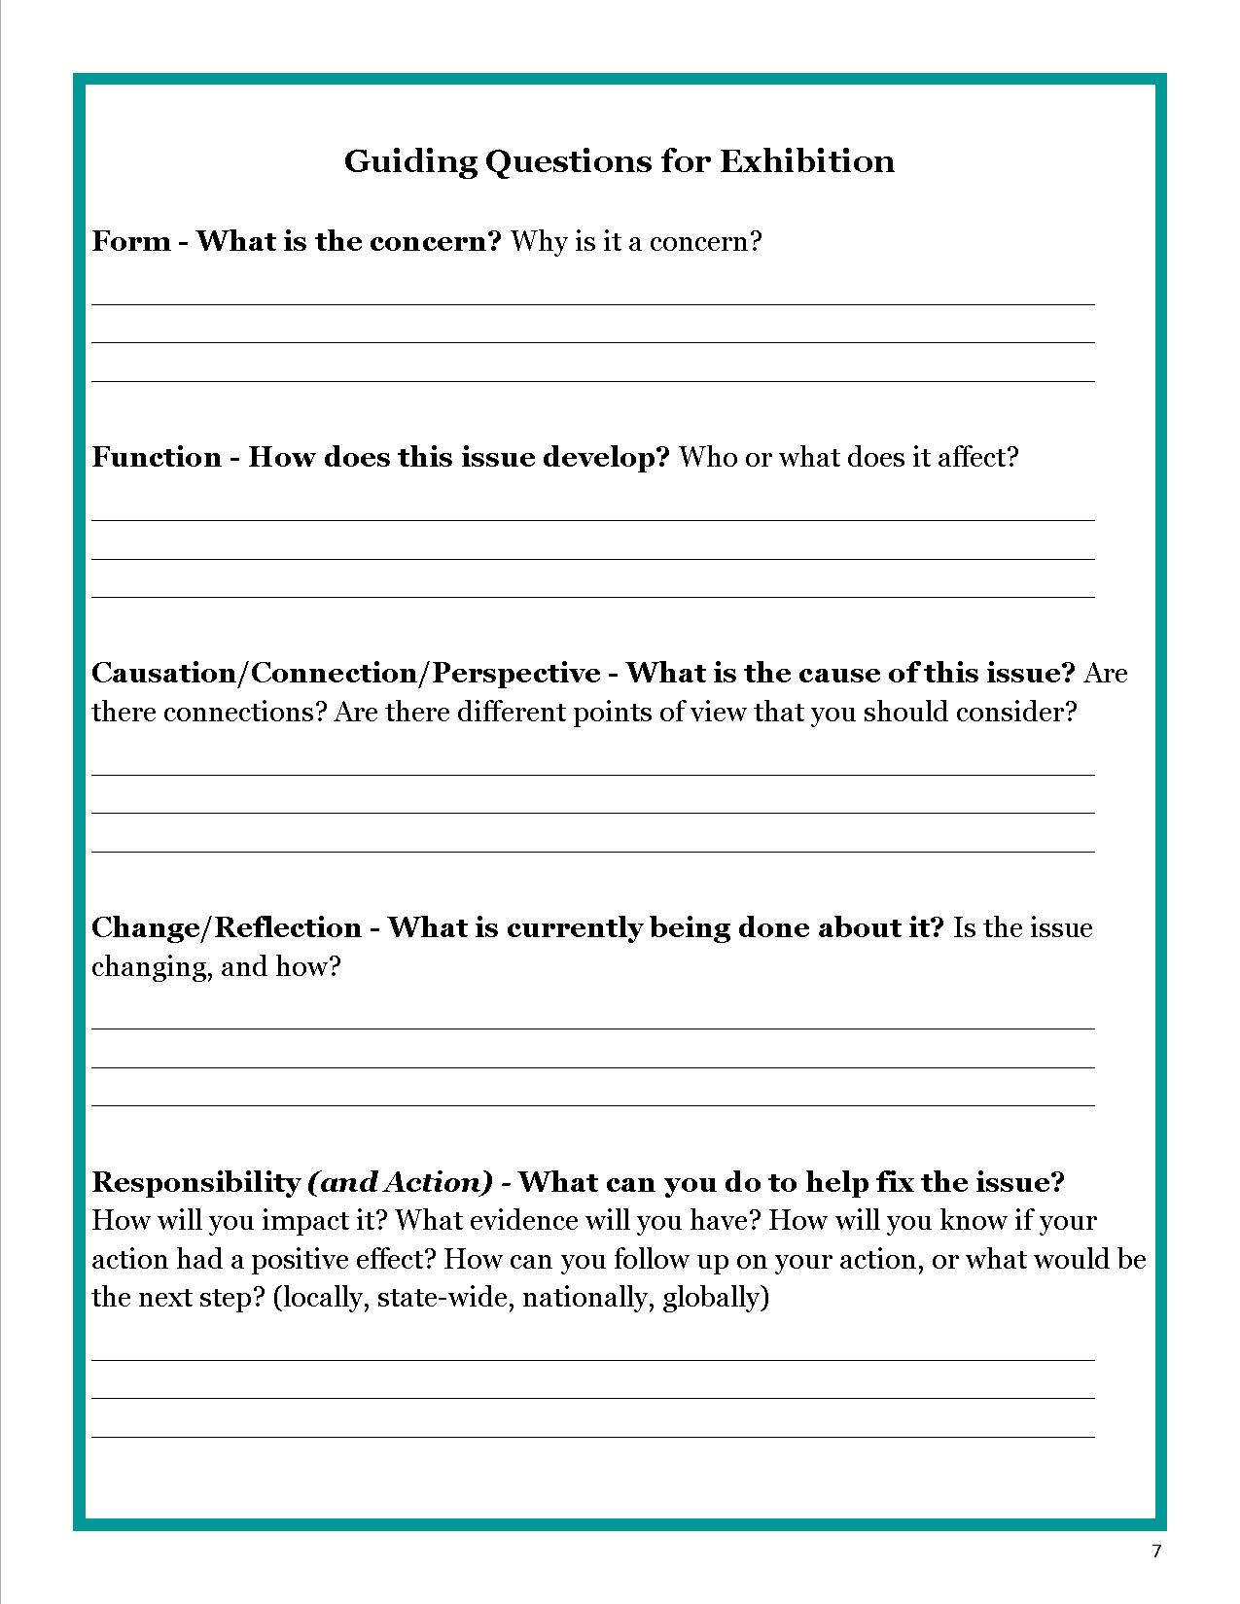
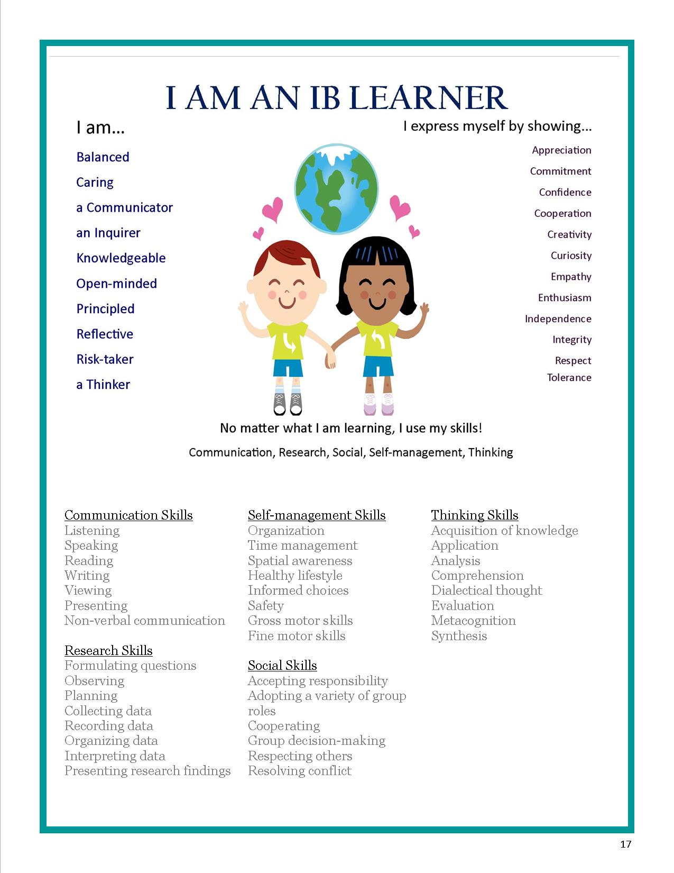
Solution - Exhibition Packet
3 pages from the packet
Graphic from a TPT item
Notes:
I created this to support the process of Exhibition – recognize issue, research, inquire, action
AND for writing up the Exhibition process as a “planner”
Can address certain sections at a time (chunking)
Which allows for collaboration - IBC can cover some parts in “Connections” class, and teacher can continue on from there

Slide 25
PYP struggles – I’m an IBC and a Specialist too
I teach a class called “Connections”
Fun
Create own curriculum
Connect to units of inquiry studied
Help document growth in the IB Portfolios
Bonus – get to connect to Junior UN as well
Hard
Teach and reinforce IB terms and concepts
Help students complete Exhibition
Class management – 6 grades, 24 classes, 600 kids, teach from a cart

Slide 26
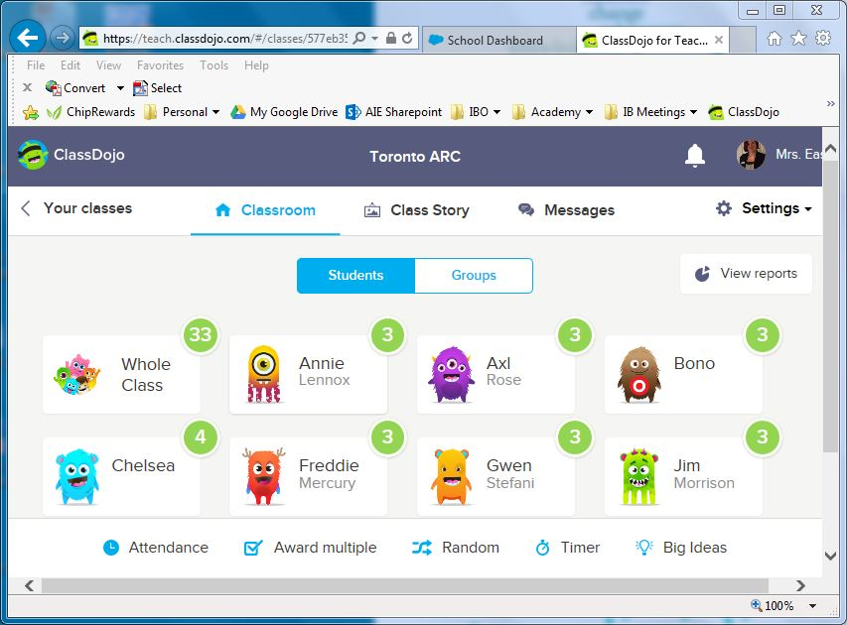
Solution - Class Dojo
Classroom (management)
Class Story (Facebook)
Messages (texting)
www.classdojo.com
Notes:
Free app – on laptop, iPad, iPhone = easy to use in class
Some project on board – remind, can have helpers manage points
Parents DL app and get reminders – easy communication with large groups!

Slide 27
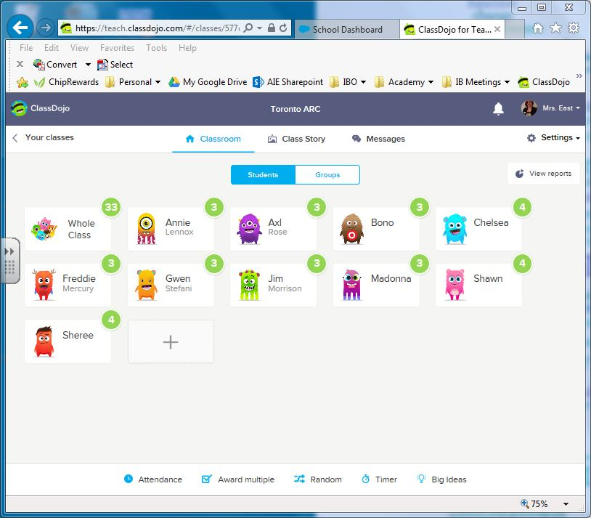
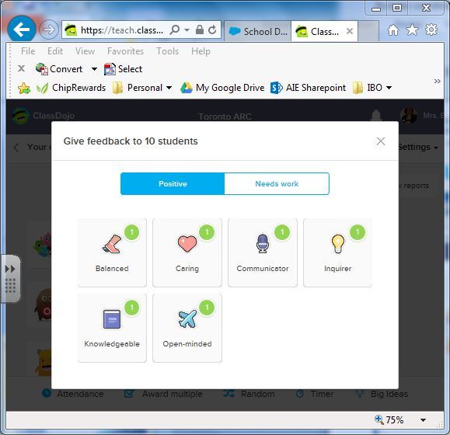
Class Dojo for me…
IB terms for the points awarded
Explicit instruction on IB terms
Motivate students
Student reflection
Notes:
Edit feedback, use IB terms for the “points awarded.”
Explicit instruction on IB terms
Motivate students with points earned and choice of avatar
Student reflection at end of class – “Which Profiles did you show today?”

Slide 28
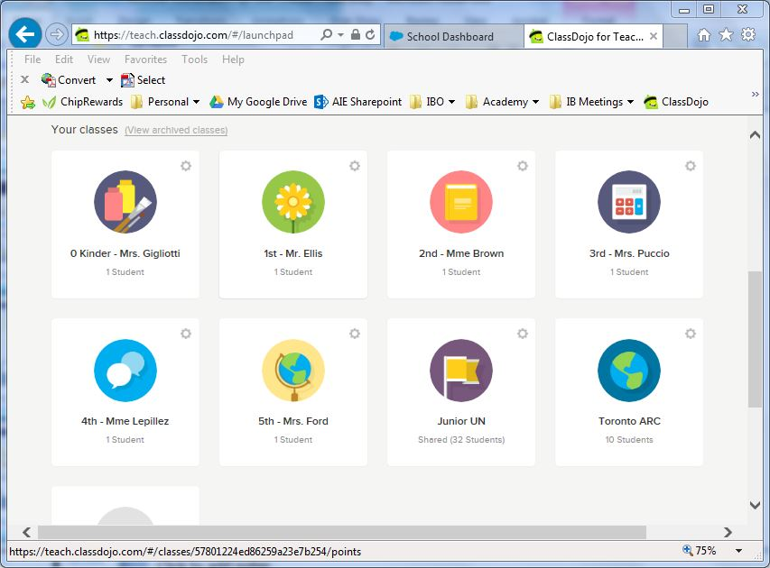
Helpful Tool
Manage whole class & individual student behavior
Can have and share multiple classes
Specialists
Support/Resource

Slide 29
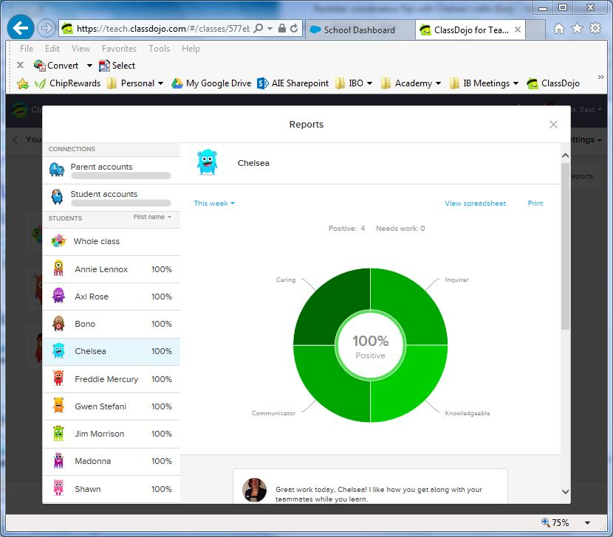
Student Reports
Student reflection
Growth in the Learner Profile
IB Portfolio
Coming soon…
Portfolio option
Et vous? ¿Y ustedes? How could you use a site like this?

Slide 30

MYP struggles
http://assets.bwbx.io/images/users/iqjWHBFdfxIU/iaxctu3TVVLo/v1/-1x-1.jpg

Slide 31
B: Organization
Leadership and Structure
B1.1: The school has developed systems to keep
the governing
body informed about the ongoing implementation and development of the programme(s).
IB Vertical Articulation meetings
Quarterly
Share best practices
Board highlights
Notes:
Hello, it’s me: Adele

Slide 32
B: Organization
Leadership and Structure
B1.5: The school develops and implements policies and procedures that support the programme(s).
Policy starters

Slide 33
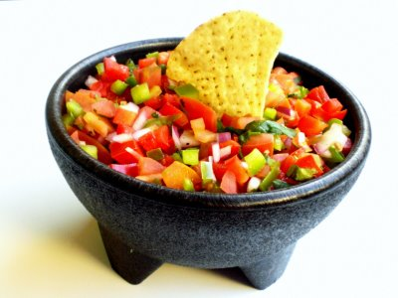
C1: Collaborative Planning
1a: The school has
an approach to curriculum planning that involves all MYP teachers.
SALSA: Support and Leadership for Student Achievement
http://www.eatbydate.com/wp-content/uploads/salsa1.jpg

Slide 34
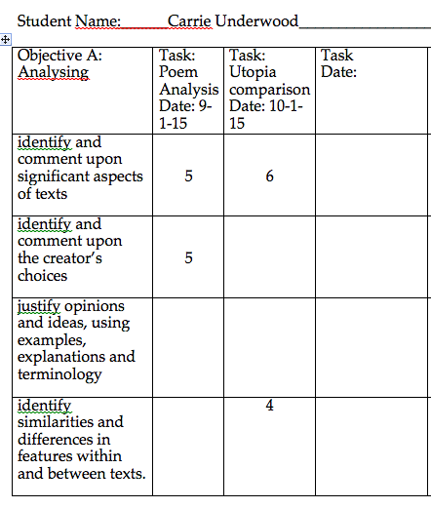
C4: Assessment
Action: multi-function tracker
1A: The school uses
the prescribed assessment criteria for each subject group in each year of the programme.
5: The school has systems for recording student progress aligned with the assessment philosophy of the programme(s).

Slide 35
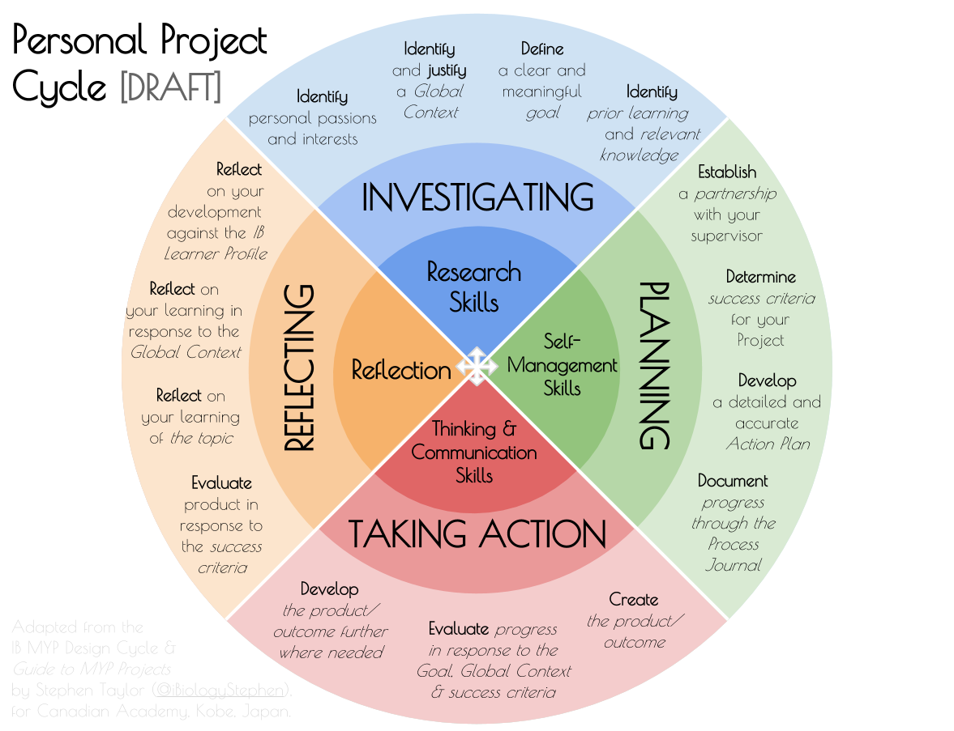
C4 Assessment
Practice:
9: The school has systems in place
to ensure that
all students can demonstrate a consolidation of their learning through the completion of the MYP personal project.
Action
Personal project kick-off
https://ibiologystephen.files.wordpress.com/2015/03/personal-project-cycle-draft.png

Slide 36
DP struggles
http://static1.squarespace.com/static/525dafc8e4b038a108be9a38/t/5622349ae4b02346886557ba/1445082267573/

Slide 37
DP struggles
Students can be taking 7 college level classes without a college schedule
Plus CAS, EE
Plus college applications
How do you support teachers and kids?
How do you spread out that schedule and give everything enough time?
How do you handle all the details?
How do you remain faithful to all S & P?
How do you fix everything?

Slide 38

Self-study, Evaluation, Action Plan, and the S & P
Practice
Learner Profile “authentically”
Community shows a commitment to the DP
Action
Student driven posters
IB Ambassadors
  Personal Project
  Articulation w/MYP
  Peer to Peer Tutoring
  Parent communication

Slide 39

Self-study, Evaluation, Action Plan, and the S & P
Practice
Collaboration in written, taught, learned and assessed curriculum
Required hours for SL courses
Action
Intentional scheduling of Internal Assessments
ATL and “intentional overlap map”
Offer SL over 3 semesters

Slide 40
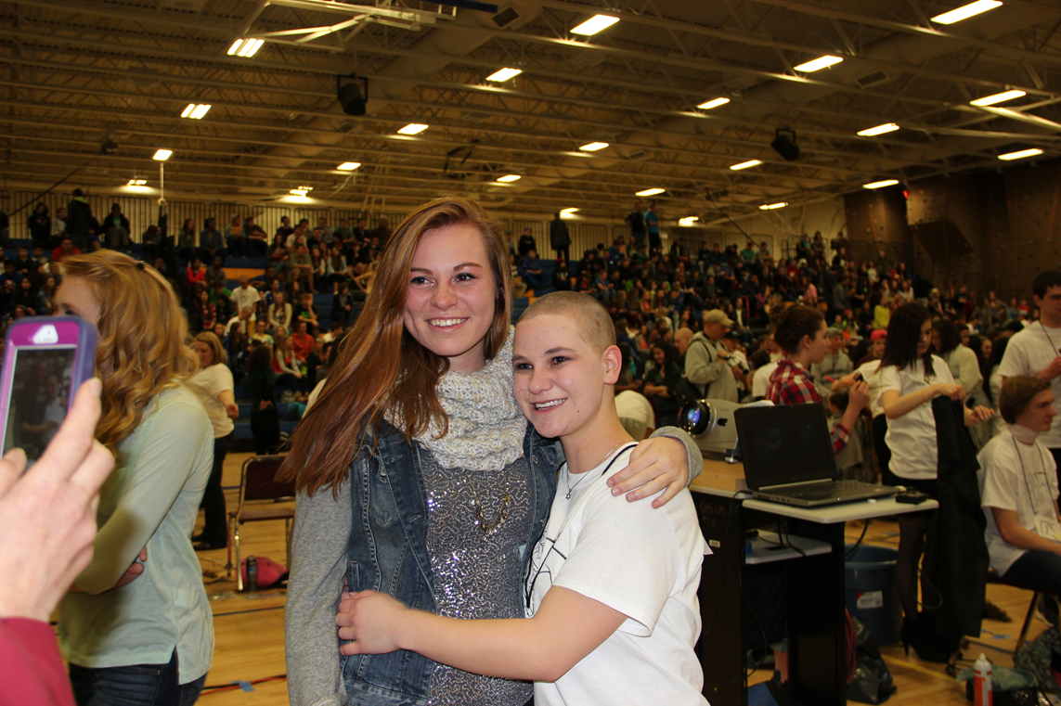
Self-study, Evaluation, Action Plan, and the S & P
Practice
Responsible action
International-mindedness
Action
Bald for Bucks Fundraiser
CAStle
Clear CAS policy
International Service Trip
Multi-cultural show
No Place for Hate
Voices from Around the World – Student Lecture Series

Slide 41

Self-study, Evaluation, Action Plan, and the S & P
Practice
Balanced curriculum
Community expertise
Action
Class offerings
Skype with Doctors Without Borders
Expeditionary Learning
  University – Group 4
  Art Museums
  Field Trips
  Putting Robert E. Lee on trial

Slide 42
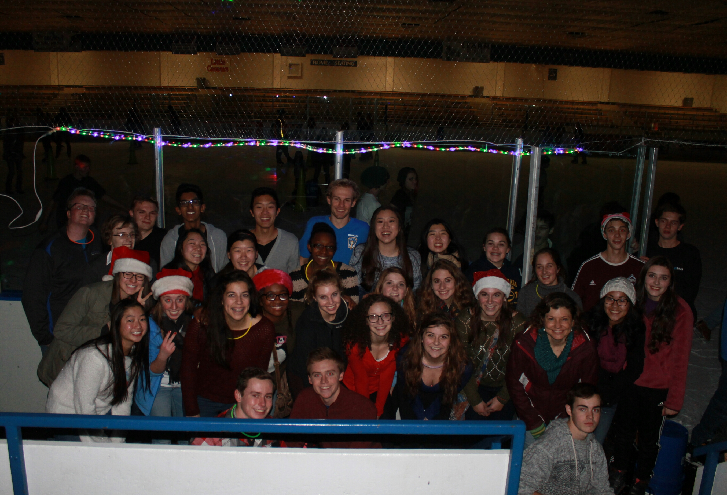
Self-study, Evaluation, Action Plan, and the S & P
Practice
Global issues and diverse perspectives
Open communication
Action
Culturally Responsive Team
Visit other schools
Bridging the Equity Gap - Grants
Meeting structure – we are a Program!
Common language

Slide 43

Self-study, Evaluation, Action Plan, and the S & P
4 Matters
Commendations for communication, commitment, and strategies to enhance the program
Recommendations based around what we knew we needed to address

Slide 44

Become a member of the IB world community
Find two other people and form a trio
Use this framework:
  One rose (positives): Think of an IB practice that you’re happy with at your school (commendation)
  One bud (potential): Think of an IB practice that needs development at your school (recommendation)
  One thorn (negatives): elements that are preventing change from occurring at your school
http://3.bp.blogspot.com/
Notes:
Chelsea: Guns and roses

Slide 45
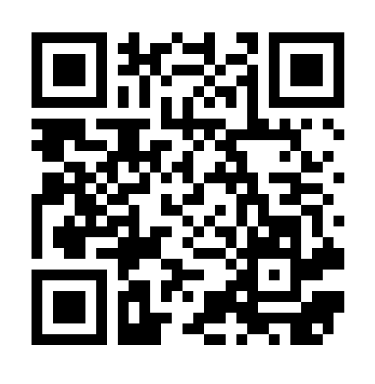
Choose, act, reflect
What did you learn from your colleagues today?
Use our Padlet to save and share your ideas.
Password: IB
https://padlet.com/justsbird/yz2hjrglaqq1
Notes:
Shawn: Use the shared device of our choice. Write and print QR codes

Slide 46

What rock do you want to roll?
With four standards and 73 practices, there is a lot to do.
Choose three things (rocks) you want to focus on for next school year.
Notes:
Shawn: suggest they actually find three rocks and write on them with sharpie

Slide 47
Release your album!
Using your starter “I am IB because” and your three rocks you’re going to roll.
Create an album cover:
  What’s the title?
  What graphics will you use?
Notes:
Sheree

