Slide 2

Kick Starting the PYP with
School-wide Initiatives
Presented by:
Jenny Mygrant and Julie Walker
Sycamore International School
Kokomo School Corporation
Kokomo, Indiana USA

Slide 3
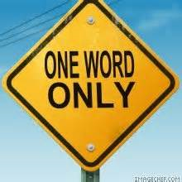
If you asked your teachers-
In one word, describe
how the changes to curriculum,
assessments, and evaluations
make you feel:
What words would
you hear?

Slide 4
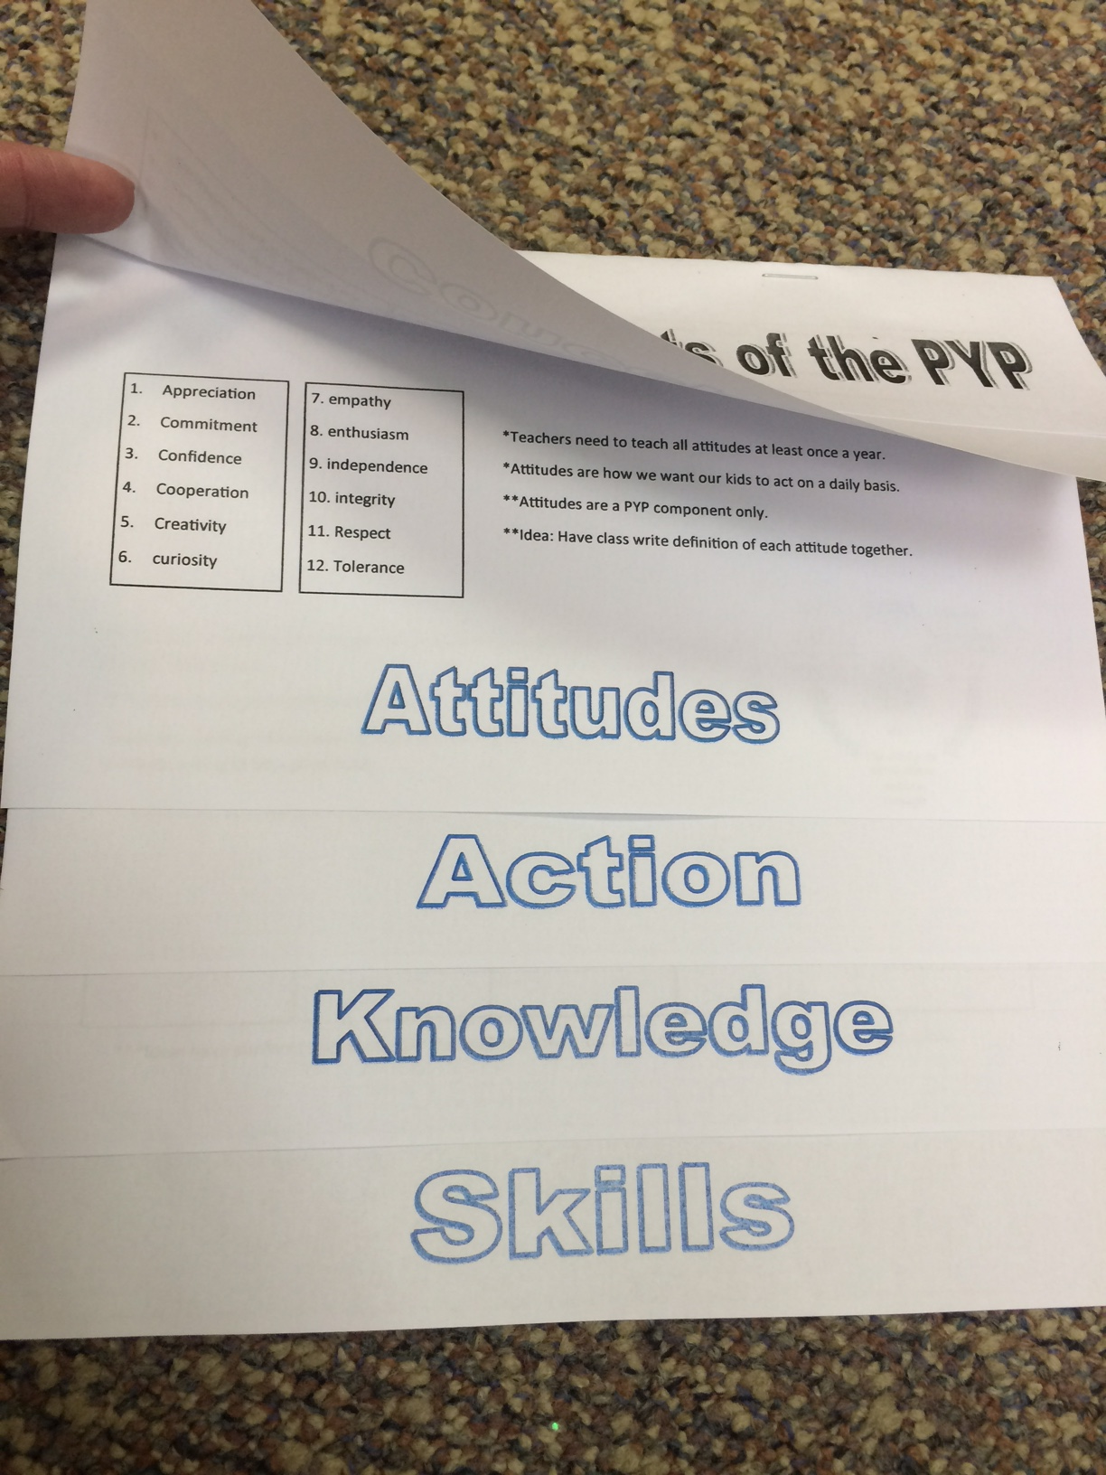
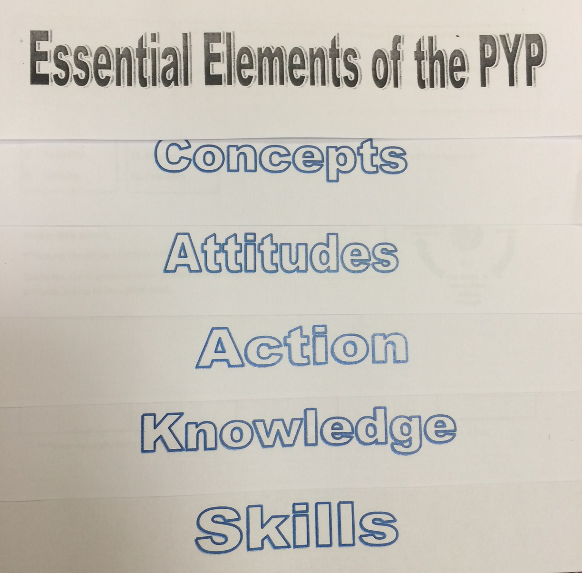
Teacher Connections

Slide 5
Non-Negotiable items for IB classrooms
Teacher Connections
Learner profile, attitudes, trans-disciplinary themes, and concepts taught and posted in room.
Each room should have a type of wonder wall or parking lot up and utilized.
Student created work and displays in and out of room.
Inquiry based lessons.
Students taught to reflect on lessons and each unit.
Students add to portfolio each year.
Each classroom should create essential agreements.
Signs of internationalism in room.
The current theme, unit title, and central idea are posted at entrance of classroom.
Students log action projects throughout the year.

Slide 6
Showcase Awesome Ideas!
Teacher Connections
Teacher Awards
Showcase walkthrough pictures during staff meetings

Slide 7

Spotlight on Awesomeness
Teacher Connections
Using pictures from walk-throughs to celebrate what teachers are doing to develop IB learners!

Slide 8
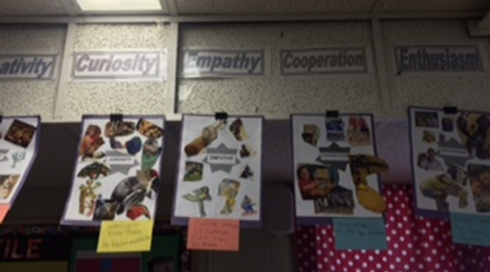
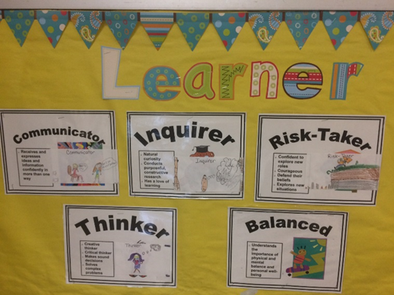
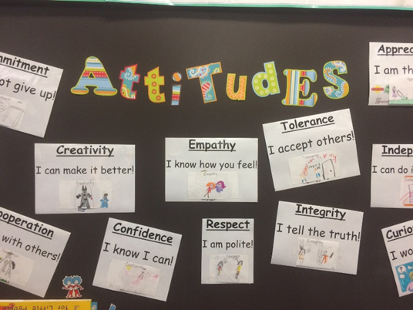
Displaying the IB attributes

Slide 9
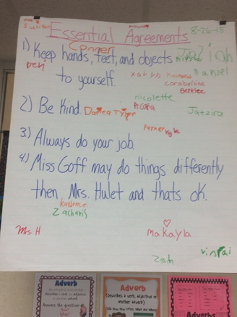
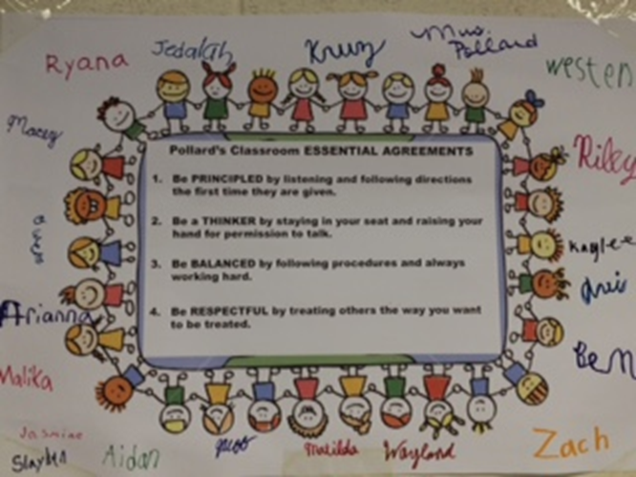
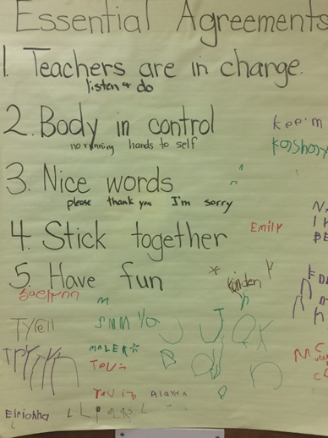
Classroom Essential Agreements

Slide 10
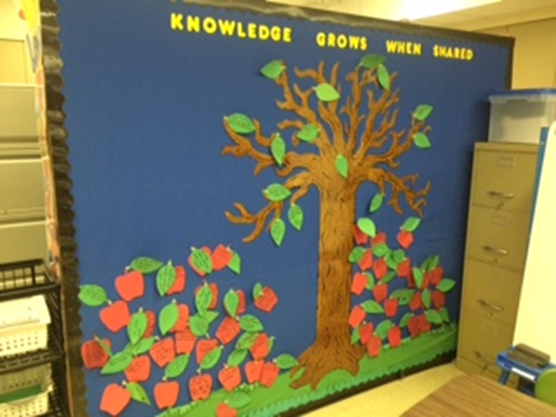
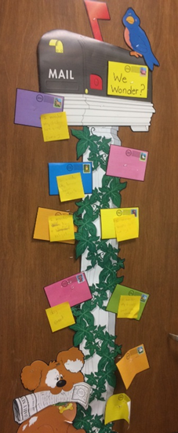
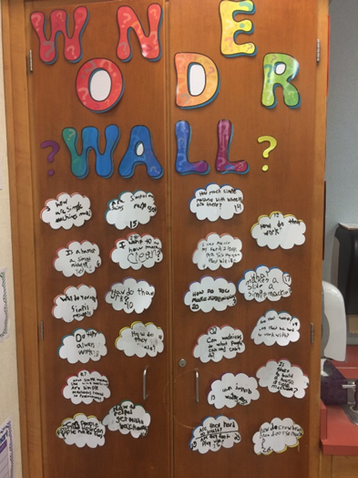
Class Wonder Walls

Slide 11
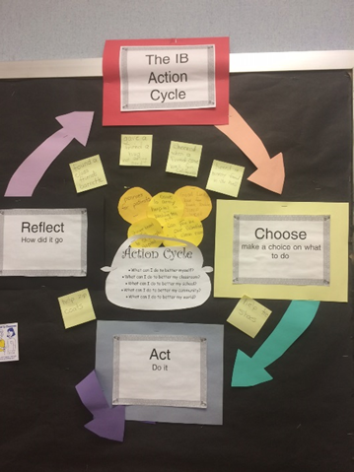
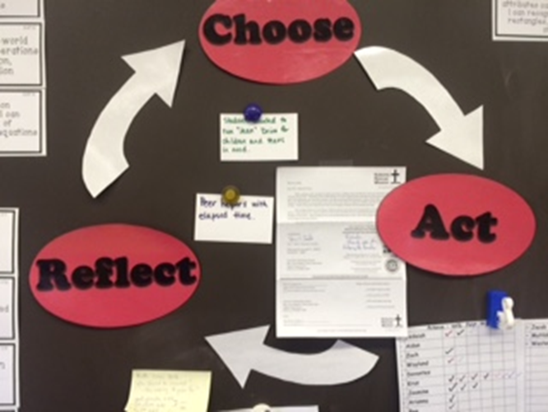
Action Cycles

Slide 12
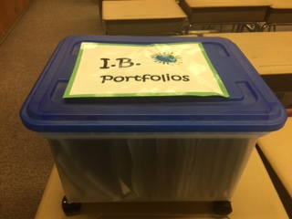
Student Portfolios
Student Connections
Start small and build upon the portfolio each year.
Year 1: End of year Learner Profile Reflection
Year 2: Action Journal
Year 3: 6 unit reflections
Future???
  Electronic portfolio’s
  Unit assessments
  Student Choice artifacts

Slide 13
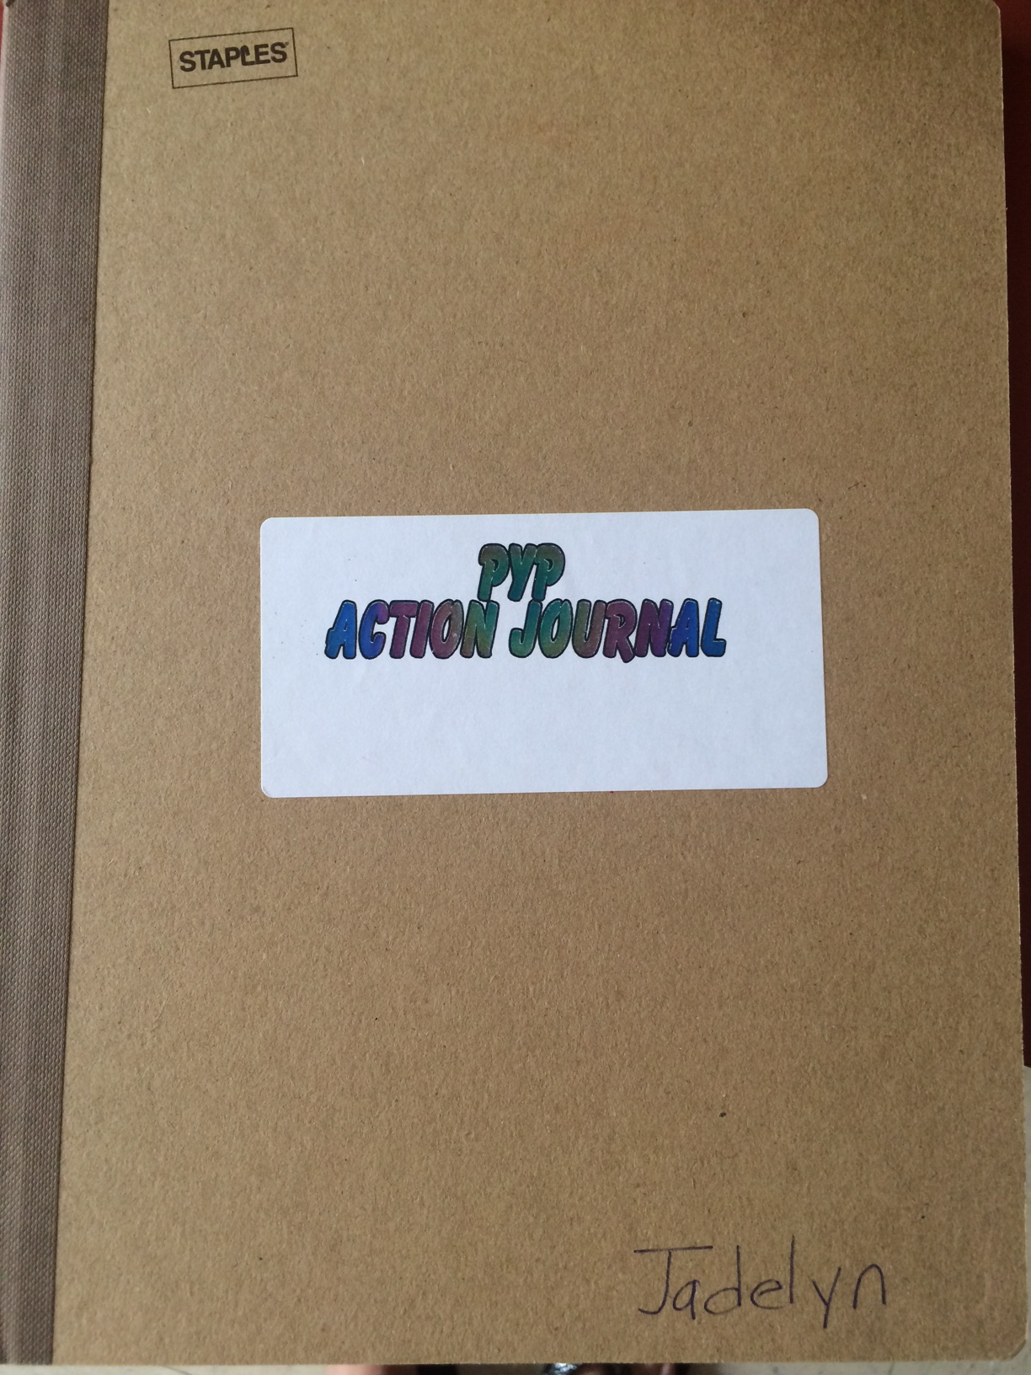
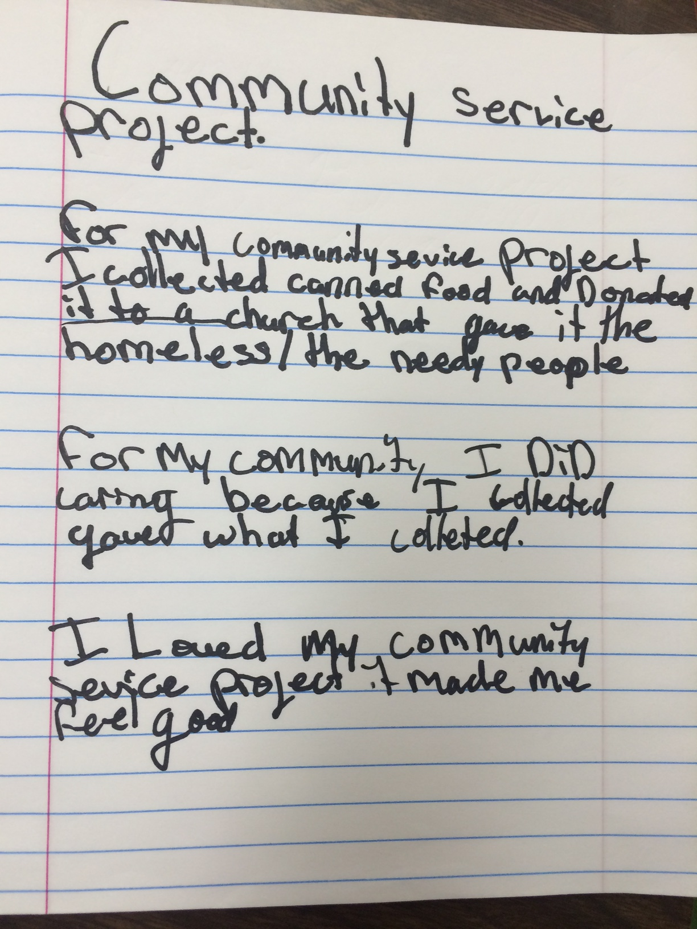
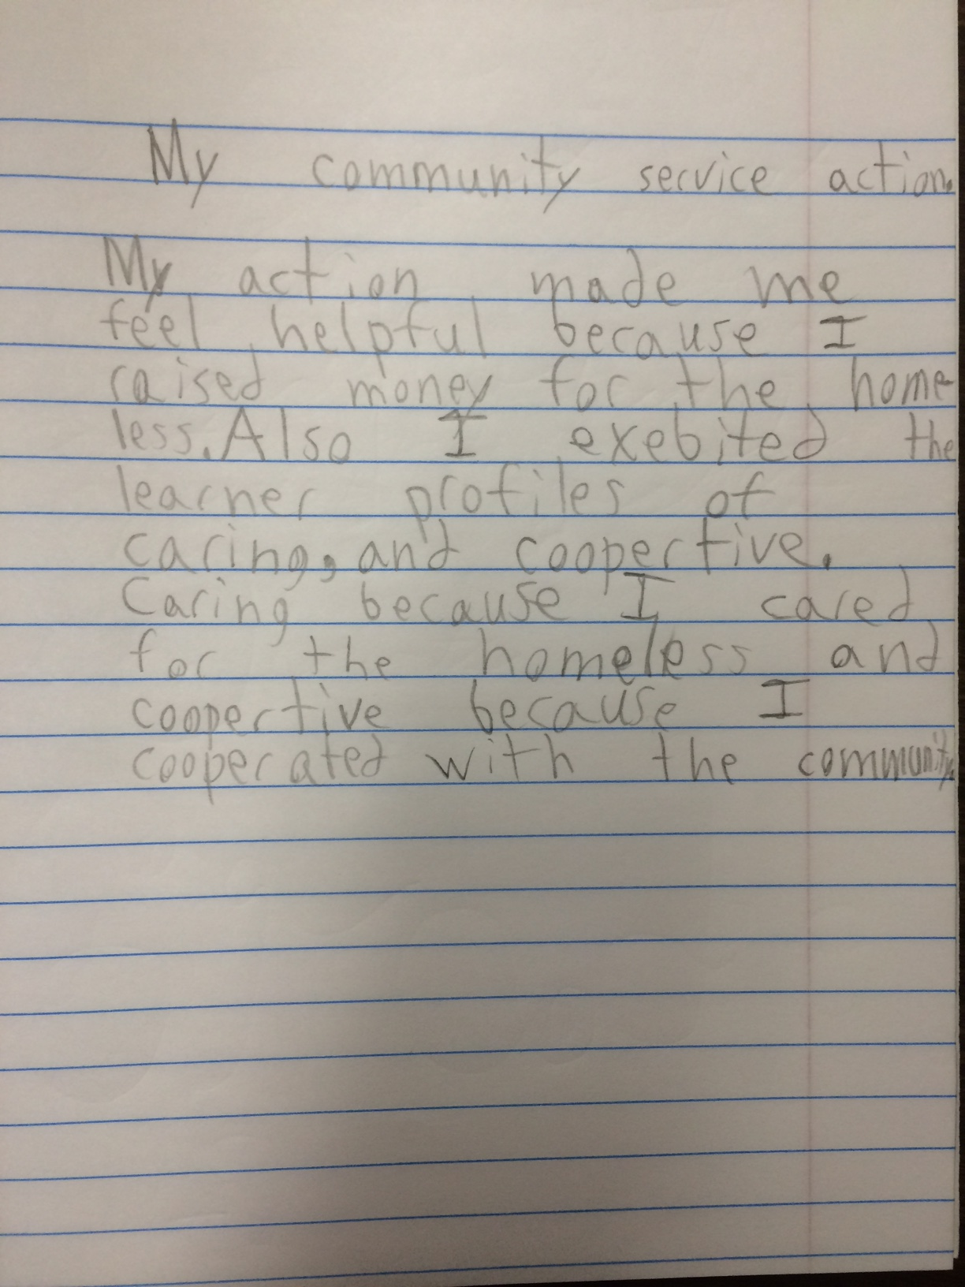
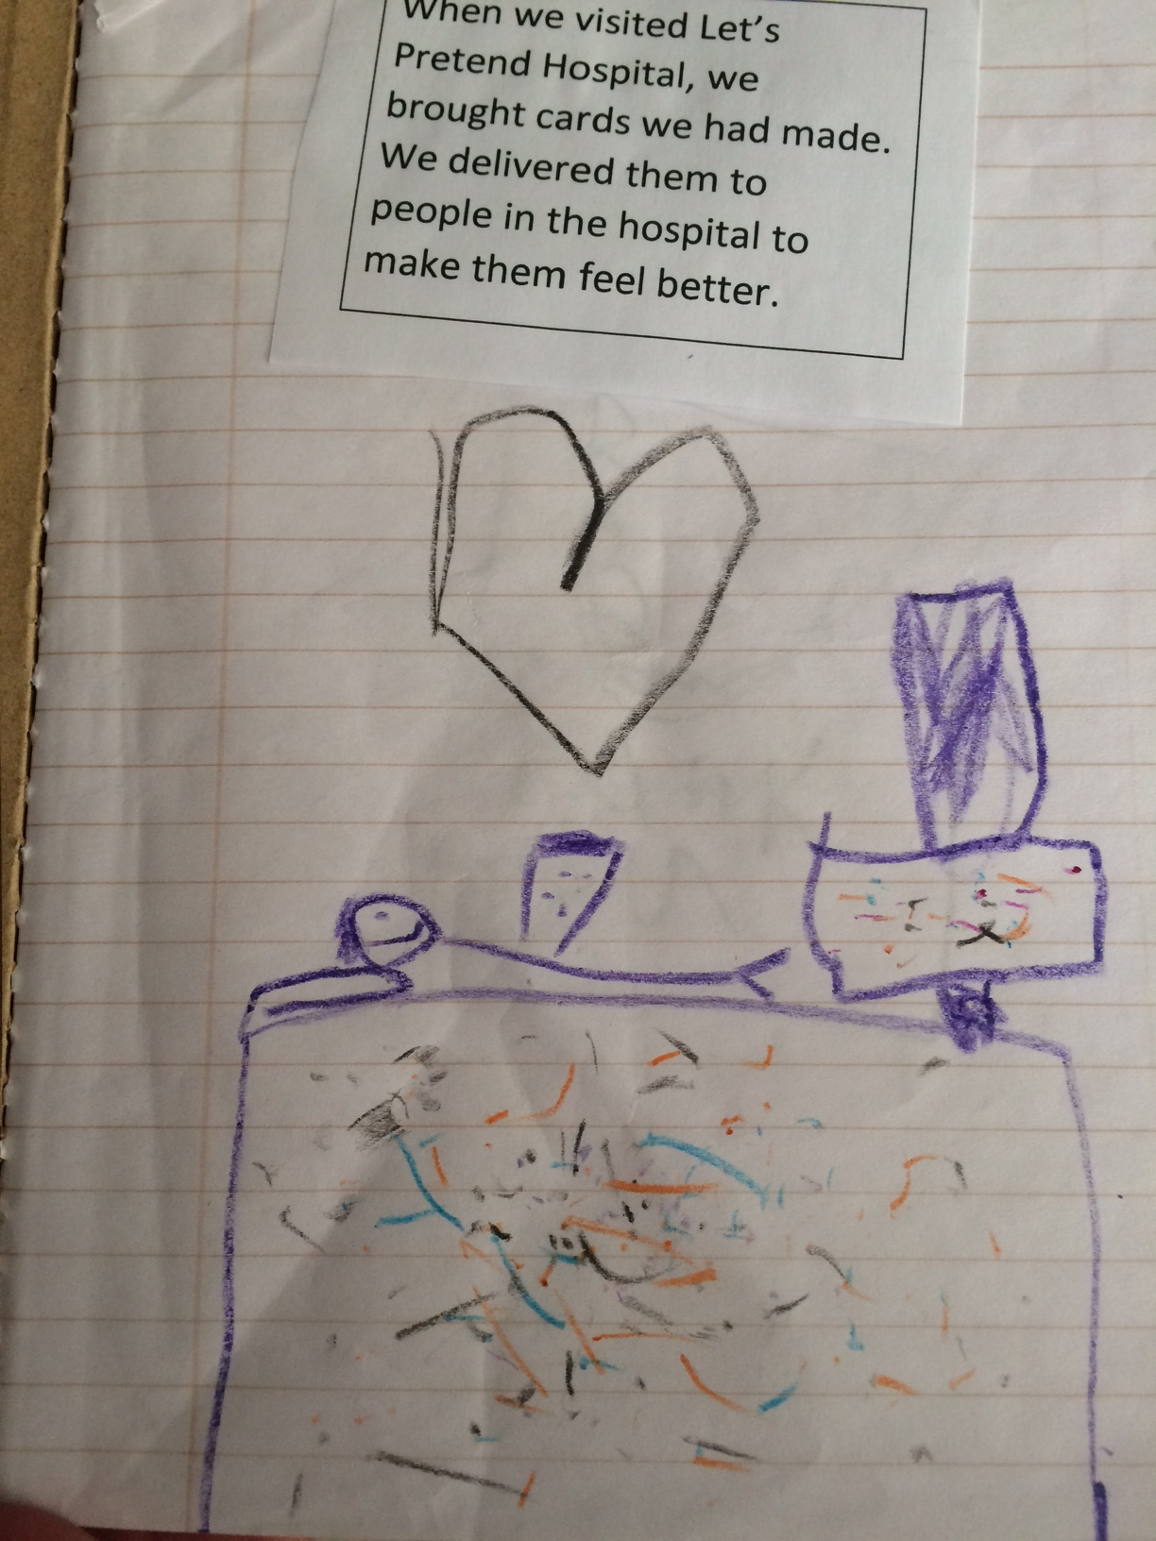
Student Connections
Action Journals
Intermediate
Primary

Slide 14
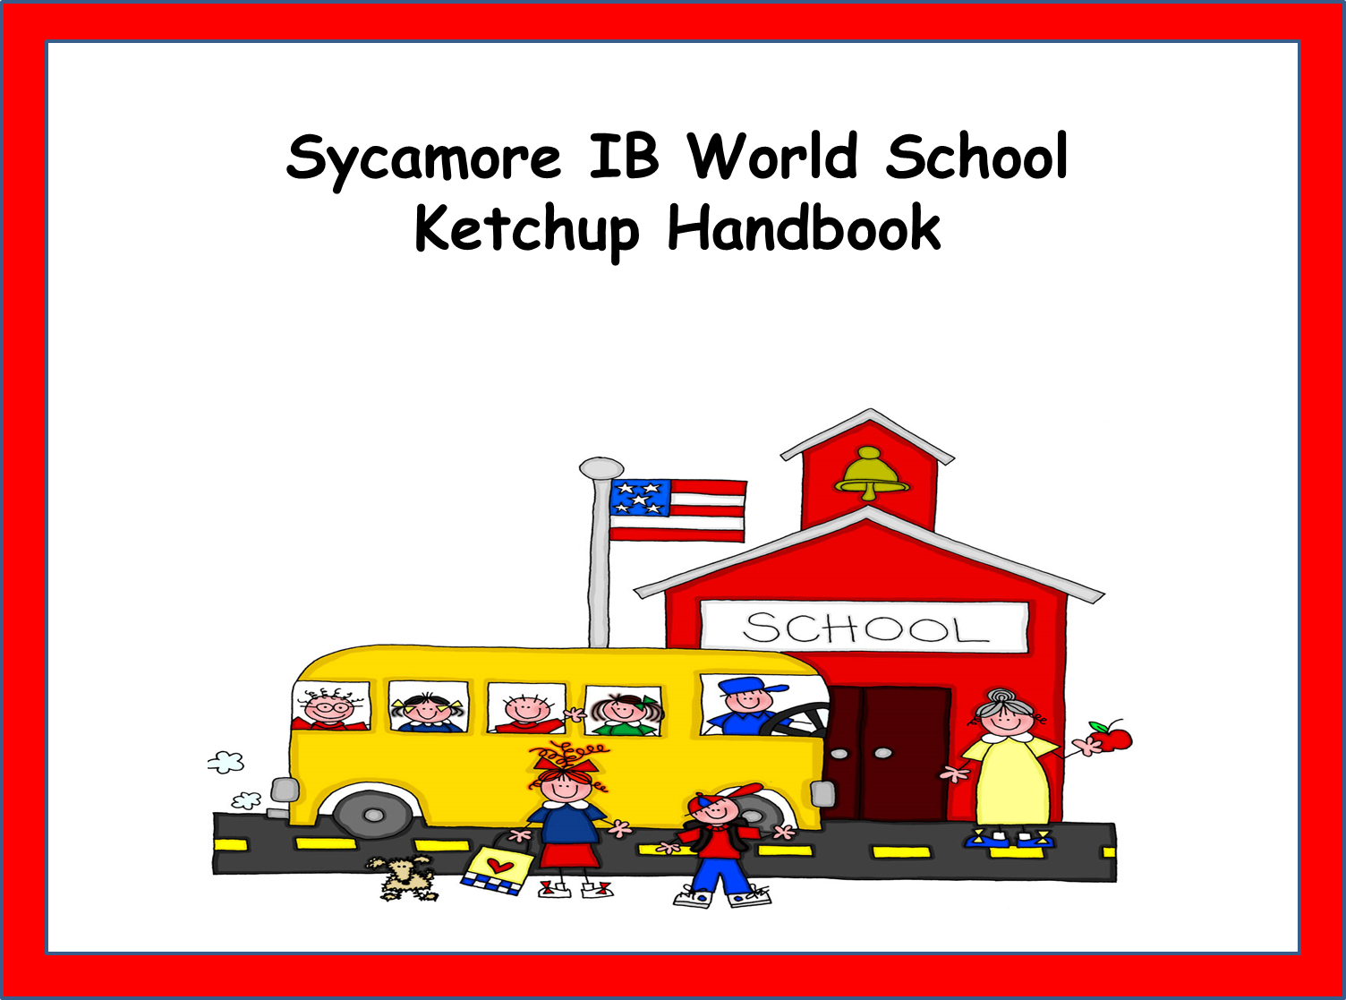
Student Connections
Part of Student Agenda Book
Beginning of the Year Convocation
  Assembilies to explain what being a student in an IB school means.
  Introduce IB vocabulary
Ketchup Groups throughout the Year
  Introducation for new enrollees throughout the year.

Slide 15
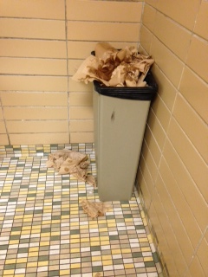
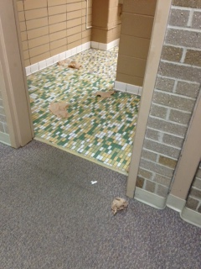
Leaving paper towels on the floor is dangerous and causes our custodians to work harder.
We have had students slip on paper towels left on the floor.
We don’t want
our guests to think that we are messy and don’t care about our school.

Slide 16
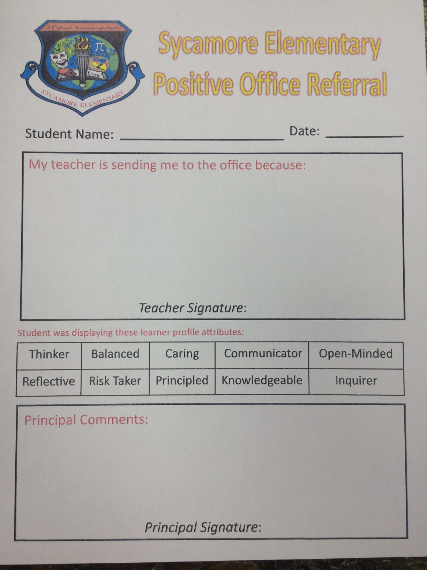
Student and Parent
Connections
  Positive
  Office
  Referrals

Slide 17
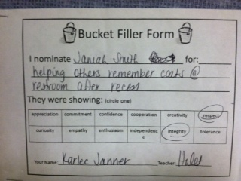

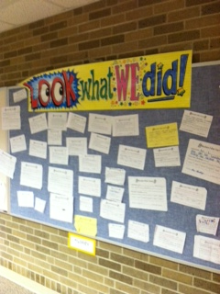
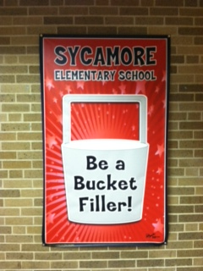
Student and Parent Connections
Bucket Filler Program
Students nominate each other for displaying the learner profile and IB attitudes.

Slide 18
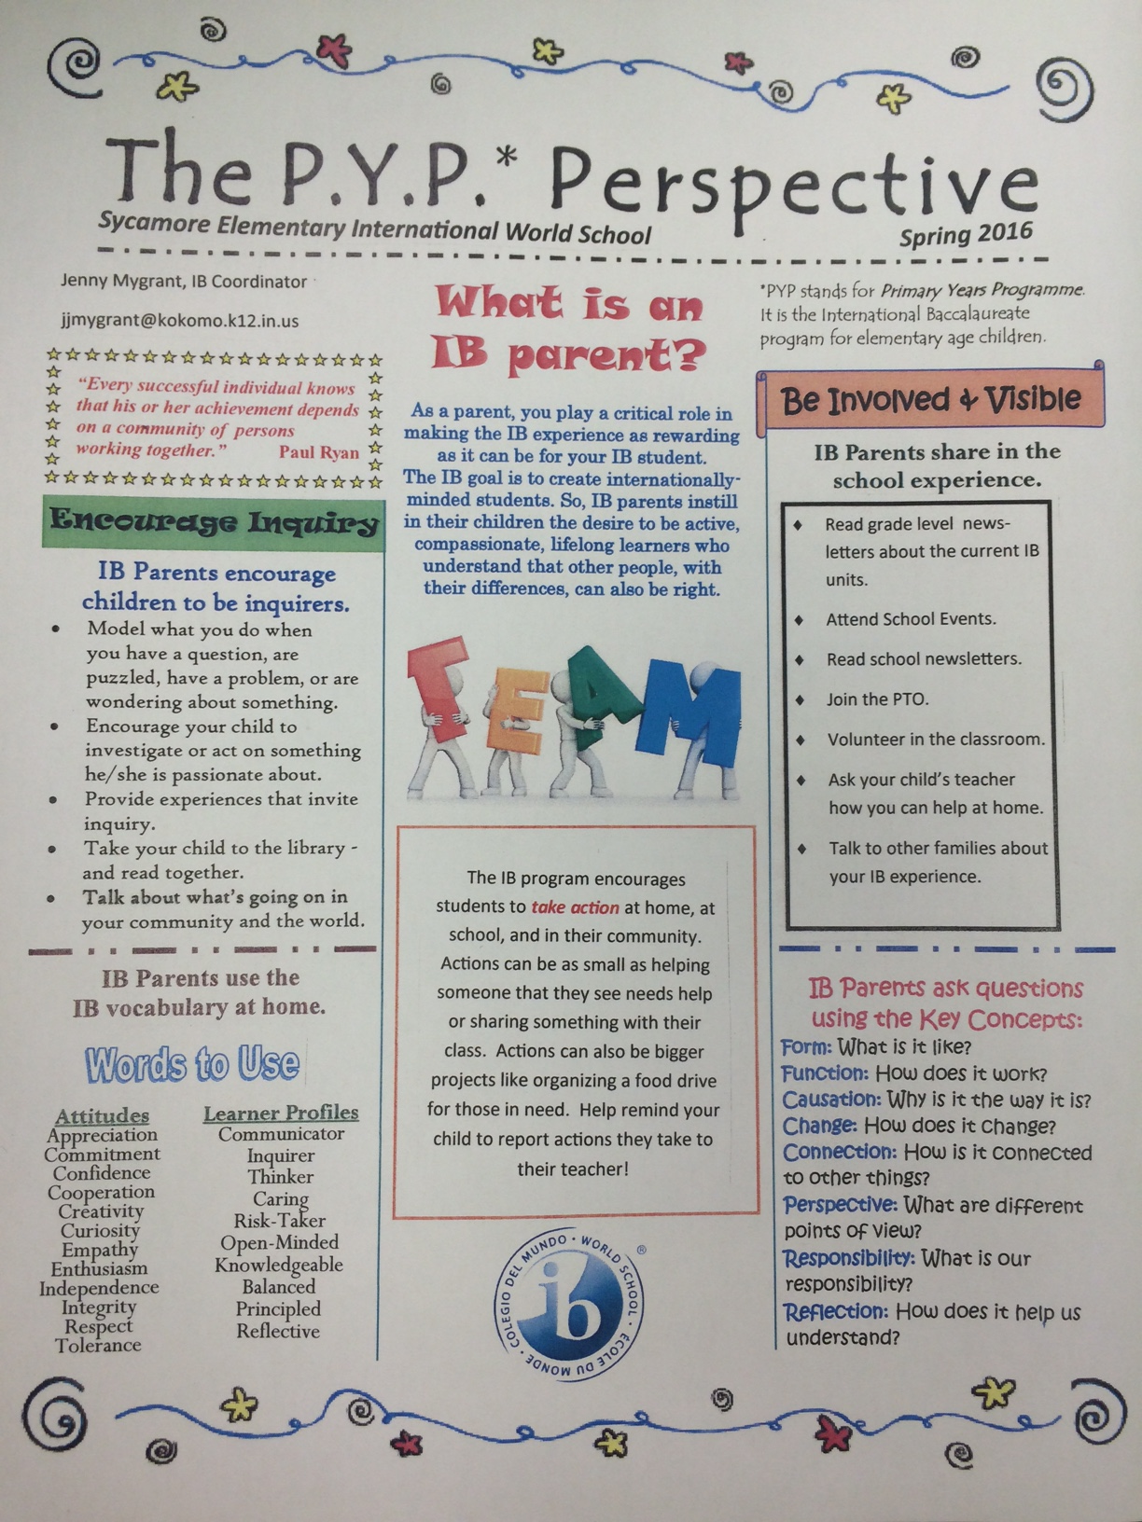
Parent Connections
Newsletters
PYP Perspective
IB Snippets in School Newsletter
Use vocabulary when writing notes home.
Unit Newsletters

Slide 19
Support Staff Connections
(Paraprofessionals, Cafeteria Staff, Office Staff, Custodial Staff, Bus Drivers)
Every year hold a mini IB workshop for new support staff to explain:
  Vocabulary
  Reward System
  Units of Inquiry
  School Wide Initiatives

Slide 20
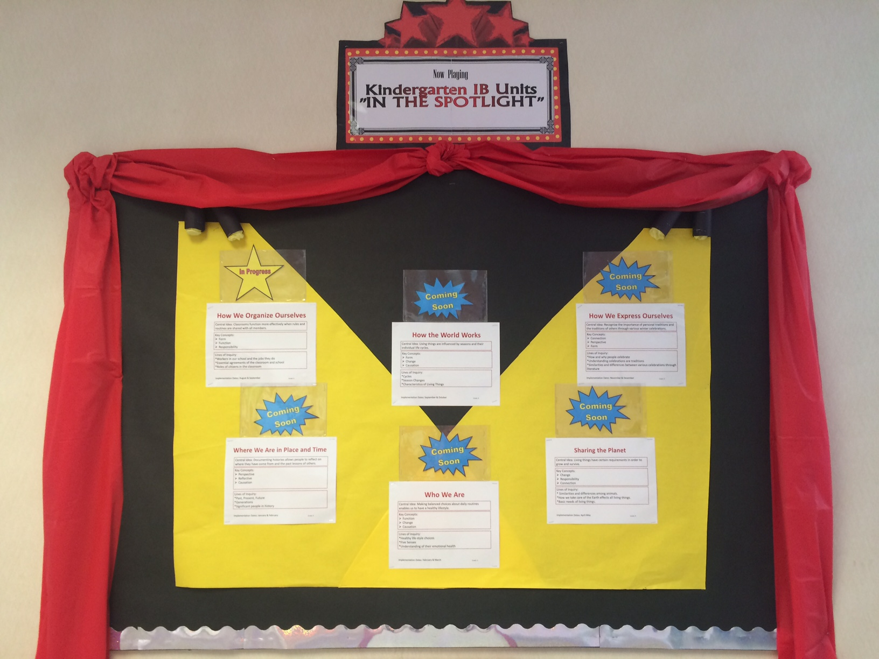
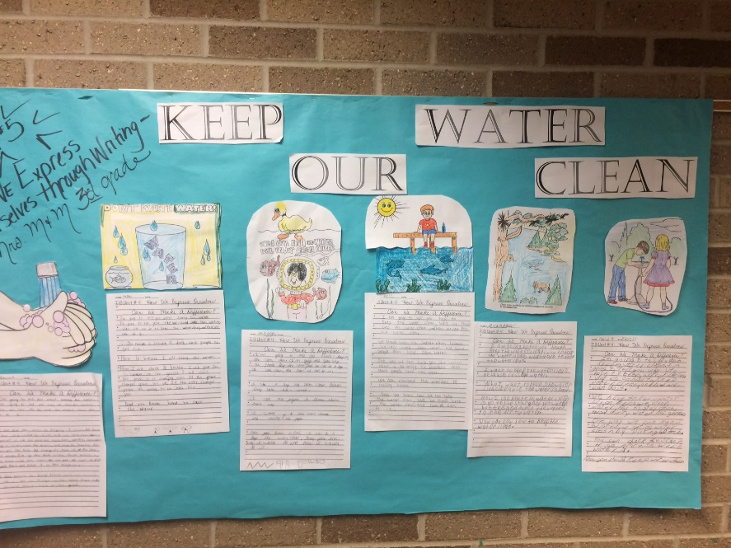
Showing our Progress
Unit Overviews
Grade Level POI Boards with Artifacts

Slide 21
Helping our Teams GROW
Semester
End of Year

