Slide 2
Every Student Succeeds Act:
Opportunities for Advanced Coursework
Phillip Lovell
Vice President, Policy and Advocacy
Alliance for Excellent Education - July 15, 2016

Slide 3
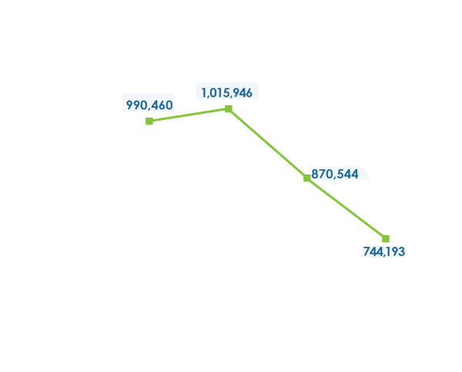
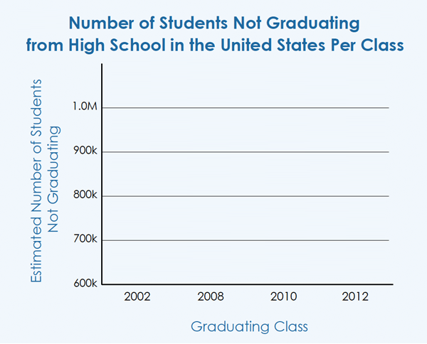
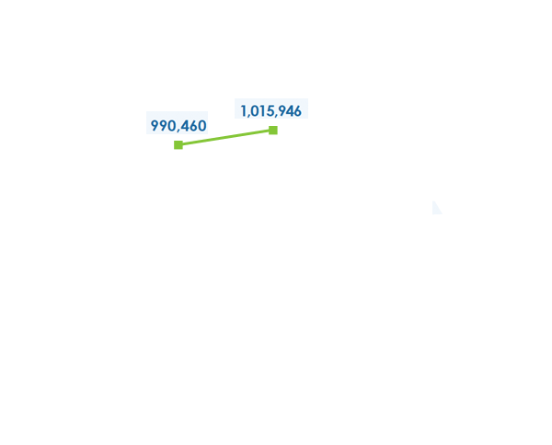

Slide 4
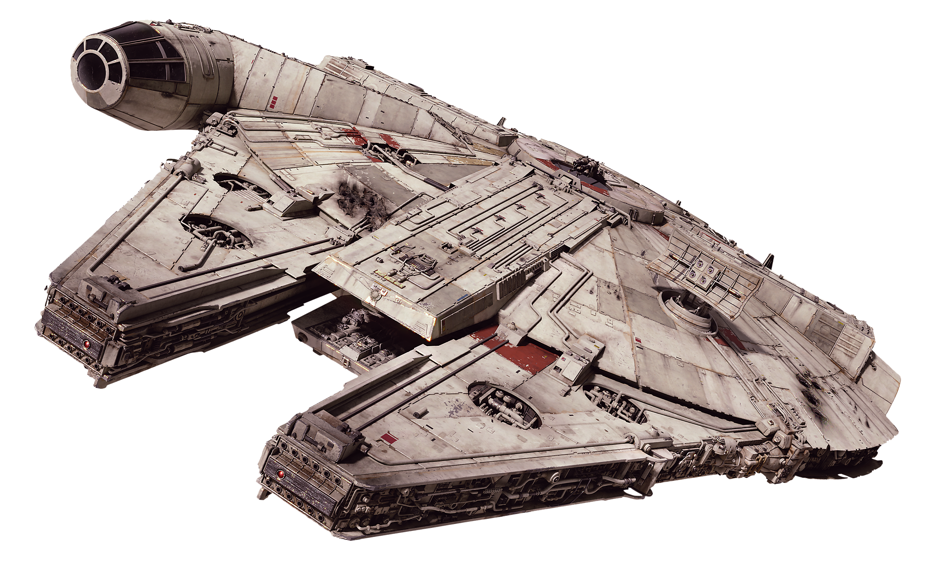



NCLB
ESSA

Slide 5
NCLB vs. ESSA: Big Picture
Policy | No Child Left Behind | Every Student Succeeds Act
Assessments | Annual tests (bubble tests) | Annual tests (may include performance tasks, portfolios, projects) Locally selected, nationally recognized (high school)
Accountability | Adequate Yearly Progress (AYP): Test scores, graduation rates | - Test scores - Additional academic indicator (elementary/middle schools) - Graduation rates (high schools) - English language proficiency - Indicator of school quality or student success

Slide 6
NCLB vs. ESSA: Big Picture
Policy | No Child Left Behind | Every Student Succeeds Act
Support for underserved students | Identification based on AYP | Consistently underperforming subgroups (defined by states)
Support for the lowest performing schools | No such requirement | Bottom 5% High schools with graduation rates below 67%
School Improvement | Federal requirements | Local flexibility

Slide 7
NCLB vs. ESSA: Big Picture
Policy | No Child Left Behind | Every Student Succeeds Act
Funding for AP/IB | Advanced Placement Test Fee Program | Title I, schoolwide Direct Student Services - Student Support and Academic Enrichment Grants

Slide 8

ESSA Funding Opportunities for IB: Title I
Schools operating a Title I, Schoolwide program may use Title I funds to raise awareness of and prepare students for advanced course work, including AP/IB
[Sec.1114(b)(7)(A)(iii)(II)]

Slide 9


ESSA Funding Opportunities for IB:
Direct Student Services
States may use up to 3 percent of their Title I allocation for “Direct Student Services,” including:
Academic course work that is not otherwise available at student’s school, including
  Advanced courses and
  CTE course work that leads to industry-recognized credentials
AP, IB, and other opportunities for students to complete postsecondary-level instruction and exams that lead to postsecondary credit (including test fees)
[Sec 1003A(c)(3)(A)]
[Sec 1003A(c)(3)(C)]

Slide 10



ESSA Funding Opportunities for IB:
Student Support and Academic Enrichment Grants
Funds may be used to
increase student access, engagement, achievement in Advanced Placement and International Baccalaureate programs, and
reimburse low-income students for exam fees
[Sec. 4104(b)(3)(A); Sec. 4107(a)(3)(D)]

Slide 11
ESSA Status
August
September
?
1
9
Accountability regulations
(deadline for comments)
Assessment regulations
(deadline for comments)
Appropriations pending

Slide 12

Advocacy Opportunity
Federal: Student Support and
Academic Enrichment Grants
Senate $300 million
VS.
House: $1 billion
State: Direct Student Services

Slide 13
NCLB

Slide 14

Thank You!
Phillip Lovell
plovell@all4ed.org
@pdclovell
All4ed.org/publications/federal-flash
Alliance@all4ed.org
@all4ed

