Slide 2
Extraordinary Inquiry: Creating a Successful Environment for Empowering Individualized, Student-Driven Inquiry and Community-Based Action
Trevor Lindsay
Riverstone International School

Slide 3
Riverstone International School
Boise, Idaho
Inspiring the journey through five pillars: Academic Excellence, Outdoor Education, International Understanding, Leadership by Example and Community and Service.

Slide 4
Objectives for Today’s Session:
Model effective strategies for constructing purposeful year-long planning, including key benchmark experiences, to help students develop research, interpersonal, and organizational skills.
Define “Community-based action” and share strategies for networking with school, local, national, and global communities to enable and inform students through significant community-based action related to real-world issues.
Model strategies for organizing an investigation incorporating multiple, simultaneous student-designed units of inquiry, culminating in a showcase event that displays student growth in knowledge, transdisciplinary skills, and enhanced worldview.
Create a specific action plan to adopt an individualized, student-driven inquiry with emphasis on community-based action in your school.
Attempt to avoid overly wordy slides.

Slide 5
Get to know your neighbor!
Connect with the person sitting next to you. Be sure to meet someone new!
Brainstorm and describe to your partner one inquiry unit or project that you are ready to take to the next level.
Write down your inquiry at the top of the planning page (page 2) in your packet and keep it in mind throughout the session!

Slide 6
Sharing The Planet
Expeditionary Learning- expose students to the concept that the world is their classroom
Discuss the importance of community connections with students
Raise student awareness of and motivation behind: Key Concepts, Central Idea, Summative Assessment, and how they work together
Remember, ‘Why’ is always more interesting than ‘What!’

Slide 7
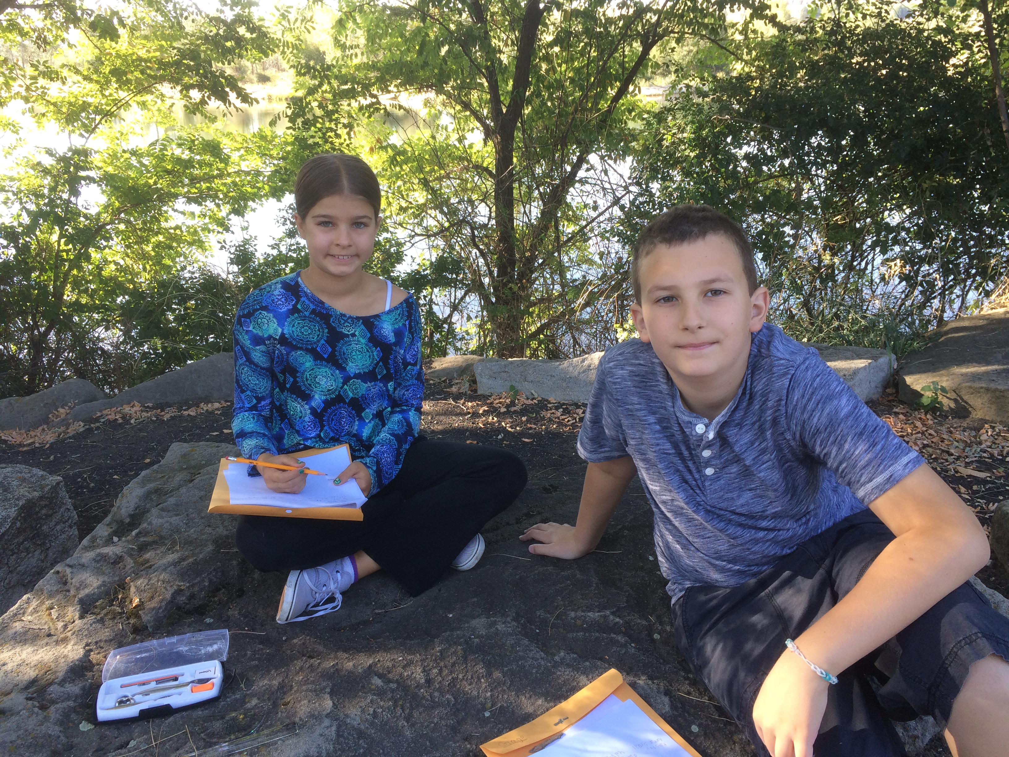
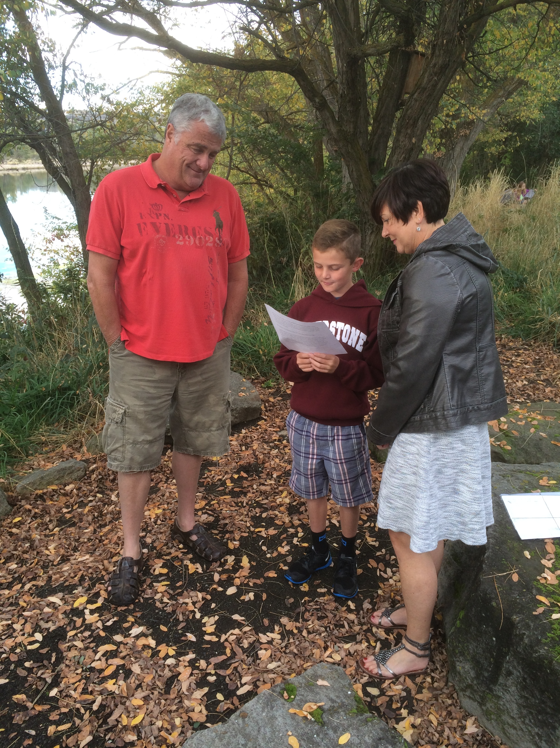
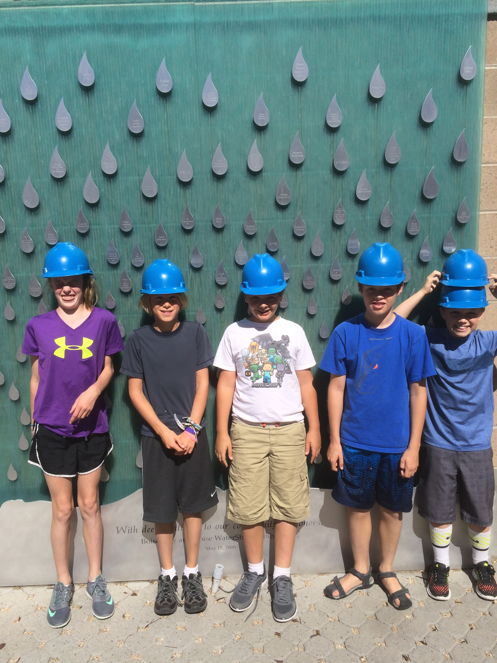
Expeditionary Learning
Sharing the Planet Summative

Slide 8
Where We Are in Place and Time
Give students full exposure to a real planner, with emphasis on central idea, lines of inquiry, and how they tie together
After learning the lines of inquiry, students actually try to guess and write a central idea for the unit
Emphasis on current events; begin developing and understanding real-world issues

Slide 9
How We Express Ourselves
The Blank Planner Project
Students, parents, teachers and administrators work together to create the central idea, lines of inquiry and summative assessment from scratch at the beginning of the unit
Teachers create formative experiences entirely based on student ideas and interests
Emphasis throughout the unit on how student efforts during the Blank Planner planning session influence each activity and experience

Slide 10
Blank Planner Results
Central Idea: Technology empowers creative change.
Lines of Inquiry: An inquiry into...
-The role of design in technology.
-How technology influences the way people communicate.
-The driving forces behind changes in technology and the resulting impact on the future.
Summative Assessment:
Create "something" in two unique ways, first utilizing available technology, then without any technology at all. Then, compare, contrast and analyze the projects from various perspectives.

Slide 11
How We Organize Ourselves and How the World Works
Emphasis on research, interpersonal, presentation and organizational skills
Students self-evaluate themselves based on transdisciplinary skills prior to student-led conferences
Parent and Mentor exhibition meetings- Get all adults on the same page, prepared to support students in a cohesive way, before the Exhibition begins

Slide 12


Slide 13
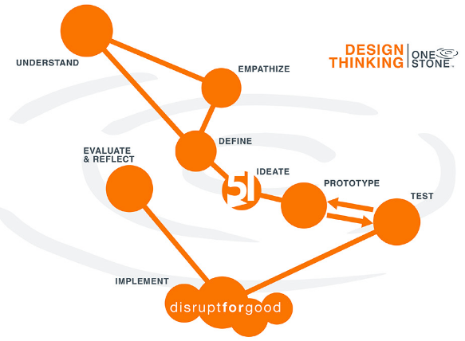

Slide 14
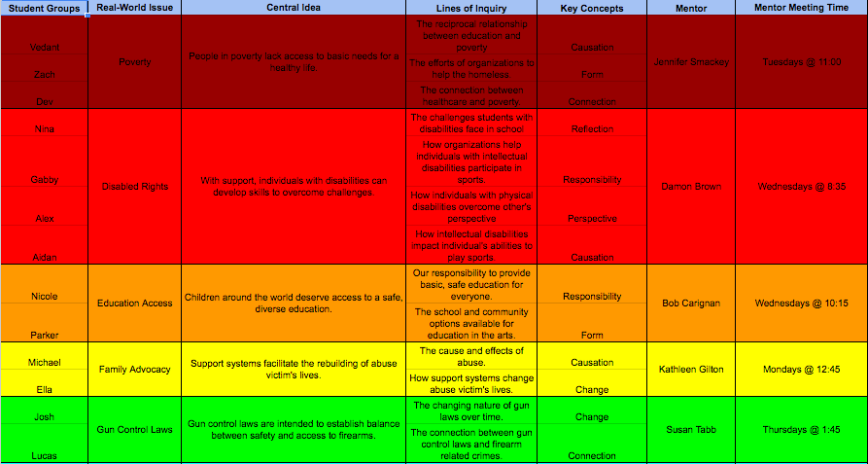
Individualized, Student Created Central Ideas, Lines of Inquiry and Concepts

Slide 15
Action Week
Community-Based Action- any authentic, student-initiated activity that requires students to interact with members of the community outside of the classroom
Builds a personal, age-appropriate understanding of important real-world issues; gives students new appreciation of efforts to make a difference by individuals and organizations in the community; prepares students for life-long community activism
Can include interviewing leaders of the community, participating in community events, and volunteering with organizations when appropriate
Does not include fundraisers, class projects, or other “events”

Slide 16

Outreach

Slide 17
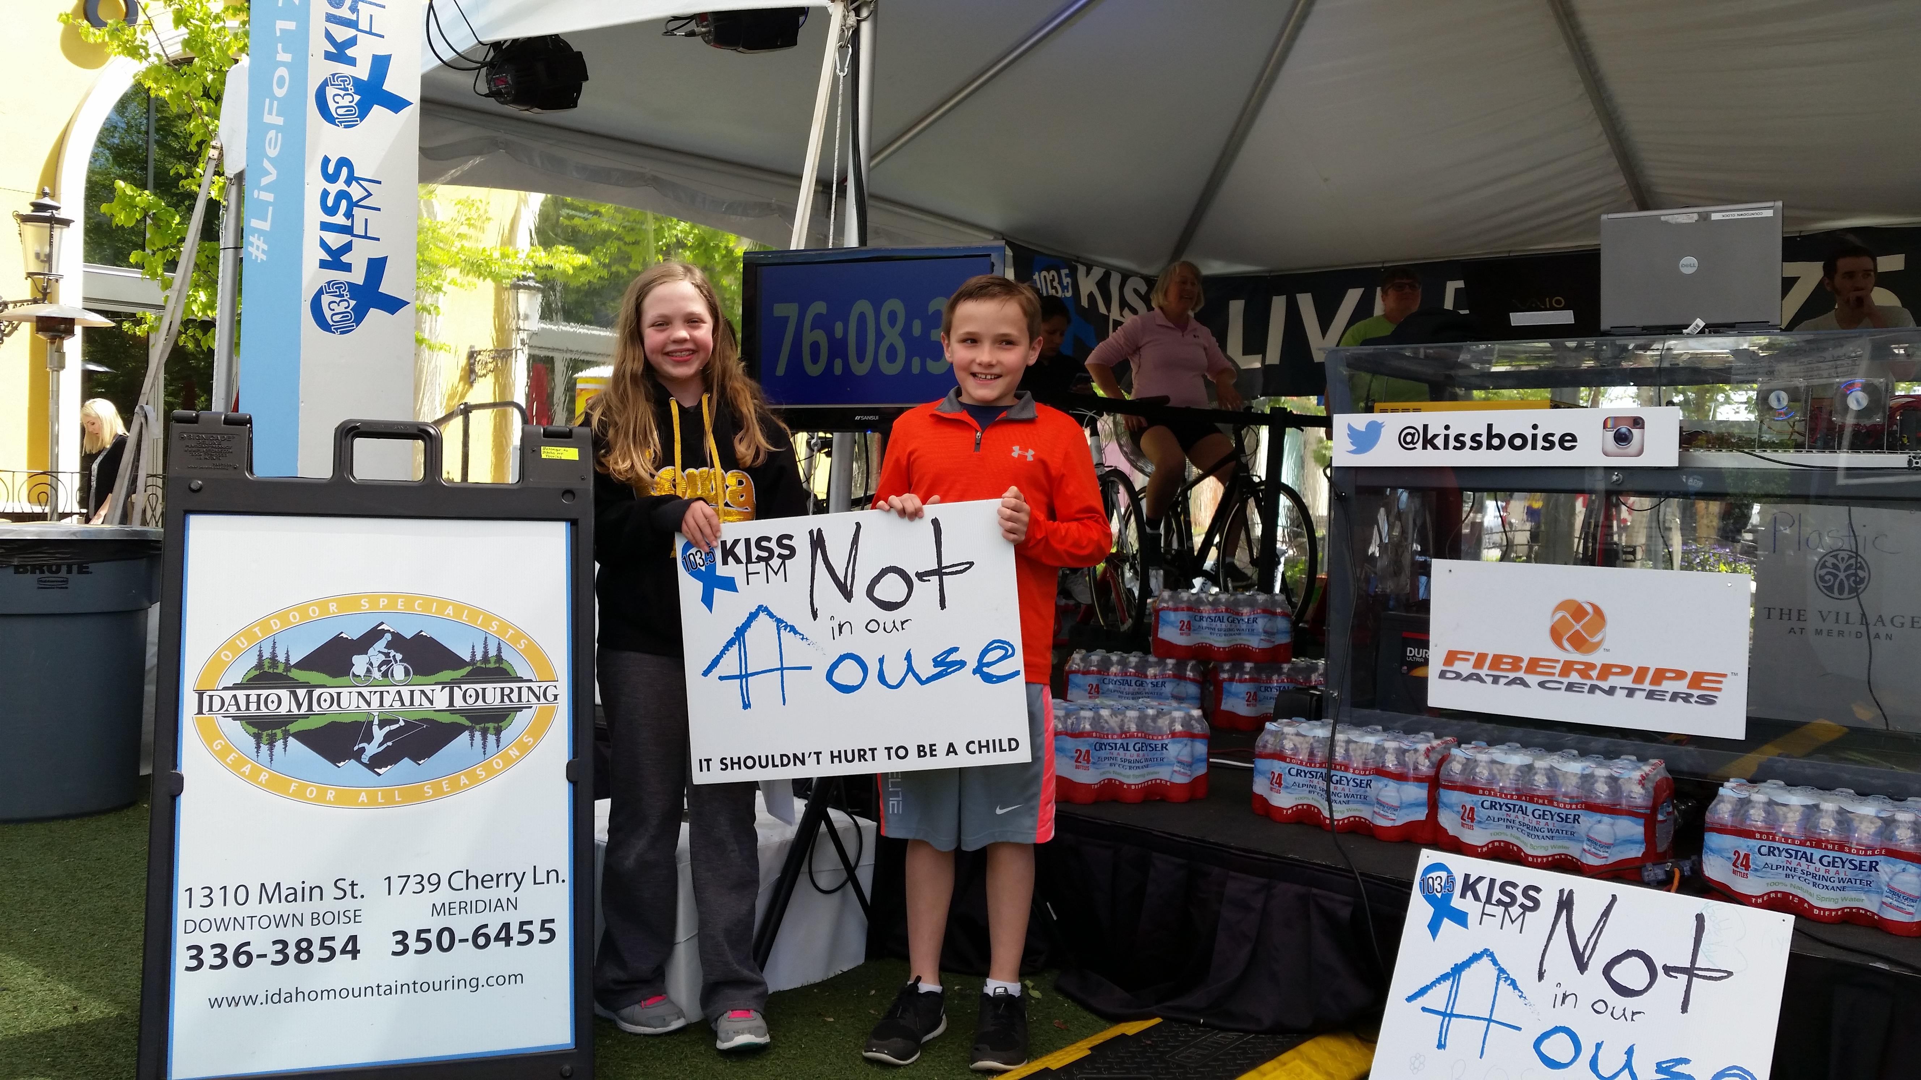
Preparation, Action, Reflection

Slide 18
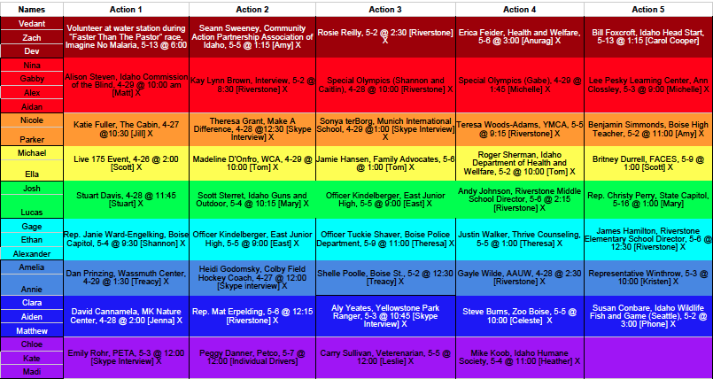

Slide 19
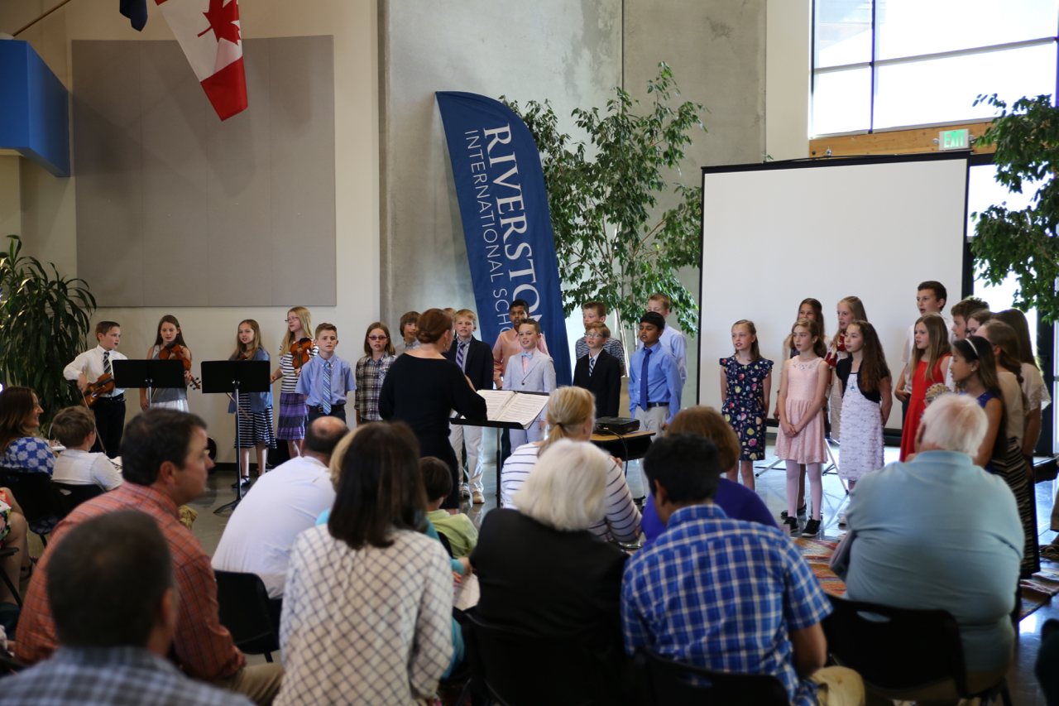
Exhibition Evening

Slide 20
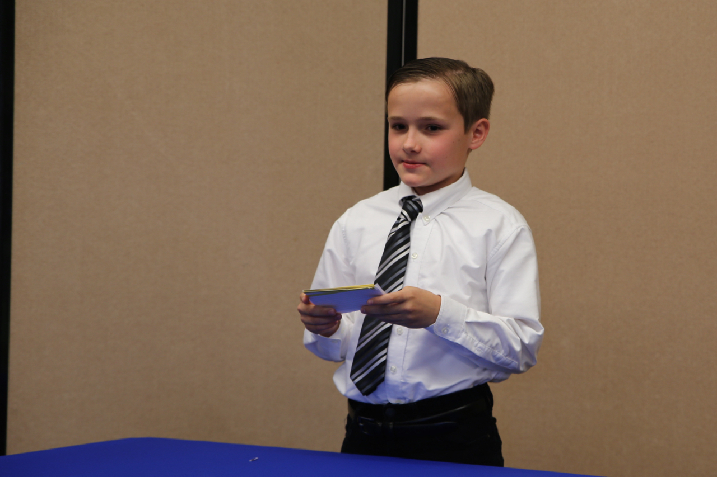
Individual Speeches

Slide 21
Thank You!
Trevor Lindsay
Riverstone International School tlindsay@riverstoneschool.org

