Slide 2
IB For All:
Building a Culture of Access,
Excellence and Equity.
Paul Marble & Matthew J. Gonzales

Slide 3
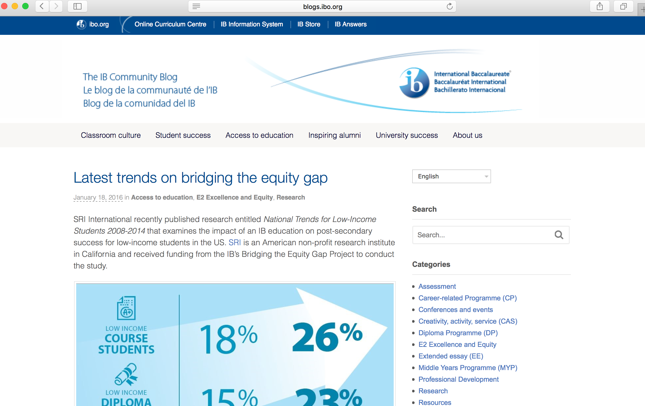
Bridging the Equity Gap
Notes:
Asheesh – background (5 minutes)

Slide 4
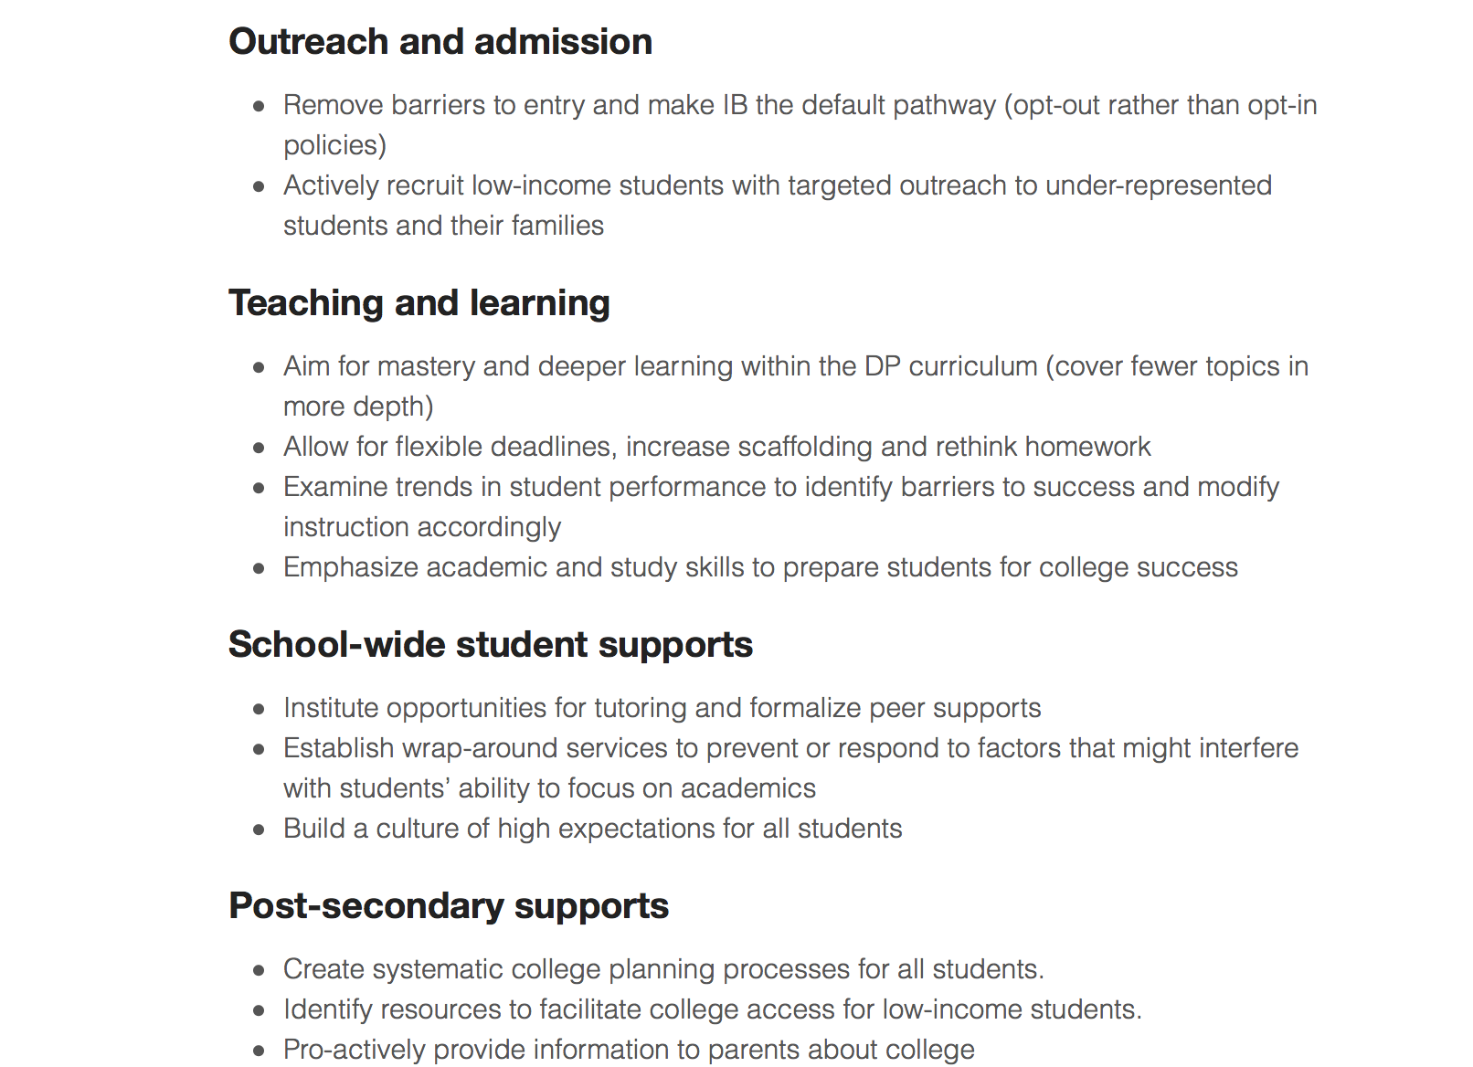
Bridging the Equity Gap
Notes:
Paul – transition into the workshop and this session.

Slide 5
The Importance of Modeling
Transparency
  (What are we doing? Why?)
Metacognition
    (Consistent Reflection Tools)
Inclusivity
  (Protocols)
Notes:
Matt – why do we model?
Working with groups of teachers
Working with ourselves as facilitators
Working with participants in this room
We model to make sure that you understand our process.
Why? The grant identified these three items as key practices that will promote equity and access in a cognitively demanding classroom.
E.g., in a cognitively demanding classroom, students will be asked to explain and justify their thinking.
For students who are not used to this style of expression, they need continued coaching and modelling.
As teachers discuss their own processes, students begin to understand the ‘why’ behind what they are being asked to do.
The more a student understands the expectation and the process of learning, the more their voice will be heard in the room.

Slide 6
Human Graphs
Please line up using the questions below:
How many years have you been in education?
How many years have been involved with International Baccalaureate?
How accessible do you think the IB DP is for all learners?
How many years have you worked in your current school?
How large is your largest class?
How large is your largest DP Class?
How many preps (different classes) do you teach?
How many different IB DP classes do you teach?
Who was present for the last Equity (grant) workshop?
How much progress have you made on your rubrics since the last workshop?
How much do you know about formative Assessment?
List Departments (raise hands)
How often do you meet with other department members?
How often do you talk about curriculum and/or instruction with other department members?
How often do you standardise assessment marks with your department members (collaboratively grade student work)?
Notes:
Matt
Question – who has used human graphs in their classroom/school?
DO NOT EXPLAIN THE WHY!

Slide 7
Human Graphs (2)
What programme or programmes do you represent? (PYP, MYP, DP, CP)
What is your role in your school? (Teacher, Building Coordinator, District Coordinator, Building Administrator, District Administrator)
How many years have you been in education? (range 1-2, 3-4, 5-8, 9-12, 13-18, 19+)
How many years have you been involved with the International Baccalaureate? (range 1-2, 3-4, 5-8, 9-12, 13-18, 19+)
How accessible do you think the IB is for all learners? (range 1-5)
Notes:
Matt
DP teachers –think about the DP as a whole – all of the component parts – AND the pieces of the DP that might work best for your learners (e.g., 3 DP classes, 2 DP classes and CAS, etc.) when contemplating accessibility.
We need to talk about, discuss and operationalise the term – ‘accessibility’

Slide 8
Debrief and reflect
What, if any, is the value of this ‘human graph’ activity (formative assessment activity)?
How might you use the ‘human graph’ activity with your school community?
What is the benefit of this activity for students?
How could this activity enhance enrollment, access and success in your IB community/classrooms?
Notes:
Matt
Turn and talk (3 minutes)
Discuss one, discuss all, whatever works for your group.
STRONGLY ENCOURAGE to discuss the last question

Slide 9
Purposes and beliefs of the two-day workshop
IB Programmes are for all learners
The experience of the IB is more important than the student results
No quick solutions (no silver bullet)
No discipline-specific instructional strategies
Purpose – to share a range and variety of general instructional topics and strategies)
Notes:
Matt
Unpack bullets

Slide 10
Guiding questions (for the two-day workshop)
How do I develop/extend a culture of inclusion in my classroom and in my school?
How do I plan instruction for the students in my classroom (how do I know my students as learners)?
How do I develop assessment criteria from IB DP assessment objectives?
How do I use IB assessment criteria to formally evaluate students and celebrate student growth?
Notes:
Matt

Slide 11
The Importance of Modeling
Transparency
  (What are we doing? Why?)
Metacognition
    (Consistent Reflection Tools)
Inclusivity
  (Protocols)
Notes:
Paul
Transition to student profile activity
Explain relevance of profile activity

Slide 12
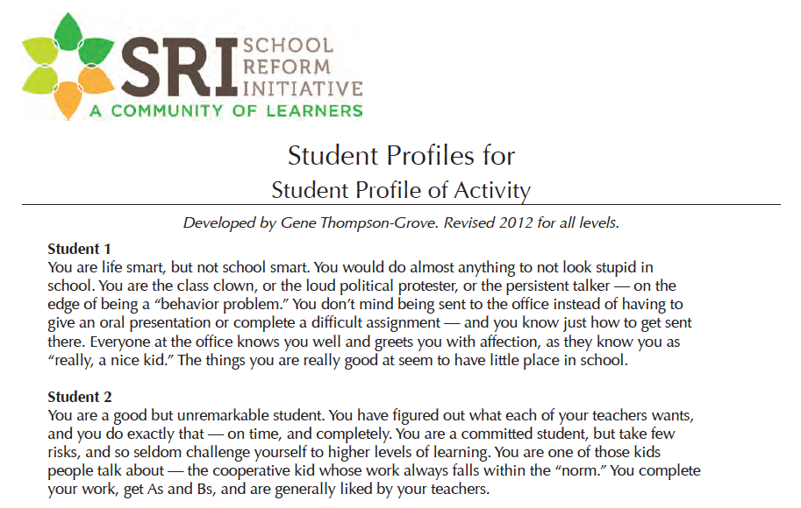
Notes:
Paul
COPIES NEEDED

Slide 13
Profile of a Student
Read the student profiles
Choose the profile that most interests you
Share with your neighbours what interested you about the profile
Notes:
Paul
Explain that in the workshop we had teachers group by specific profiles, but we will not do this today for the sake of time.
We also had teachers document their responses as a group to the following questions (on next slides)

Slide 14
Profile of a Student - first (of two) set of questions
Imagine you are a school design team and your team
has to design a school with this student in mind.
What would your school look like?
How would you engage this student in continuously culturally relevant, challenging, rigorous and standards-based learning?
Notes:
Paul

Slide 15
Profile of a Student - second (of two) set of questions
What kinds of supports need to be in place in a small
school learning environment for your student profile
group to be willing to take academic risks to learn?
Notes:
Paul

Slide 16
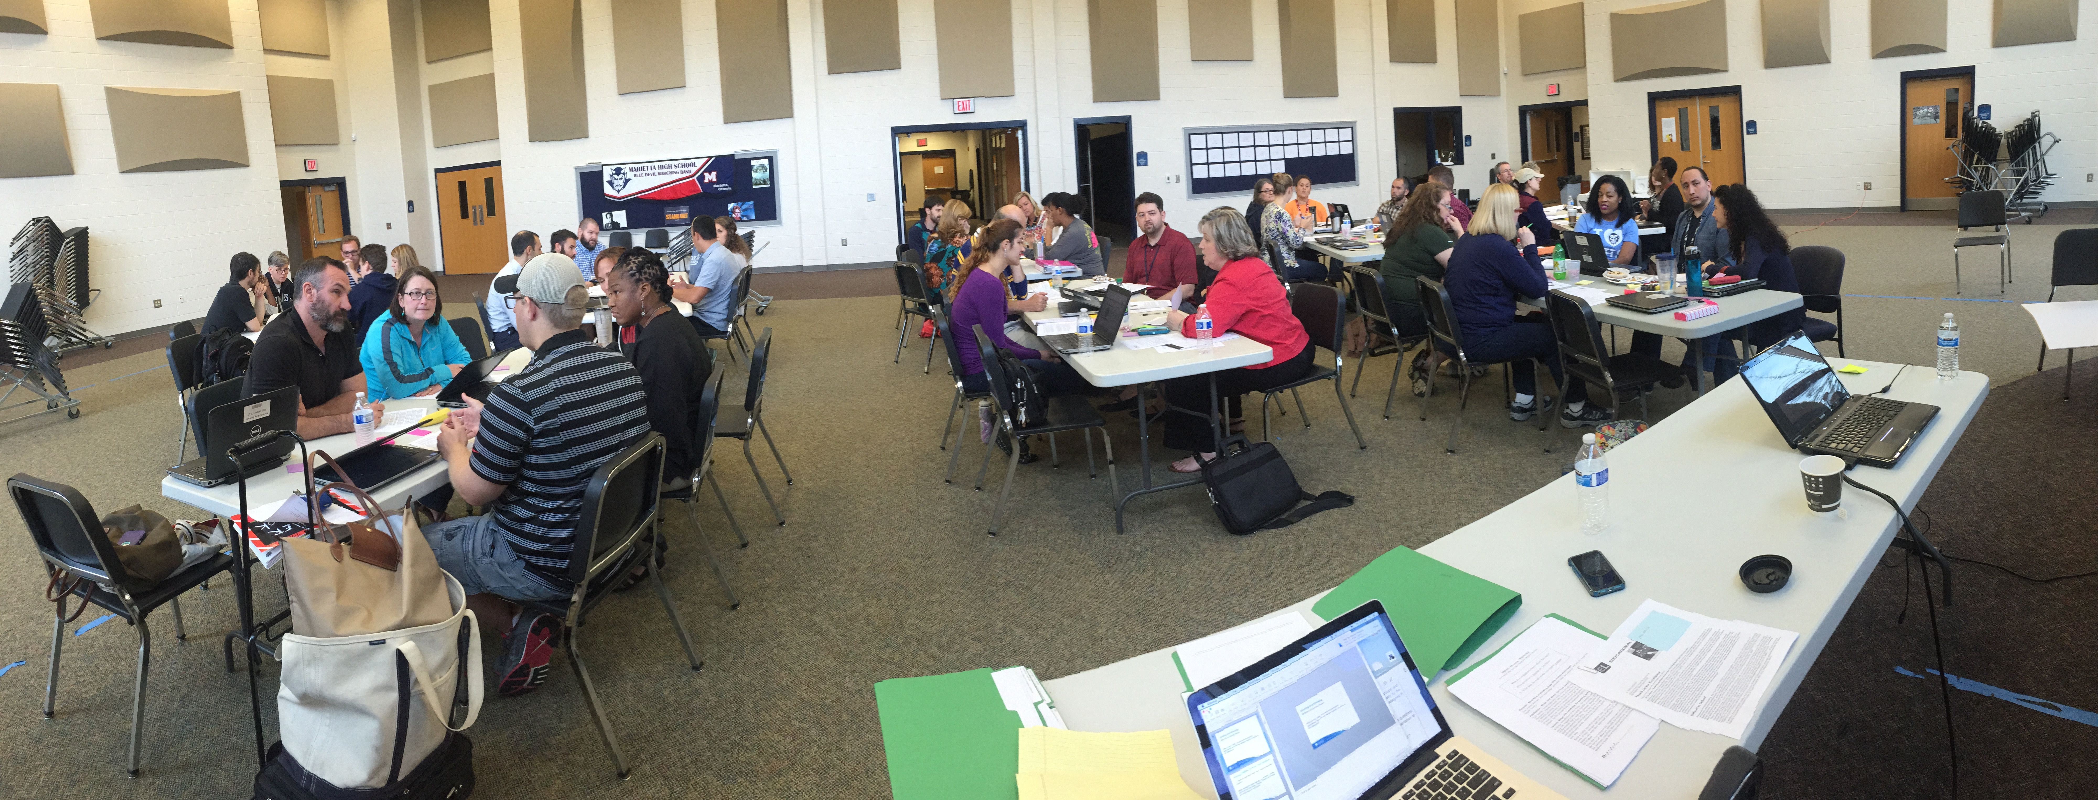
Marietta, GA
Notes:
Paul

Slide 17
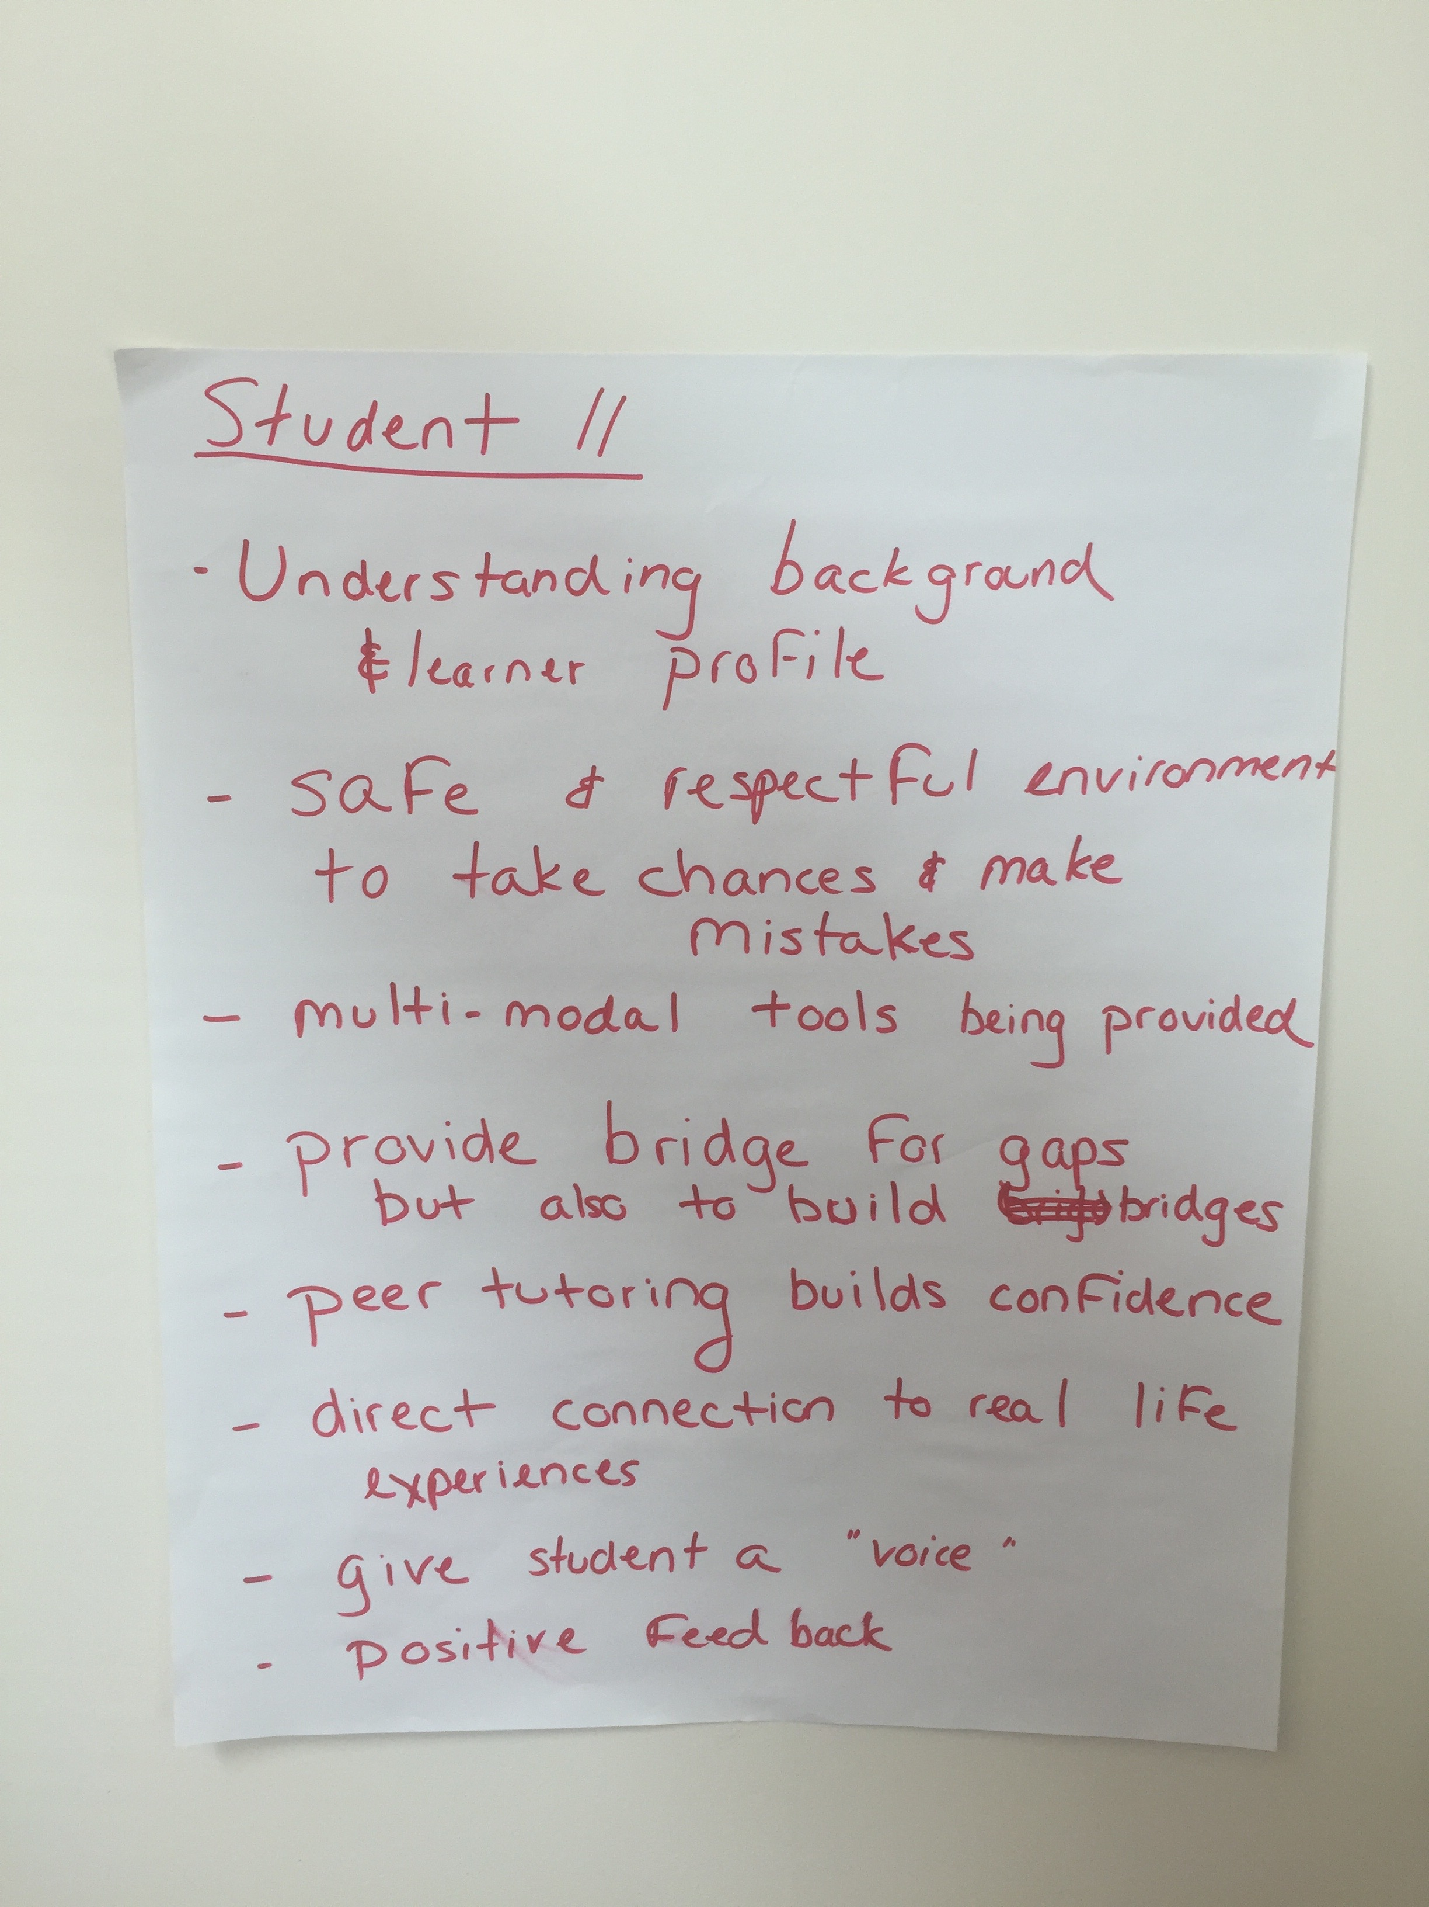
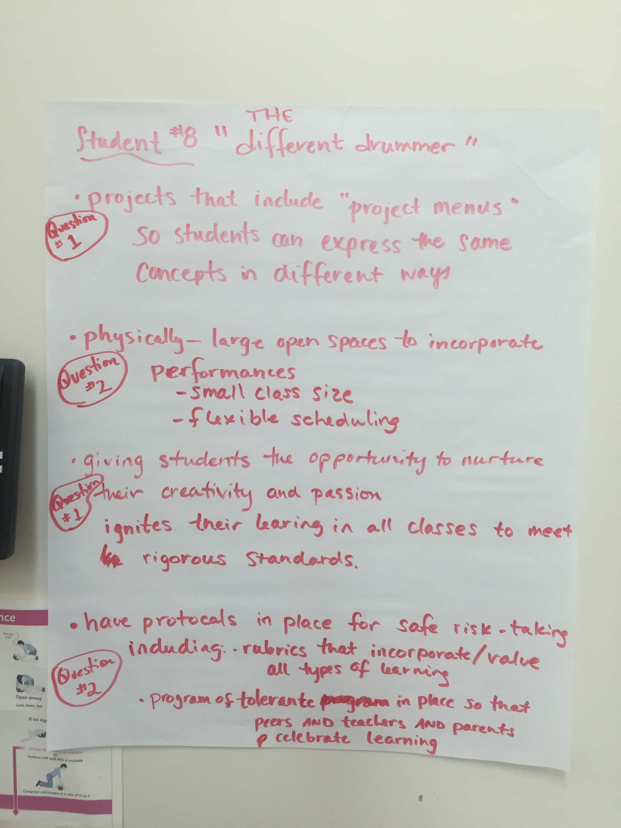
Notes:
Paul

Slide 18
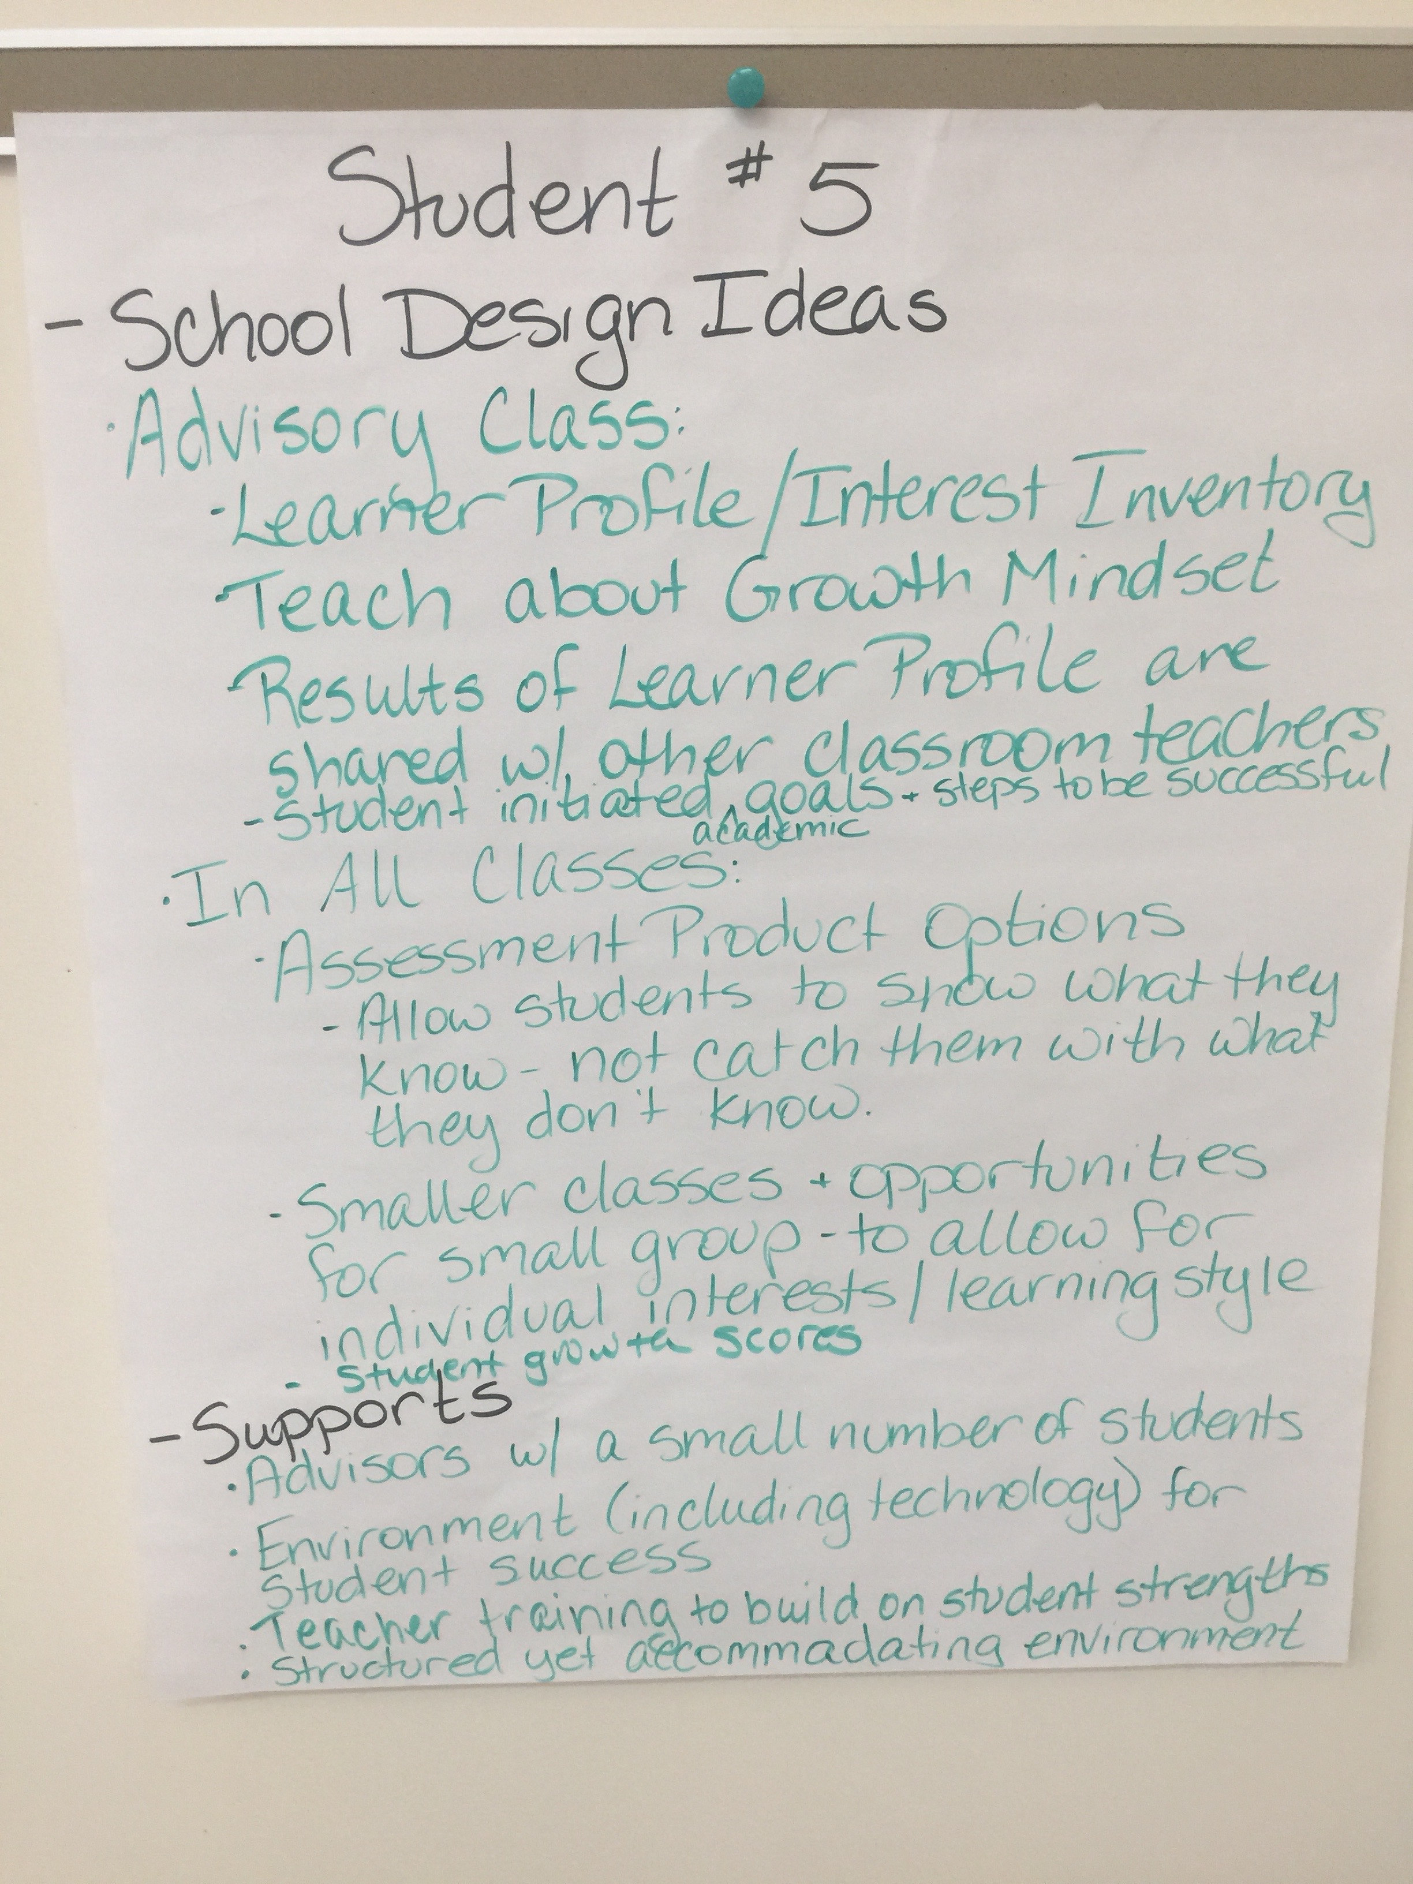
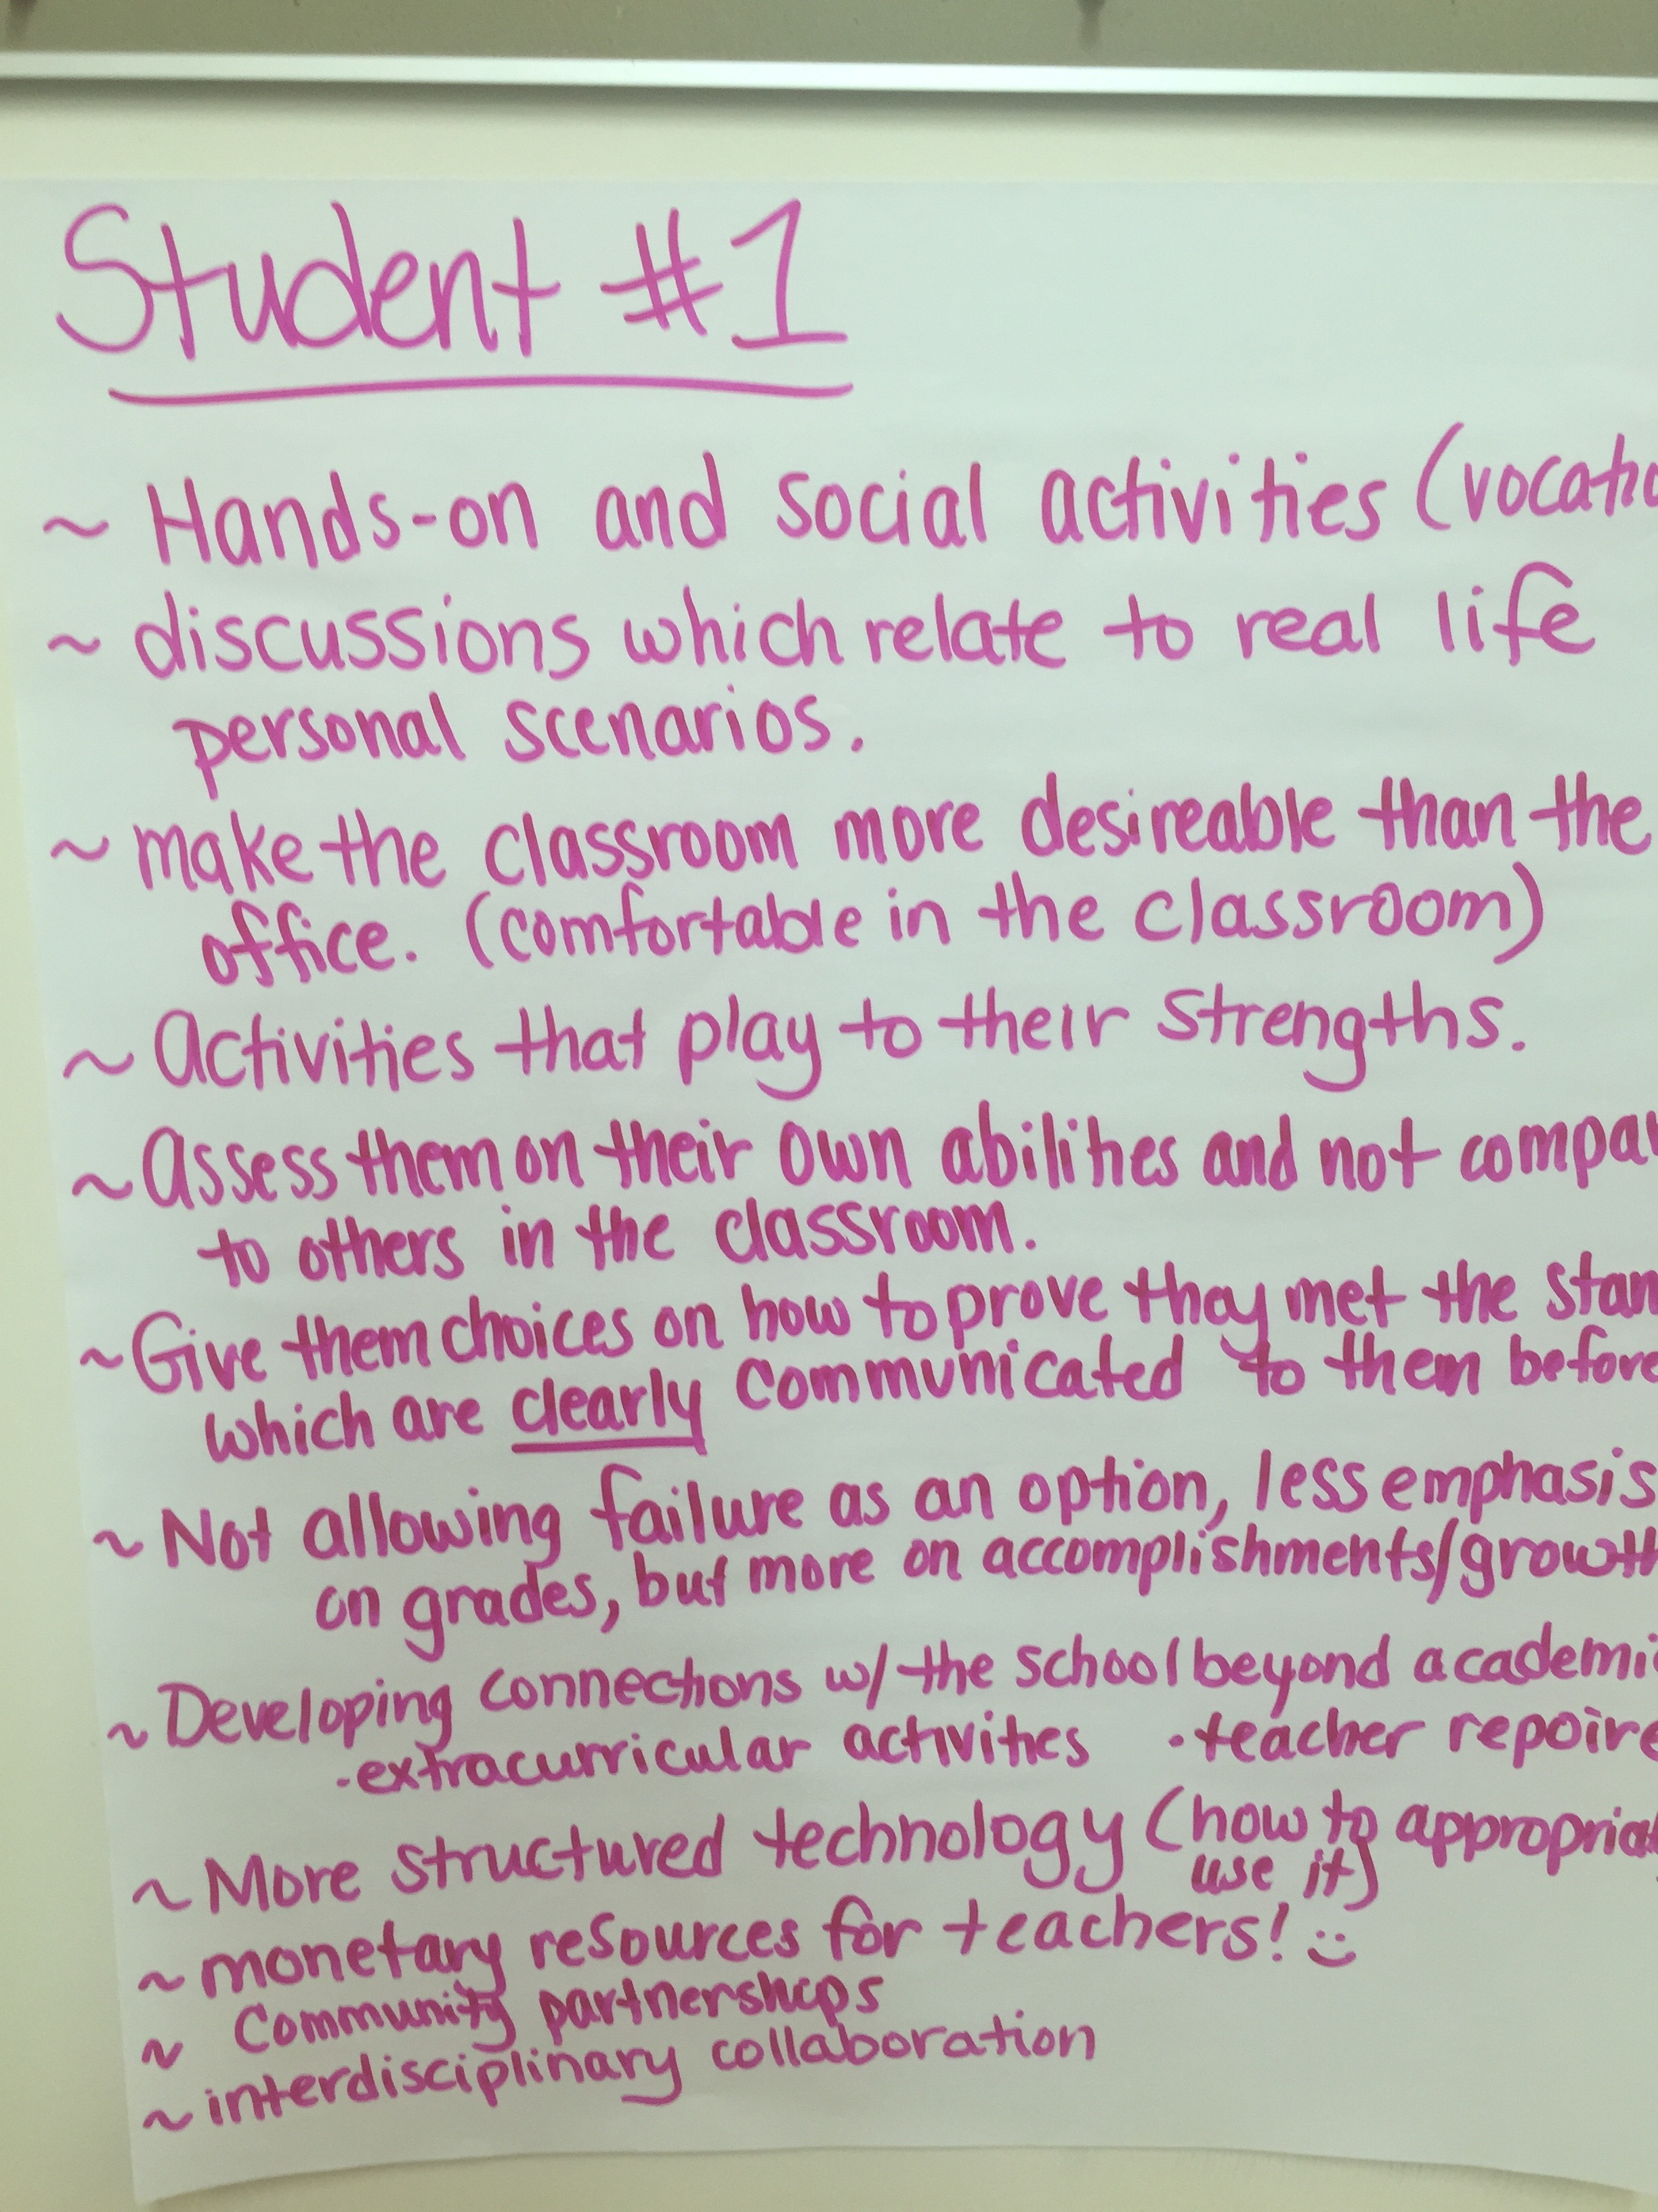
Notes:
Paul

Slide 19
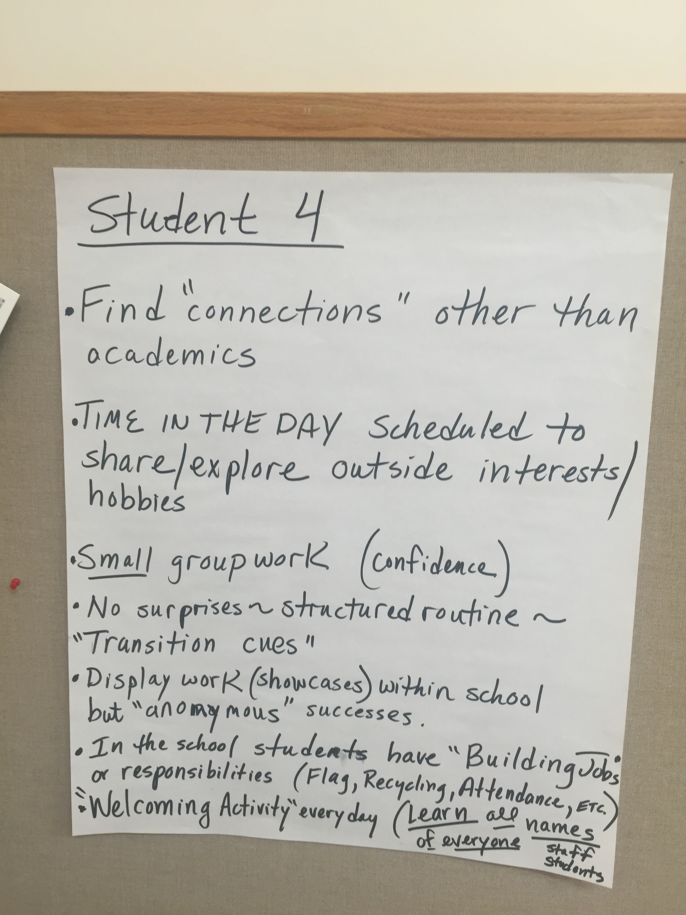
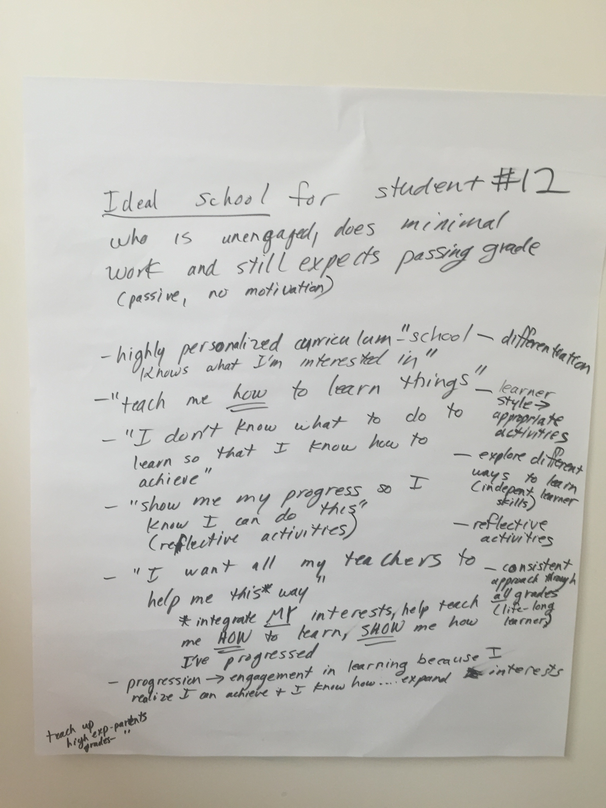
Notes:
Paul

Slide 20
Reflections (Think/Pair/Share)
What was it like for you to engage in the Student Profile
activity?
How might you use this student profile activity?
What might you change about this student profile activity?
To what extent could this activity enhance enrollment, access and success in your IB classrooms?
Notes:
Paul

Slide 21
DP Assessment –
Principles into Practice
(jigsaw)
Leading to DP Music lesson
Notes:
Matt
Talking through the process – NOT DOING THE ACTIVITIES

Slide 22
Jigsaw sections
ALL - 2.1 Why “assessment”?
ALL - 2.4 Assessment and learning
Group 1 - 2.2 Formative and summative—what are the purposes of assessment?
Group 2 - 2.5 Norm-referencing and criterion-referencing
Group 3 - 2.7 Bias
Notes:
Matt
Criterion-referenced
Ask group to show what they know about criterion-referencing (1-5 fingers)
Explain if needed

Slide 23
The Importance of Modeling
Transparency
  (What are we doing? Why?)
Metacognition
    (Consistent Reflection Tools)
Inclusivity
  (Protocols)
Notes:
Matt
Explain the previous activity (jigsaw)
Briefly explain the next activity (musical discussion)
FOCUS ON BEING A NOVICE – why this particular activity was selected
ASK – any musician in the room?

Slide 24
DP Music lesson

Slide 25
Listening exercise (one)
(walking in the shoes of a novice)

Slide 26
Please self assess your level of musical knowledge and understanding
(1-5)
(1 – low)
(5 – high)
Notes:
Matt
DO NOT SHOW FINGERS – private self assessment

Slide 27
DP Music Paper 1 rubrics
Criterion A: Musical elements
This criterion concerns the student’s ability in each extract to perceive the musical elements (duration, pitch, timbre/tone colour, texture and dynamics) and their significance. Articulation and other expressive and production techniques might also be discussed.
Criterion B: Musical structure
This criterion concerns the student’s ability to perceive the principal structural features of each extract.
Notes:
Matt
Teachers were given copies of these rubrics

Slide 28
DP Music Paper 1 rubrics
Criterion C: Musical terminology
This criterion concerns the student’s knowledge of musical terminology and its appropriate use.
Criterion D: Musical context
This criterion concerns the student’s ability to place each extract in its musical context—cultural, historical and stylistic—and relate it to music that s/he knows
Notes:
Matt
Teachers were given copies of the rubric

Slide 29
Listening exercise (one)
Please write what you hear (we will hear the song 2x)
Please organise your response using the following items:
General musical elements (instruments, tonality, etc.)
Structure (how the music moves through time)
Context (where and when does this music come from?)
Listening 1 – individual work
Listening 2 – Paired work
Notes:
Matt
CHECK FOR TIME – cut listening if needed
SCAFFOLD before and between listening 1 and listening 2

Slide 30
Listening exercise (two) - DISCUSSION
Please review the student sample work using the markscheme
Please review the student sample work using assessment criteria A, B, D
Please come to agreement on a number (mark) for each assessment criteria (e.g., A = 2, B = 4, D = 1)
Discuss
(Share final score)
(Share process)
Notes:
Matt
EXPLAIN PROCESS IN DETAIL
Teachers were given a detailed vocabulary list of terms used in the student response
EXPLAIN USE OF CONTENT – the song selected was intentional = doorway in
GIVING THE STUDENT THE KNOWLEDGE THAT THEY CAN DO IT

Slide 31
Silent reflection:
To what extent did support/scaffolding
(facilitator questioning) increase your level of success in the task?
Notes:
Matt
Talk about the types of scaffolding that were used.

Slide 32
Reflections (Think/Pair/Share)
What was it like for you to engage in the music assessment
activity?
How might you use this type of assessment activity?
What might you change about this assessment activity?
To what extent could this assessment activity enhance enrollment, access and success in your IB classrooms?
Notes:
Matt
Turn and talk (3 minutes)
Discuss one, discuss all, whatever works for your group.
STRONGLY ENCOURAGE to discuss the last question

Slide 33
Resources
Do Students Learn More When Their Teachers Work Well Together? – Esther Quintero
Teach up for Excellence - Tomlinson & Javius
The Best Value in Formative Assessment – Chappuis & Chappuis
From Principles to Practice (Assessment)
Critical Friends Group Training – National School Reform Faculty
Critical Friends Group Protocols – nsrfharmony.org
Notes:
Paul

Slide 34
Thoughtful Reflections
Use the IB’s Self-Reflection Tool to review our learning from today.
Please jot down your responses to the following sentence starters:
I wonder…
I need to go deeper into…
I fully understood…
My next step will be…
My level of comfort at this point (from 1 to 7) is…
Notes:
Paul

Slide 35
Contact
Matthew J. Gonzales
matthewjgonzales@gmail.com
Paul Marble
pmarble@sturgischarterschool.org

