Slide 1
IB Americas Conference
Toronto 2016
Does your School Community
have a shared understanding
of Global Citizenship?

Slide 2

CIS Global Education Community
706 Schools
456 Accredited Schools
537 Universities
and Colleges
Representing 112 countries

Slide 3
Our Organisational Values
We provide LEADERSHIP.
  We draw on our collective knowledge and experience to guide others. Together we achieve more. We inspire each other to expand our minds and perspectives, always striving to explore new ideas and innovations that enable us to act progressively and meaningfully.
We CHALLENGE ourselves and others.
  We keep an open mind to new perspectives and look ahead to gain new insights. Our natural curiosity challenges routine thinking and keeps us focused on growth and development.
We are PRINCIPLED.
  Our guiding principles are based on our Definition of Global Citizenship. These principles form a solid foundation that inspires and challenges our members to actively promote international education and intercultural perspectives.
We value DIVERSITY.
  We embrace ideas, cultures and educators from every corner of the world making different views and opinions a source of inspiration that enrich every member of our community.

Slide 4
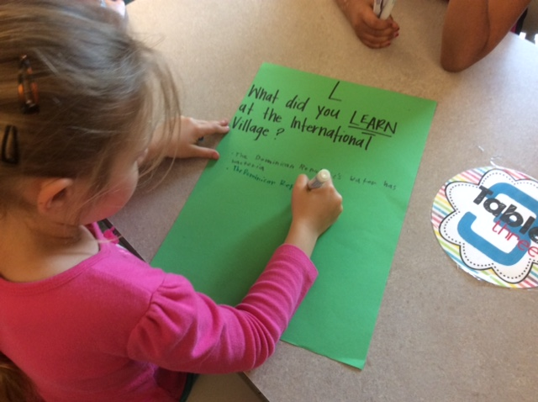

What does Global Citizenship look like in your school?
Notes:
Today we’re going to help you find out how to answer this question.

Slide 5
Minding the Gap
What is the most effective way to provide an international education?
How do you know you are developing global citizens in your school?
Notes:
2 min. Graham
Key questions facing schools: Educators around the world face common challenges…
How do we know we are taking the right steps to provide students with an education that keeps pace with internationally-recognised standards and enables their development as global citizens?
TASK
How many participants have defined global citizenship and what it means in your school community?
How many participants feel competent in measuring the degree to which students are global citizens?
What is a question you would like to have answered during this International Certification presentation? Share with a person near you.

Slide 6



What is CIS International Certification?
A means to support and validate a school community’s commitment to global citizenship
An evaluative and developmental process to further develop students as global citizens
Project-based learning that demonstrates what a school is doing well, and how it may develop to an even richer experience for its students
Notes:
3 min. Graham
What is CIS International Certification?
School’s commitment to global citizenship-The International Certification process would apply only to the schools in which global citizenship is a vital part of who they are, who have the time, leadership focus and resources to engage in a targeted and strategic focus on intercultural competence and global citizenship.
Stress developmental process- International Certification takes school where it is in the development of intercultural competence and global citizenship and helps the school to move along a global citizenship developmental continuum. It is very much a consultative model with CIS offering professional development and guidance throughout the process.
Project based learning focus- The International Certification process is designed to be embedded in the fabric of the school’s curriculum and learning programs.

Slide 7
What Matters in
International Certification
The translation of these values into authentic learning across the community
Developing understanding in the community
The community’s values on global education
Notes:
2 min. Graham
What Matters in International Certification?
Emphasise that this is a whole school community process. What would it look like in the curriculum, in professional development, the school’s admissions policy, the school’s language policy, the library, in school celebrations, in food served during celebrations?

Slide 8

Intended Outcomes for International Certification
Learn ways that you can strategically focus on the development of students as global citizens.
Notes:
What Matters in IC / What were we trying to achieve?
In working with schools we emphasised that this deep dive into global citizenship was a whole school community process and encouraged schools to think about what would it look like – for example; in the curriculum, in professional development, the school’s admissions policy, the school’s language policy, the library, in school celebrations, in relation to food served during celebrations etc, etc………..
We have ESTABLISHED A SERIES OF Intended outcomes for schools undertaking the International Certification process……we WANT ScHOOLS TO;
Learn ways that they can strategically focus on the development of students as global citizens.
Learn what intercultural competence looks like in a school, and in school leaders.
Explore, identify and evaluate the school community’s fundamental values and beliefs about international education and their impact on the resulting outcomes intended for students.

Slide 9
Intended Outcomes for International Certification
Learn what intercultural competence looks like in a school, and in school leaders.
Notes:
What Matters in IC / What were we trying to achieve?
In working with schools we emphasised that this deep dive into global citizenship was a whole school community process and encouraged schools to think about what would it look like – for example; in the curriculum, in professional development, the school’s admissions policy, the school’s language policy, the library, in school celebrations, in relation to food served during celebrations etc, etc………..
We have ESTABLISHED A SERIES OF Intended outcomes for schools undertaking the International Certification process……we WANT ScHOOLS TO;
Learn ways that they can strategically focus on the development of students as global citizens.
Learn what intercultural competence looks like in a school, and in school leaders.
Explore, identify and evaluate the school community’s fundamental values and beliefs about international education and their impact on the resulting outcomes intended for students.

Slide 10
Intended Outcomes for International Certification
Explore, identify and evaluate the school community’s fundamental values and beliefs about international education and their impact on the resulting outcomes for students.
Notes:
What Matters in IC / What were we trying to achieve?
In working with schools we emphasised that this deep dive into global citizenship was a whole school community process and encouraged schools to think about what would it look like – for example; in the curriculum, in professional development, the school’s admissions policy, the school’s language policy, the library, in school celebrations, in relation to food served during celebrations etc, etc………..
We have ESTABLISHED A SERIES OF Intended outcomes for schools undertaking the International Certification process……we WANT ScHOOLS TO;
Learn ways that they can strategically focus on the development of students as global citizens.
Learn what intercultural competence looks like in a school, and in school leaders.
Explore, identify and evaluate the school community’s fundamental values and beliefs about international education and their impact on the resulting outcomes intended for students.

Slide 11



International Certification Process
DEFINE global citizenship
APPLY the International Certification Criteria
PARTICIPATE in professional development opportunities
COMPLETE projects involving students and the entire school community, reflect on process and results
SHARE resources in a peer network
Notes:
5 min. Graham
International Certification Process
Later in the presentation you will see a sample of the International Certification criteria, and projects.
The International Certification process helps the school come together to discuss how they define global citizenship and how the International Certification criteria can be applied to their school.
By participating in a professional development opportunity, the school will challenge their own intercultural views and think about how different perspectives influence the direction of the school.
Finally the school will take action to involve the school community in completing the 6 International Certification projects which address various aspects of global citizenship in the school centered on the International Certification Criteria.

Slide 12

Step 1: Define Global Citizenship
We designed our picture to look like a globe because Turning Point School is a globally aware school. The globe represents being globally aware and taking care of our community.
- Rachel, Charlie, and Emma
Notes:
2 min. Graham
Definition of Global Citizenship
(Picture) This is the schools mission and global citizenship as illustrated by students at Turning Point School in CA.
The first task for an International Certification school is to define what they mean by global citizenship, align this with the school’s guiding statements, its curriculum and programs and policies, and educate the school community about the definition.
A school cannot design a global citizenship curriculum nor measure the growth of global citizenship in its students when they do not know what exactly is being measured.
CIS provides global citizenship resources for the school to use when creating their definition.

Slide 13
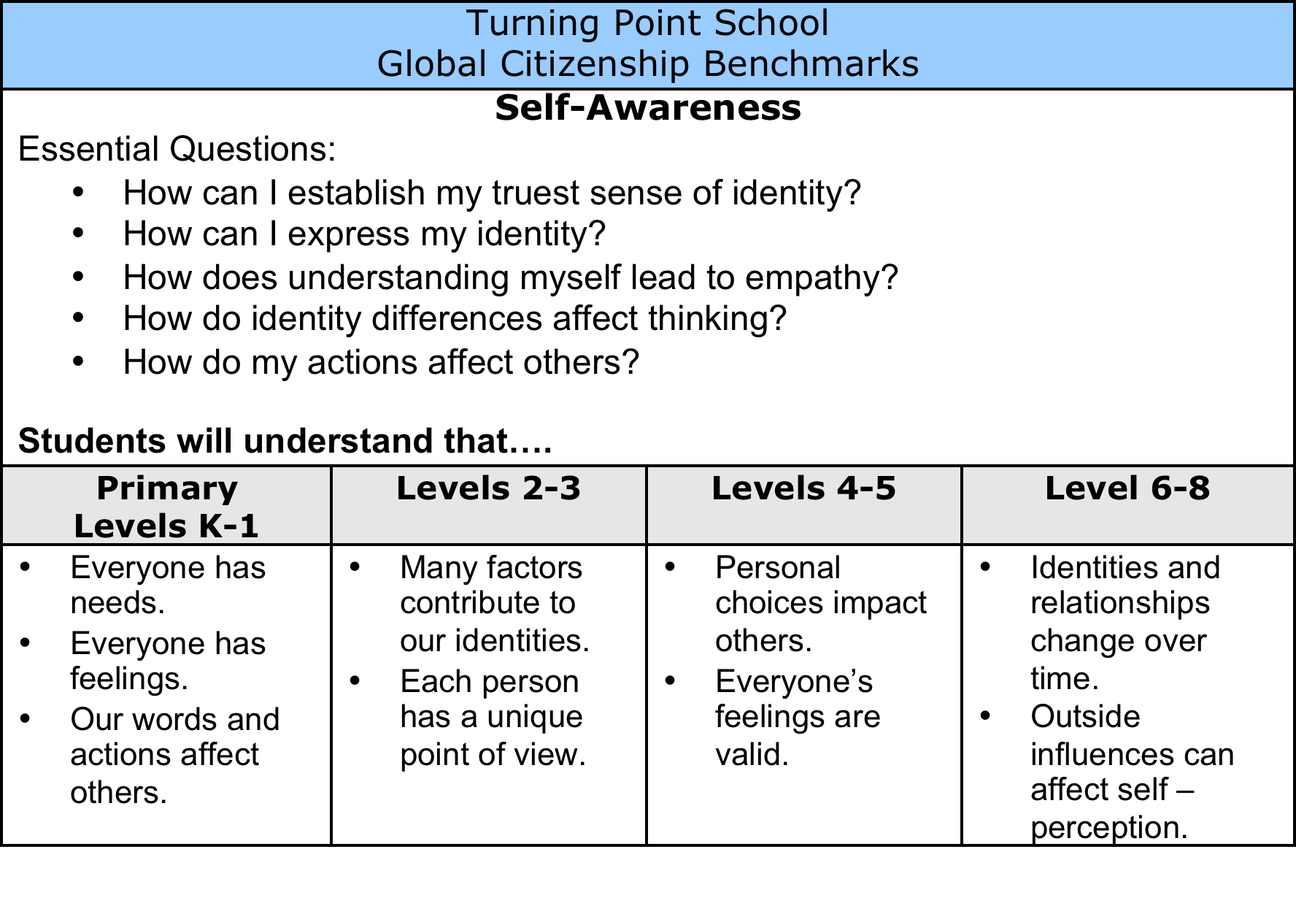
Defining global citizenship
understandings,
skills and Turning Point’s core values

Slide 14
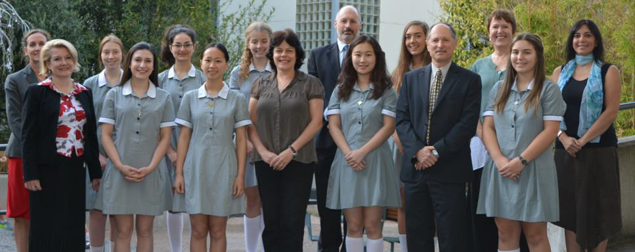
Step 2: The Role of Leadership
Methodist Ladies’ College, Melbourne, Australia
Notes:
The role of leadership
So, how did we go about making this a reality in schools? First of all we started with the creation of a steering group of around 8-12 diverse representative members of the school community including administrators, representatives for the grade
level scope of the school, service learning or CAS coordinator, etc. The group, known as the International Certification Group (ICG), had three main goals;
1) To model and promote the fulfilment of the commitment to the school’s
Guiding Statements to educate for global citizenship.
2) To plan and oversee the completion of the projects and subsequent presentations.
3) To monitor progress in the development of students’ global citizenship in terms
of knowledge, understanding, skills, dispositions and actions.
Methodist Ladies’ College in Melbourne, Australia was one of our pilot schools and their feedback was very encouraging – the school commented; “The external process was powerful for us. It included elements of the whole school; every teacher and staff member participated in some form. It provided a degree of objectivity and authenticity, and power to carry out the task at hand.”

Slide 15
Intercultural Development Inventory (IDI) Continuum
Monocultural Mindset
Measures Intercultural Competence:
the ability to understand and adapt behaviours to cultural difference and commonality
Intercultural Mindset
Notes:
4 min. Jane
Intercultural Development Inventory (IDI)
Developed by Mitch Hammer from Washington University building on the work of Milton Bennett’s Developmental Model of Cultural Sensitivity.
The IDI has been cross validated across multiple cultural groups.
The intercultural assessment is completed online by members of the ICG and any other members of the school community the school selects to complete the inventory.
It measures intercultural competency: The ability to understand and adapt behaviours to cultural difference and commonality.
Its importance lies in the fact that it measures the intercultural perspectives of school leaders and staff who influence the school’s strategy and programmes.
The assessment is followed by a professional development session to understand the developmental continuum and what can be done to increase our own and the school’s intercultural competency. It is conducted by an IDI Qualified Administrator.
The understanding of intercultural competency is at the foundation of the International Certification process and will be linked to the 6 International Certification projects.

Slide 16
Your Intercultural Competency
When have you taken cultural differences into account?
When have you assumed similarity?
In what areas of your school
could more attention be paid
to cultural differences?
Notes:
Jane: TASK - discuss in a group

Slide 17
Intercultural Competence in Schools
Monocultural Mindset | Intercultural Mindset
School’s guiding statements address global citizenship in word only with no alignment with learning programs. | School’s guiding statements show clear commitment to global citizenship and are aligned with learning programs.
Community service | Service learning
One style fits all communication and conflict management approaches used. | Differentiated communication and conflict management approaches are used.
School ethos reflects only the needs of the school’s dominant culture being taken into account. | School ethos embraces diversity through policies, procedures, learning programs.
Professional learning lacks focus on cultural understanding. | Professional learning focuses on cultural understanding.
“Am I assuming similarity where there are important differences to which I should be paying attention?”
Notes:
Jane – explain scenario from Columbia University – how an explanation of universal acceptance and support generated criticism due to minimization of difference
Research study by Gavin Hornbuckle – concluded that the majority of international school educators assume that intercultural competence “happens automatically” due to the diversity of the community
In fact, research shows that progress can only be made if intentional efforts are undertaken.

Slide 18
Intercultural Leadership
What factors do leaders in multicultural environments need to be aware of?
What understandings, skills and dispositions would an effective leader need?
Notes:
Task: 2 Minutes – discuss in groups
Jane - Examples: Sudden drug testing – explain what happened and how the school was split along cultural lines
Stories by heads on retreat – almost every challenge cited involved intercultural misunderstanding or conflict – and not easily resolved, difficult, right vs. right

Slide 19
Intercultural Leadership Traits
Emotional Intelligence
Empathy
Knowledge of Other Cultures
    According to: (Livermore, 2010) (Ang, et.al., 2007) (Goleman, 2005)
Self-regulation
Self-awareness
Social Skills
Motivation
Notes:
Jane

Slide 20
Step 3: Project-based Learning
School Guiding Statements
Environmental Sustainability
Staff Professional Development
Service Learning
(Extra)
Co-curricular Activities
Students’ Global Citizenship Learning
Notes:
2 min. Graham
International Certification Projects
Schools that earn International Certification will complete and assess the impact of 6 projects, several of which will be presented to the school community to demonstrate the outcomes of its work during the CIS Final Presentation Visit.
The expectations for each project are defined in rubrics provided to the school.
The projects reflect the 3 Domains of the International Certification Criteria which you will be introduced to a bit later in the presentation.

Slide 21
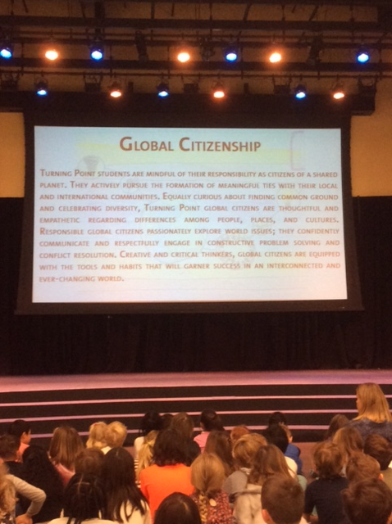
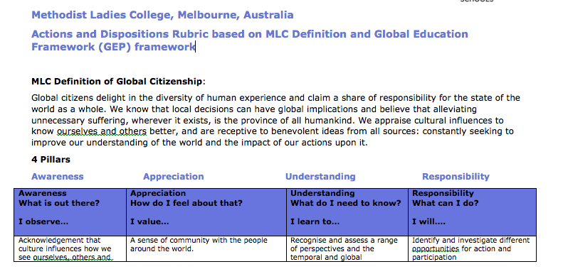
School Guiding Statements Project
Turning Point School
California, USA
Methodist Ladies’ College
Melbourne, Australia
Notes:
2 min. Graham
Project #1- School’s Guiding Statements
(Picture) Turning Point school shares their definition of global citizenship at a school community assembly.
(Picture) Methodist Ladies’ College in Melbourne, Australia created their definition of global citizenship building upon their 4 pillars of Awareness, Appreciation, Understanding and Responsibility. Their next step was to define a framework for students’ global citizenship knowledge, understandings, skills and dispositions.
The School’s Guiding Statements, definition of global citizenship as well as other relevant policies (for example, students’ assessment, language, community service and/or professional development) will be reviewed to ensure there is a well-defined commitment to and alignment with developing global citizenship in students.
The International Certification Group will create awareness and understanding of global citizenship within the school community.

Slide 22
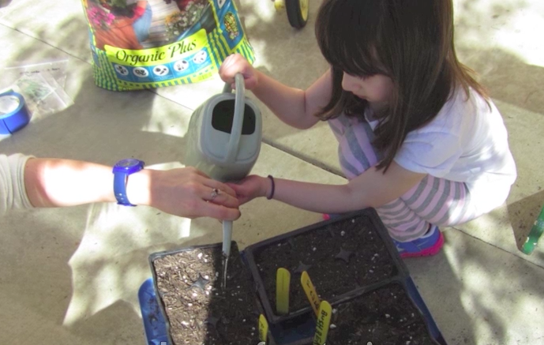
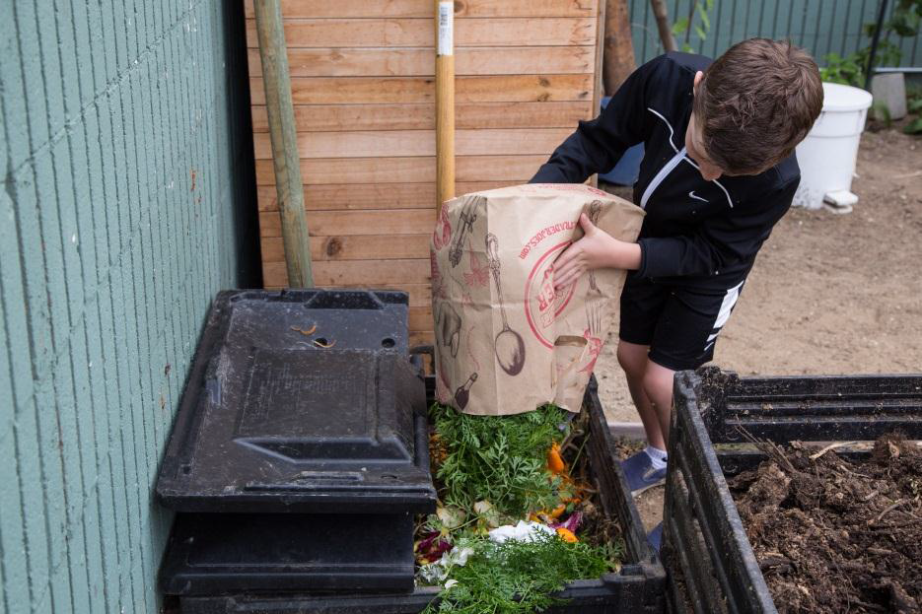

Environmental Sustainability Project
Turning Point School
California, USA
Notes:
2 min. Graham
Project #2 – Environmental Sustainability
(Picture) Turning Point’s gardening project involving every student in the school in planting, growing, harvesting, cooking and sharing their harvest with families. Not a new project, for International Certification, but a long established project which became a more intentional process and an embedded part of the curriculum as a result of International Certification.
(Picture) PK-8 composting project which happens at home and school. Compost is used for the community garden…part of every area of the curriculum.
Project outcome: provide examples of sustainable environmental operating practices within the school and the resulting effects on minimising its environmental impact. The related learning on environmental sustainability is connected to the school’s curriculum and is evident in classrooms throughout the school. The school community’s awareness of and contribution to the school’s sustainable operating practices will be illustrated.

Slide 23
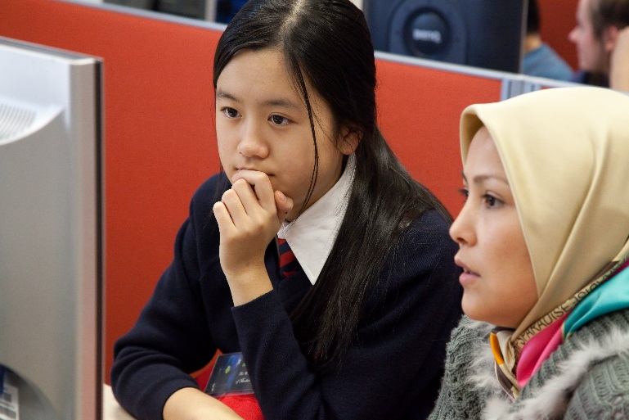
Student Global Citizenship Learning Project
Mentone Girls’ Grammar
Melbourne, Australia
Turning Point School
California, USA
Notes:
2 min. Graham
Project #5- Student Global Citizenship Learning
(Picture) Mentone Girls’ Grammar School students connecting to their global partners in Beijing.
(Picture) Turning Point student reflecting after attending the International Village culminating IC Community Project.
Project outcome: present evidence of how the curriculum effectively develops global citizenship in students across the school in terms of understanding, intercultural skills, dispositions, actions and reflection through curricular and extra/cocurricular learning opportunities.

Slide 24
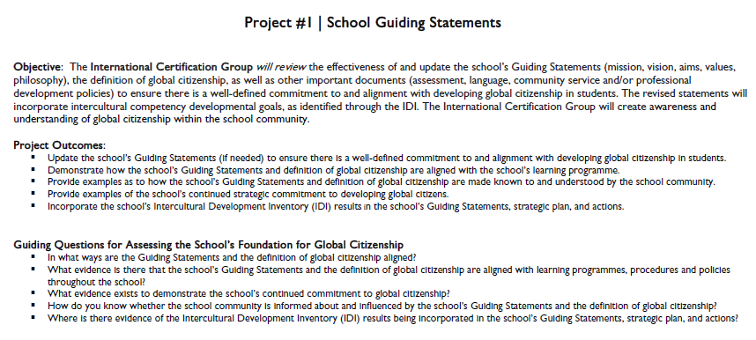
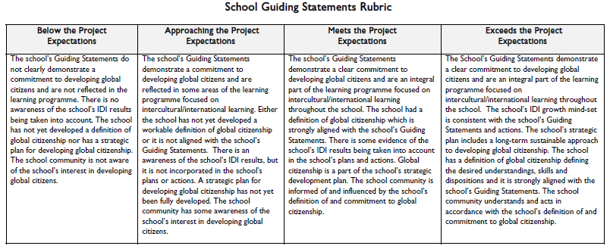
Project Evaluation Rubrics
Project Objectives
Outcomes
Guiding Questions
Evaluation Rubric
Notes:
2 min. Graham
Project Evaluation Rubric
The expectations for each project are defined in rubrics provided to the school. The school International Certification Group uses this to develop their school projects, they will self-assess the project against the rubric criteria, and the CIS Evaluators will also assess the project using the rubric and the project outcomes.

Slide 25
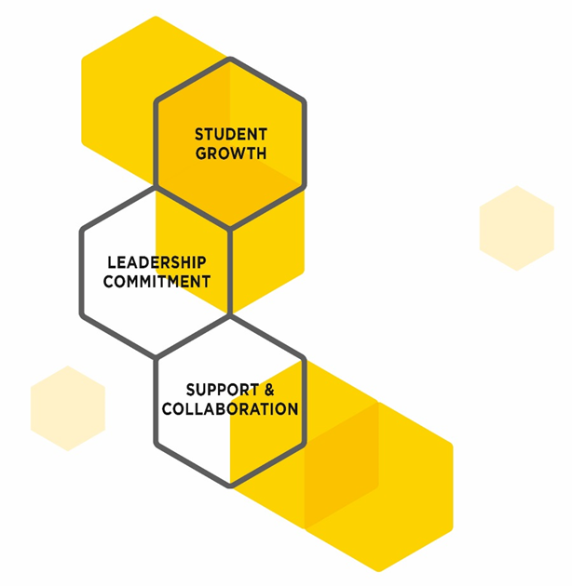
Three
International Certification Domains
Notes:
1 min. Graham
The 3 IC Criteria Domains
The strategies and practices needed to develop global citizenship in schools have been divided into 3 domains - leadership commitment, student growth, and support and collaboration.

Slide 26
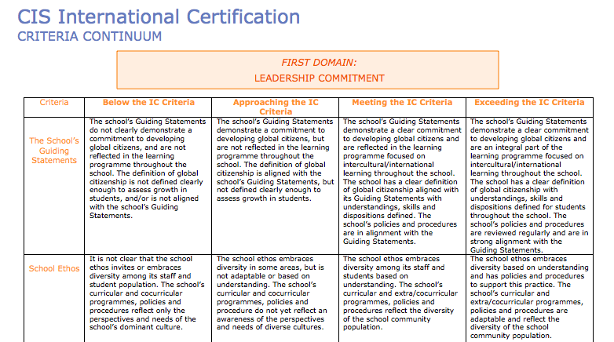
International Certification Continuum
A guide to help evaluate progress towards International Certification
Notes:
1 min. Graham
IC Criteria Continuum
As a guide for evaluation, CIS developed the International Certification Continuum, which presents three domains for International Certification Criteria on a 4 point continuum of performance. Schools will evaluate their progress formally using the continuum twice during the certification process but may find the continuum useful throughout the process.

Slide 27

Benefits of International Certification
ENABLE students to participate in a rapidly changing, interdependent world
HELP schools recognise and disseminate effective, innovative international education practices
PROVIDES school communities with recognition for high quality international programmes
FOSTER collaboration and whole-school discussion of values related to global citizenship
SUPPORT educators as they explore intercultural competence, their own perspectives as teachers and role models and the impact on students
Notes:
1 min. Graham
Benefits of International Certification
In addition to those benefits listed on the slide, International Certification schools have experienced, increased interest from international teachers in applying to teach at the school, increased interest from families who desire an international education for their children.
Mentone Girls’ Grammar School shared,” IC for us has been empowering, interesting, rewarding, enriching, and fulfilling.”
” I think it is also highly educative: it promotes self-awareness and promotes the complexity of inter-cultural understanding by refusing to simplify it into a sound byte.” (Malcolm Dow, Mentone Girls’ Grammar School )

Slide 28
International Certification School Feedback
“The shared definition of global citizenship was powerful in the creation which involved lots of discussion. We next defined what it looks like in practice.”
Methodist Ladies’ College
Australia
“International Certification opened up conversations among students, teachers, and the administration. It was great to have an external eye to see how we are going and how we can improve.”
ST. Timothy’s School
USA
Notes:
1 min. Jane
Quotes from IC schools-
St. Timothy’s School, Methodist Ladies’ College

Slide 29
International Certification School Feedback
“CIS International Certification gave us strategic impact. We were looking for quality assurance as we asked ourselves,” Is the school really living its mission?” The achievement of International Certification showed us we are authentically living the School’s mission. It was a catalyst for learning.”
Mentone Girls’ Grammar
Australia
Notes:
1 min. Jane
Quote from IC school
Mentone Girls’ Grammar School

Slide 30


International Certification School Feedback
“The International Certification process was an effective and “real” process for us. It avoided simply following a “tick the boxes” approach and was not bureaucratic. The most important part of the process for us was to think about exactly what space we wanted to be in, and developing a clear definition of what Global Citizenship meant at Ivanhoe was critical to this process. If we did not know what we wanted to achieve, how could we achieve it? As we anticipated, International Certification highlighted some areas we need to improve on and in particular in ensuring Global Citizenship is part of the DNA of an Ivanhoe education and does not occur by happenstance.”
Ivanhoe Grammar School
Australia
Notes:
1 min. Jane
Quote from IC school
Mentone Girls’ Grammar School

Slide 31
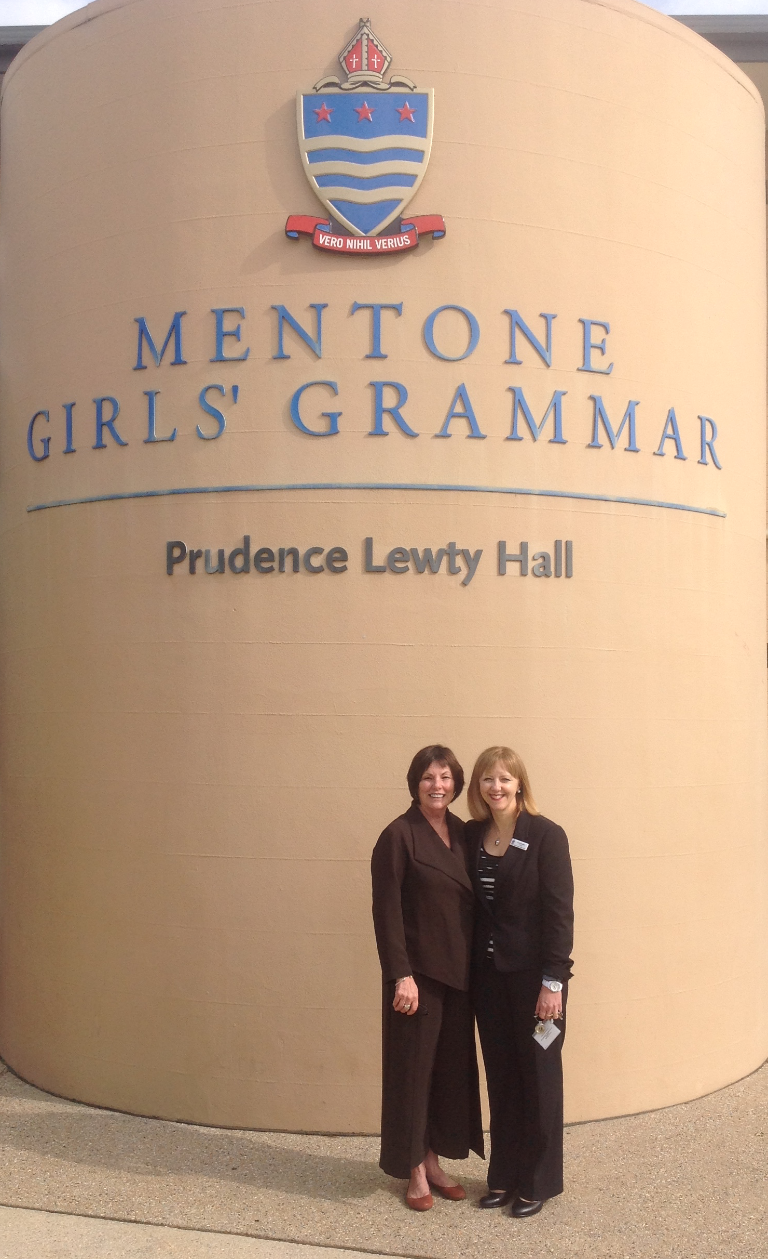

CIS Network
Deborah Richman Turning Point School
USA
Fran Reddan
Mentore Girls’ Grammar School
Australia
Notes:
1 min. Graham
IC School Network
One of the most valuable aspects of International Certification has been schools from around the world helping one another through the International Certification process and learning from one another.
As more International Certification schools enter the network, the richer it will become.
School will be part of a smaller cohort network with like schools facilitated by CIS as well as a larger network of all International Certification schools.

Slide 32

International Certification Schools
International School Indiana, USA
St. Timothy’s School, USA
Mentone Girls’ Grammar, Australia
Methodist Ladies’ College, Australia
Turning Point School, USA
ACS Hillingdon, UK
Ivanhoe Grammar, Australia
Notes:
1 min. Graham
International Certification Schools
CIS IC icon on their website
Plaque for the school
Plan for continued development of global citizenship
5 year Recertification Process…notified year 4 for the Recertification Process

Slide 33

Join a cohort of CIS Schools
Application available in the CIS Community Portal
Learn ways that your school can strategically focus on the development of students as global citizens.
Learn what intercultural competence looks like in a school, and in school leaders.
Explore, identify and evaluate your school community’s fundamental values and beliefs about international education and their impact on the resulting outcomes you intend for your students.
33
Notes:
1 min. Graham
Prerequisite: CIS membership is prerequisite for International Certification.

Slide 34
Thank you!
Notes:
Questions?

