Slide 2
For Sale!
Selling the IB Programme in Your Community
Cherissa Vitter
Southeastern Louisiana University

Slide 3
Session Objective
Leave with a plan to sell Your Programme(s) in Your Community.

Slide 4
IB Learner Profile
Inquirers
Knowledgeable
Thinkers
Communicators
Principled
Open-minded
Caring
Risk-takers
Balanced
Reflective
(The IB Learner Profile, www.ibo.org)

Slide 5
Communis – (Latin) to make common
Do we have a common understanding?
(Communication, www.etymonline.com)

Slide 6
Public Relations
“Public relations is a strategic communication process that builds mutually beneficial relationships between organizations and their publics.”
-PRSA (Public Relations Society of America)
www.prsa.org

Slide 7
Public Relations
Anticipating, analyzing and interpreting public opinion, attitudes and issues that might impact, for good or ill, the operations and plans of the organization.
Counseling management at all levels in the organization with regard to policy decisions, courses of action and communication, taking into account their public ramifications and the organization’s social or citizenship responsibilities.
Researching, conducting and evaluating, on a continuing basis, programs of action and communication to achieve the informed public understanding necessary to the success of an organization’s aims. These may include marketing; financial; fund raising; employee, community or government relations; and other programs.
Planning and implementing the organization’s efforts to influence or change public policy. Setting objectives, planning, budgeting, recruiting and training staff, developing facilities — in short, managing the resources needed to perform all of the above.
www.prsa.org

Slide 8
Internal Publics
Communication Audience
External Publics

Slide 9
Internal Publics
Teachers
IB Teachers
Non-IB Teachers
Administration
School Site
Central/District Office
Staff
Secretary
Librarian
Custodian
Volunteers

Slide 10
School Climate and Culture

Slide 11
How do you promote a positive school climate?

Slide 12
External Publics
Community
Businesses and Corporations
Universities
Educational Institutions
Government and Military Agencies
Health Care Organizations
Faith Organizations
National Service and Volunteer Organizations
Senior Citizens’ organizations
Cultural and Recreational institutions
Other Community-Based organizations
Individuals
(Sanders, 2001)

Slide 13
Who Communicates?
Teachers
School Staff
Administrators
District Office
Stakeholders

Slide 14
Community Involvement
“Student-focused school-community connection that directly or indirectly supports the students’ physical, social, emotional, and intellectual needs (Preston, 2013).”

Slide 15
Who are the people in your Neighborhood?

Slide 16
Tools for Communication

Slide 17
IB Digital Tool Kit http://www.ibo.org/digital-toolkit/

Slide 18


Slide 20
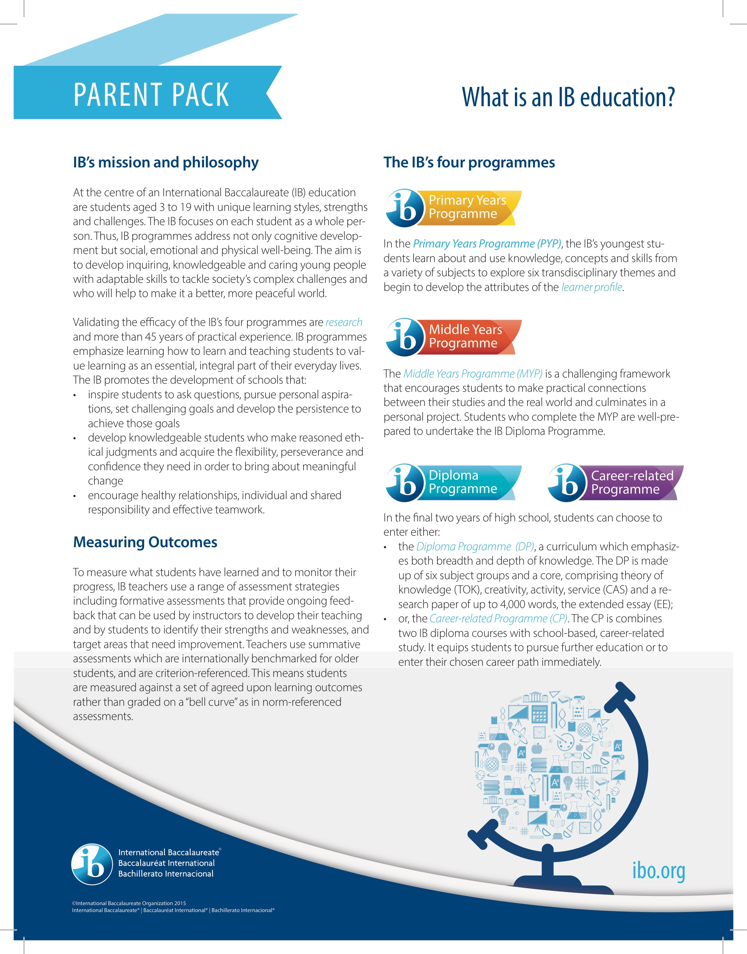

Slide 21
Community Outreach Challenges
Time
Participation
Leadership
Funding

Slide 22
Community Outreach
Media/Social Media Communication
Student-Centered Events
School-Based Events
Booster Organization
(Parent Volunteers)

Slide 23
Ways to Communicate

Slide 24
Media - then and now
In the 1960s…
Prediction about the growth of media
Conclusion – Mass media is here to stay
“The growth of the media may provide a new range of knowledge for great numbers of people who otherwise might not have had the opportunity to learn”
“The media may encourage uniformity-in thinking, in behavior, in beliefs, in dress, in virtually every area of life “
“The media may convey status on communication personalities, thereby creating powerful influence figure”
Can you control the narrative of your local media?
(Boram, 1963)

Slide 25
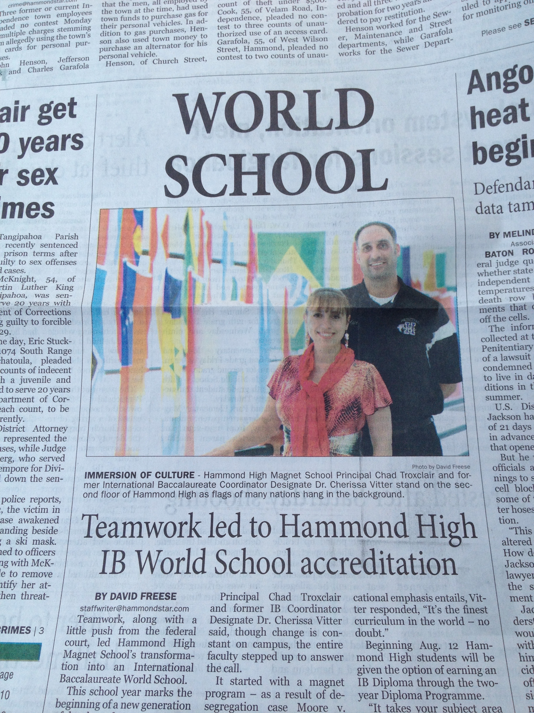
Local Media for Internal Publics

Slide 26
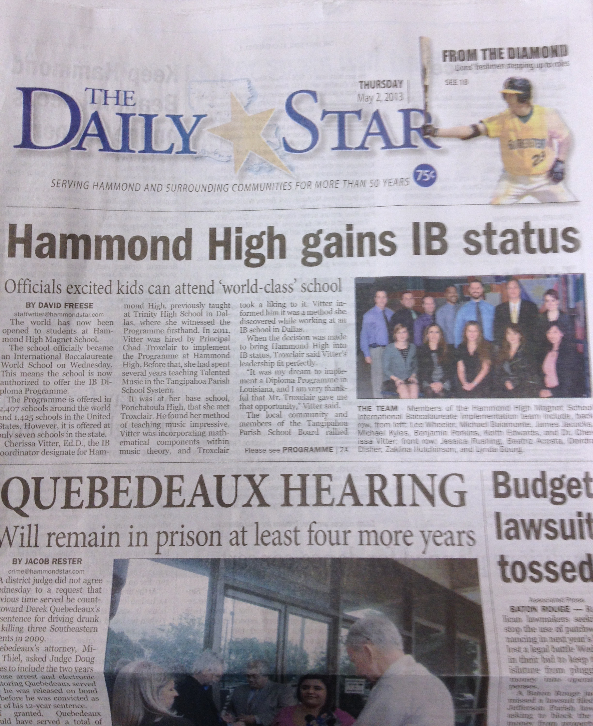

Slide 27
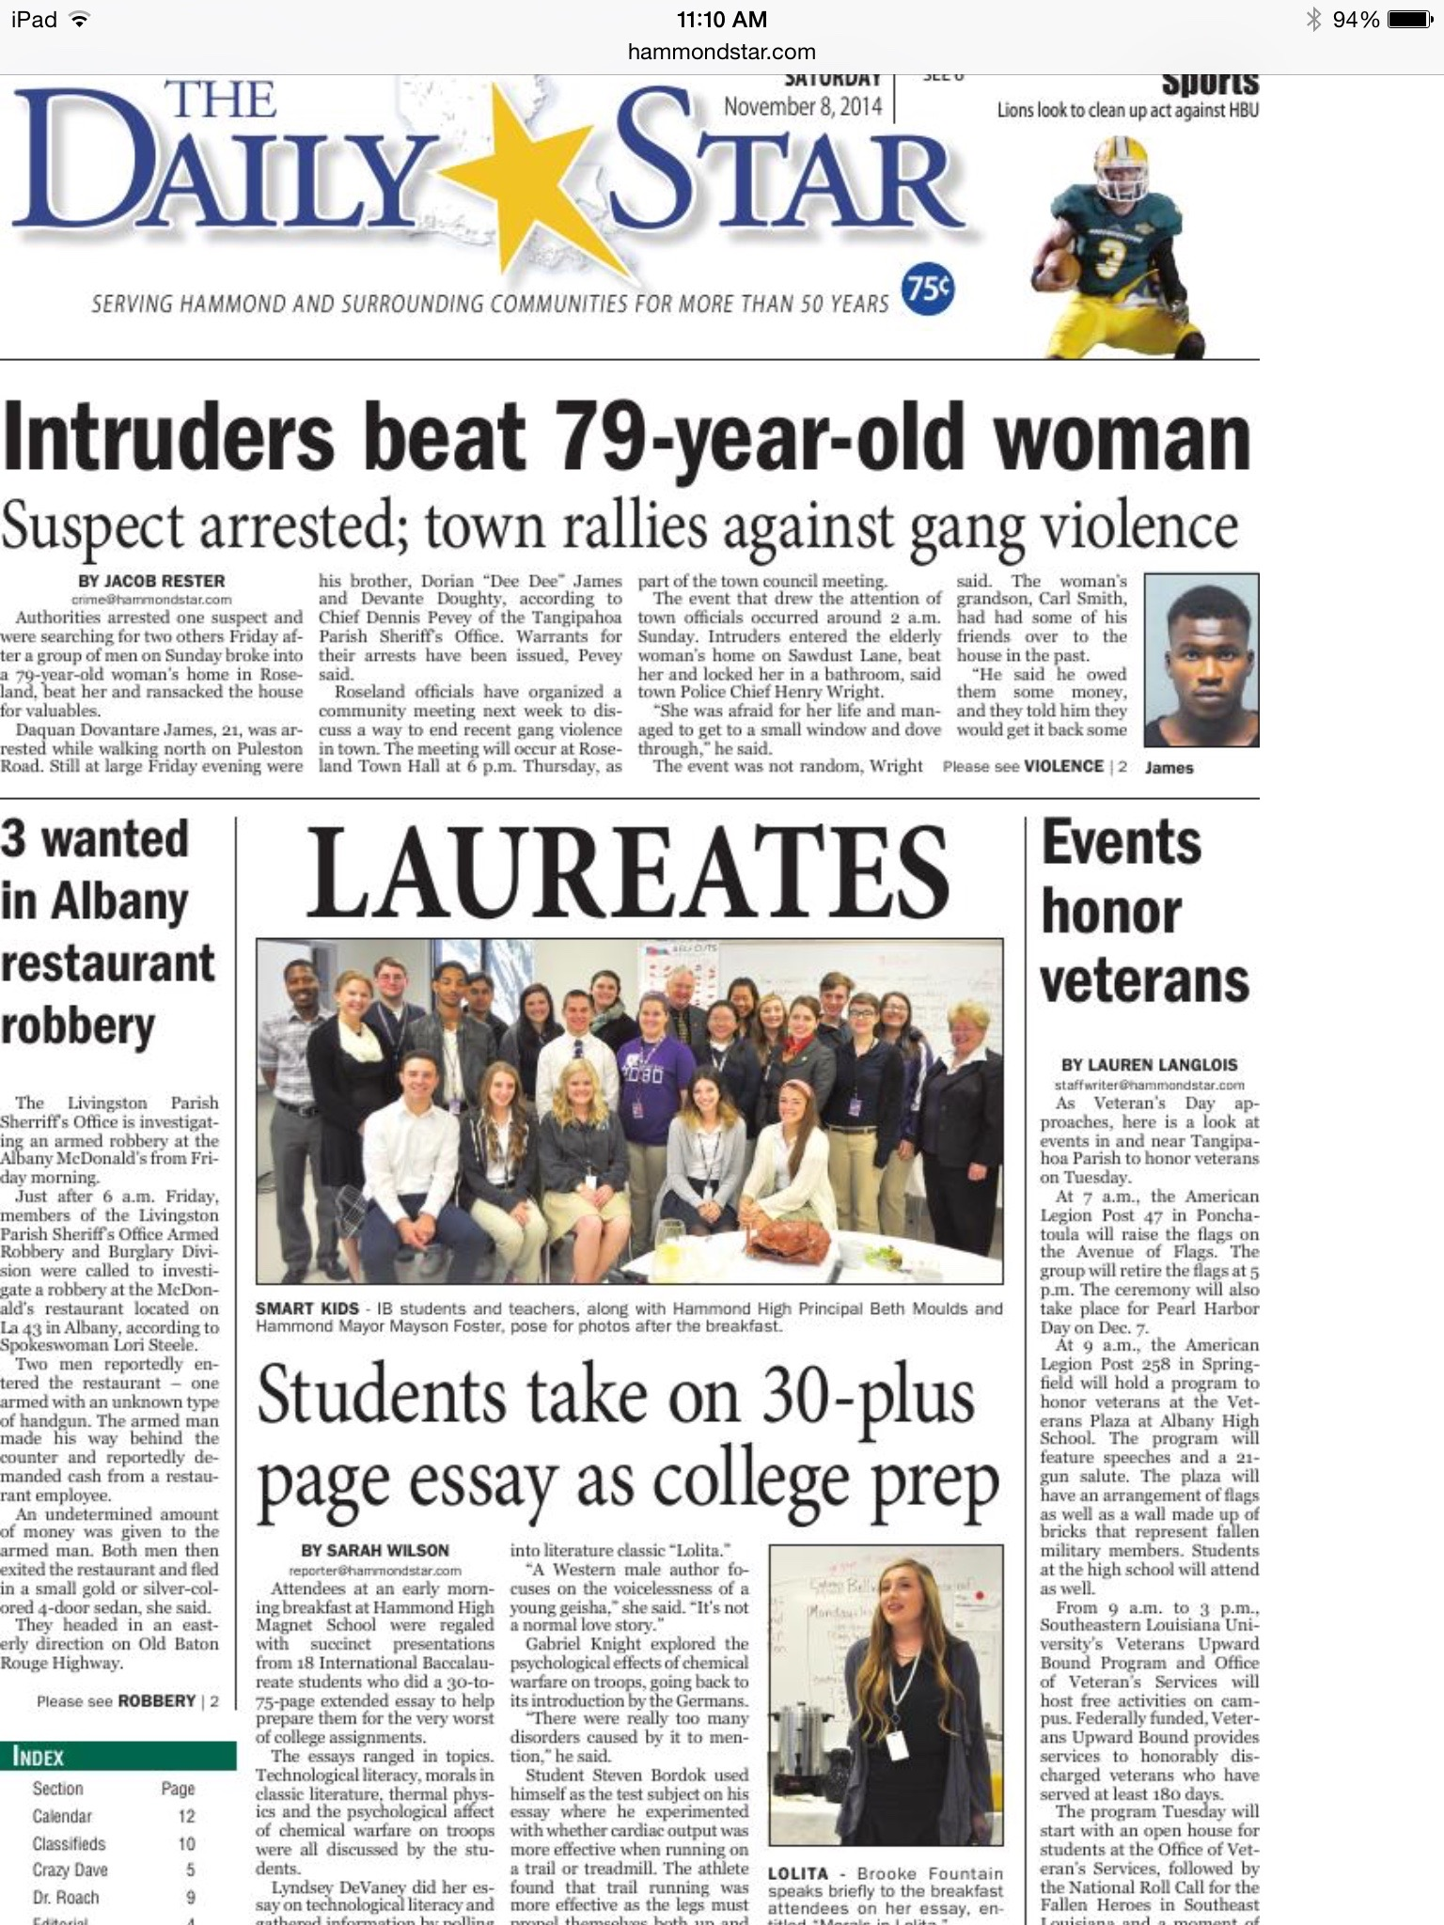
Extended Essay
Exhibition
Personal Project
Reflective Project

Slide 28
References
Boram, W. (1963). The Mass Media of Communication as Extra-School Educative Force. The Journal of Educational Sociology, 36(9), 437-441. doi:1. Retrieved from http://www.jstor.org/stable/2264608 doi:1
Communication, http://www.etymonline.com/index.php?term=communication
"Digital Toolkit." International Baccalaureate®. IBO, n.d. Web. 30 June 2016.
Freese, D. (2013, May 2). Hammond high gains IB status. The Daily Star, p. A1.
"Learner Profile for IB Students | International Baccalaureate®." International Baccalaureate®. IBO, n.d. Web. 10 May 2016PRSA (1982) – About Public Relations, https://www.prsa.org/aboutprsa/publicrelationsdefined/#.V21dGV76zBI
Preston, J. (2013). Community Involvement in School: Social Relationships in a Bedroom Community. Canadian Journal of Education / Revue Canadienne De L'éducation, 36(3), 413-437. Retrieved from http://www.jstor.org/stable/canajeducrevucan.36.3.413
Sanders, M. (2001). The Role of "Community" in Comprehensive School, Family, and Community Partnership Programs. The Elementary School Journal, 102(1), 19-34. Retrieved from http://www.jstor.org/stable/1002167
Wilson, S. (2014, November 8). Laureates: Students take on 30-plus page essay for college prep. The Daily Star, p. A1.

