Slide 2
Primary Years Programme Update

Slide 3
PYP team, IB Americas
Bethesda, Maryland, USA
Michael Clifton, PYP manager
Erich Schmid, PYP associate manager
Buenos Aires, Argentina
Alicia Olea, PYP associate manager
Milagros Barrera, PYP associate

Slide 4
What we do
The PYP School Services team supports schools through the application, consultation, authorization and evaluation processes
We ensure that visits and school support services are carried out in a timely and efficient manner.
We work with other IB teams such as MYP, DP and CP, IB Educator Network, Global School Services, Academic and Progamme development, Finance, Professional Development.

Slide 5

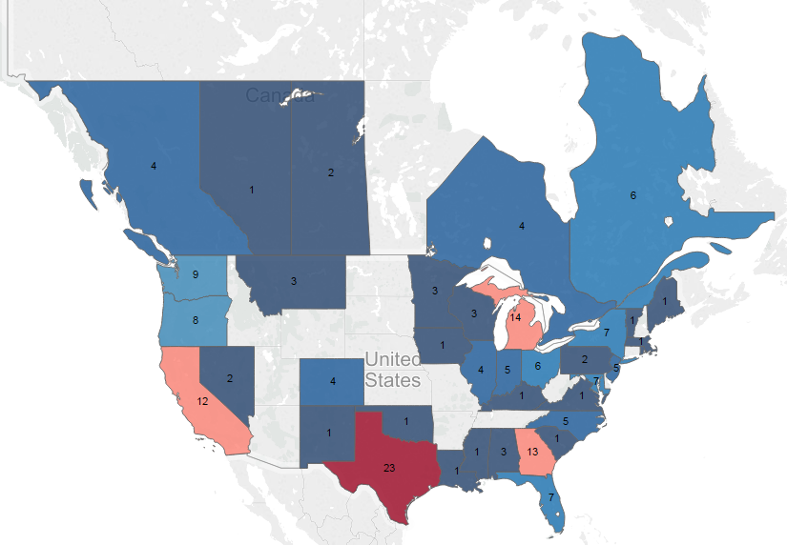

Candidate Programmes in
North America

Slide 6
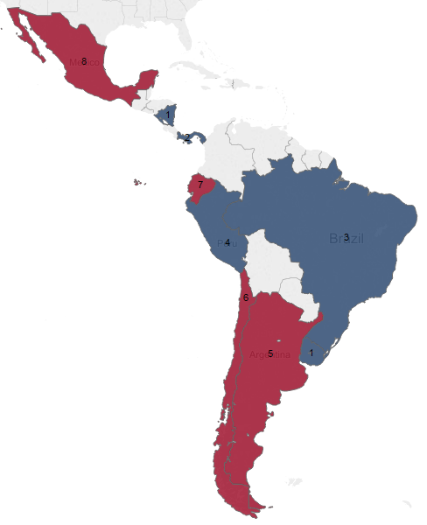
Candidate Programmes in Latin America

Slide 7
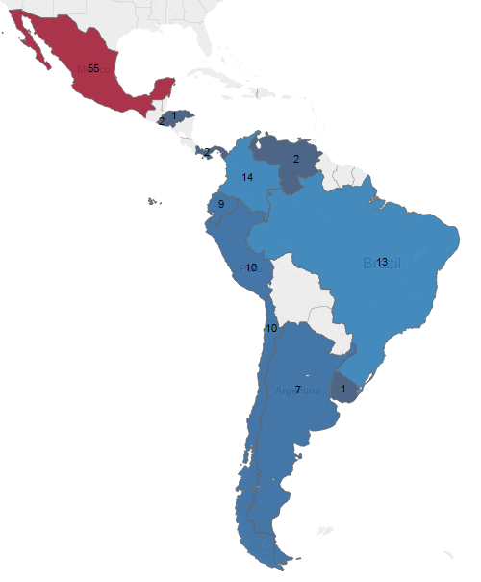
Authorized Programmes in Latin America

Slide 8

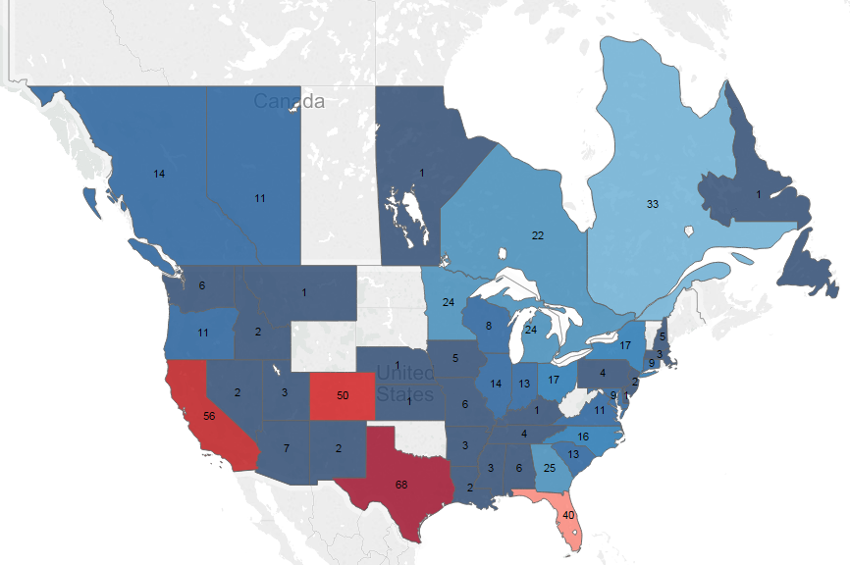
Authorized Programmes in North America

Slide 9

School Enhancement Services
Sean Rankin – Global Head of School Enhancement Services
Notes:
http://www.adweek.com/socialtimes/facebook-announces-ad-targeting-based-on-bandwidth-connection/300645

Slide 10

What are school enhancement services
Optional services aimed at school improvement and effectiveness
  Not required as part of authorization or evaluation
  Support authorization and evaluation
  Affordable
  High access
  Tiered structure
  Highly customizable
  Target specific stakeholders
  Can be bundled
Notes:
Points to highlight:
Optional: school do not have to purchase these services and they are not required as part of the authorization or evaluation process
Support: these services support the authorization and evaluation process, could be used to demonstrate development, evidence etc.
Different buy in points based on how much support is needed
Not a ‘one size fits all’ approach, customized to the schools needs
SES’s can be bundled together
Working with PD to develop bundles with workshops
IMAGE
http://www.gpsinsight.com/wp-content/uploads/2015/12/favicon.png

Slide 11

Building Quality Curriculum PYP
Preparing for mainstream launch
Notes:
IMAGE
http://www.ambermoves.com/wp-content/uploads/2012/07/Stacking-Blocks.jpg

Slide 12
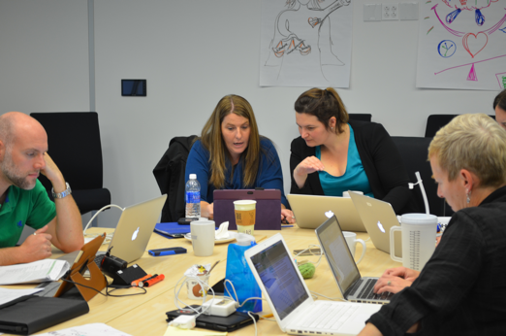
What is Building Quality Curriculum PYP?
Schools receive expert, experienced feedback on PYP programme of inquiry and units of inquiry
Offered to both authorized and candidate schools
Piloted in schools that offer or plan to offer PYP
Notes:
Feedback is provided on individual units as well as the PoI as a whole
Educators have been trained to give feedback with a focus on consistency and clarity of information
Helps candidate schools to develop their curriculum and get feedback on progress at an early stage
Supports authorized schools to review and enhance their curriculum
IMAGE:
http://blogs.ibo.org/blog/2014/12/11/how-would-you-value-feedback-on-curriculum-documents-you-write/

Slide 13
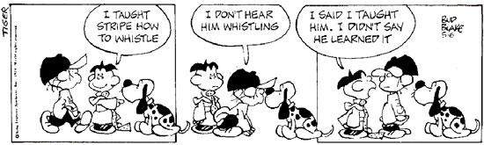
What is Building Quality Curriculum PYP?
Feedback on written curriculum to improve teaching and learning
PYP units of inquiry and POI (6 units across grade levels)
Notes:
Focus of BQC is supporting improvements to teaching and learning. Units and programmes of inquiry must have this focus in order to be effective and impactful.
The BQC submission allows for a sample of units across grade levels as well as looking at the PoI as a whole.
IMAGE
http://3.bp.blogspot.com/-nLD5jKO5OrI/UPXUx2r20ZI/AAAAAAAAAGo/7CZcdINMzUg/s1600/assessment+cartoon.jpg

Slide 14
Key findings on feedback reports
75% found reports moderately or very useful in determining the extent to which PYP units of inquiry and POI are meeting IB requirements
92% found reports moderately or very useful in providing guidance for teachers regarding how to improve their written curriculum
92% found the quality of the reports good, very good or excellent
85% found consistency to be good, very good or excellent. 15% found it to be fair.

Slide 15
Comments from participants
This provided our school with a strong place to start reflecting on all of our units.
This will be useful information as we approach Evaluation!
The information received was excellent. As a first year coordinator, having specific suggestions to take to teachers was extremely helpful. I felt that we were doing better than we were giving ourselves credit for, but we still have a long way to go. Now, with the feedback, I know where to start with my teams.

Slide 16
Mainstream launch progress
Final materials in development
Predicted availability December 2016
Notes:
Predicted cost
The predicted cost structure is:
WAITING FOR INFORMATION FROM ERIN TO FINALISE THE BC AND COSTS
IMAGE
http://www.adweek.com/socialtimes/facebook-announces-ad-targeting-based-on-bandwidth-connection/300645

Slide 17
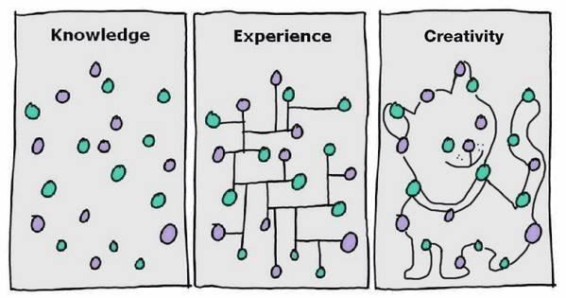
Curriculum Connections
Preparing for mainstream launch
Notes:
IMAGE
http://1.bp.blogspot.com/-1_AO9FElv6E/VLa4Lduc3BI/AAAAAAAAFF4/U8jdo1SnPvA/s1600/Knowledge-Experience-Creativity.png

Slide 18

What is Curriculum Connections?
The curriculum connections service is designed to support a school, or an organization responsible for a group of schools, in making appropriate connections between the respective IB programmes and the local or national requirements that the school or group of schools are required to meet.
Notes:
Highlight it is there to support the school in doing this, not a service that will simply have someone come and do it for them.
Want the school to develop the knowledge and skills to connect their curriculum requirements. Having someone support and guide them through this process develops these capabilities. Having someone do it for them does not.
IMAGE:
http://fiberartspgh.org/guild/node/218

Slide 19
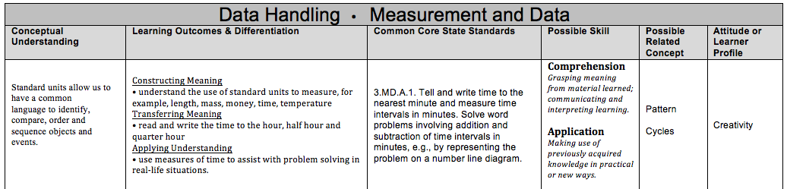
What is Curriculum Connections?
This service provides, information, support, guidance and skill development for the school’s own curriculum development process. In this sense, we have developed a consulting/coaching service to deliver support to a school or groups of schools to connect their local or national curriculum and the respective IB programme(s) they are delivering.
Once purchased the service lasts for up to 12 months
Notes:
The hope is that through this service schools will develop the expertise to repeat it themselves in other areas.
Coaching and development model, as well as a creation and feedback service.
The service lasts for up two 12 months. However, the length of the service is up to the school. They may decide to work intensively and use hours allocated over 2 months (just an example).
IMAGE: From materials developed by Diego Zaragoza Tejas

Slide 20

How is the service structured?
The service has been divided into three strands:
whole programme for school development teams (programme philosophy, concepts, approaches to learning, Learner Profile)
subject/area specific (knowledge, content, subject-specific skills, scope and sequence and curriculum maps)
whole programme for school community (programme philosophy, concepts, approaches to learning, Learner Profile, recognition)
Each strand will consist of three tiered levels of support
Tier 1: Access to the Curriculum Connections document with supporting videos.
Tier 2: all of the above + The school will be allocated a curriculum connections expert who will provide the school with 15 hours remote consultation through online databases, webinars, post-webinar clarification and online support
Tier 3: all of the above + 10 extra hours remote consultation (25 hours total) and a two day on-site coaching visit, as well as pre and post visit support.
Notes:
Three broad areas the service is divided into. From here schools then identify the specifics they would like to look at before being paired with a service provider.
Three entry points based on the level of support needed – for curriculum connections we are looking to give tier 1 away for free
This tier is for schools who would like to see documents and examples of how a local/state/national curriculum has been connected to IB programmes.
T1 These materials will be made available to all school via the public website. Materials will be rotated on a regular basis.
The library will consist of static documents, templates and videos explaining the resources.
At this tier there is no IBE working with the school.
T2: At this tier the school is paired with an IBE that can support their specific request.
The IBE provides 15 hours of remote consultation.
Could be via virtual meetings, providing feedback, document creation etc.
T3: At this tier the school is paired with an IBE that can support their specific request.
The IBE provides 25 hours of remote consultation.
Could be via virtual meetings, providing feedback, document creation etc.
Two day visit is over two consecutive days.
IMAGE
From Curriculum Connections library.
vice is divided into. From here schools then identify the specifics they would like to look at before being paired with a service provider.

Slide 21
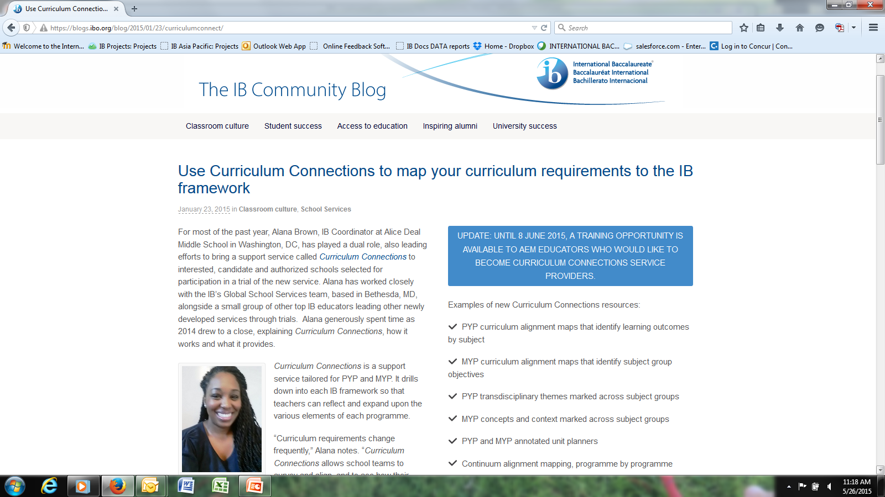
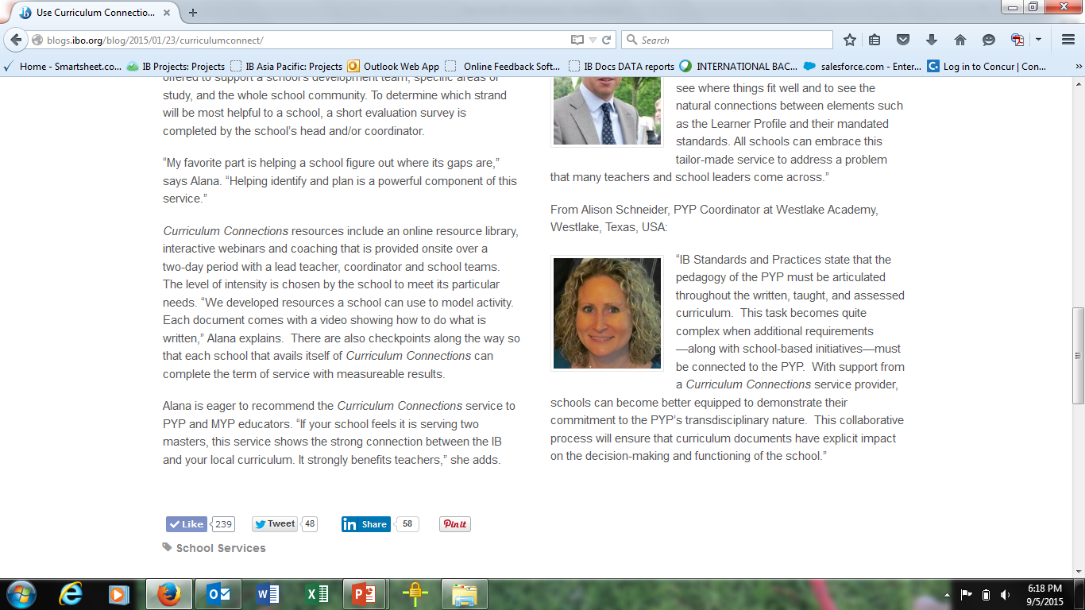
Notes:
- Highlight that the full article can be found on the Community Blog

Slide 22
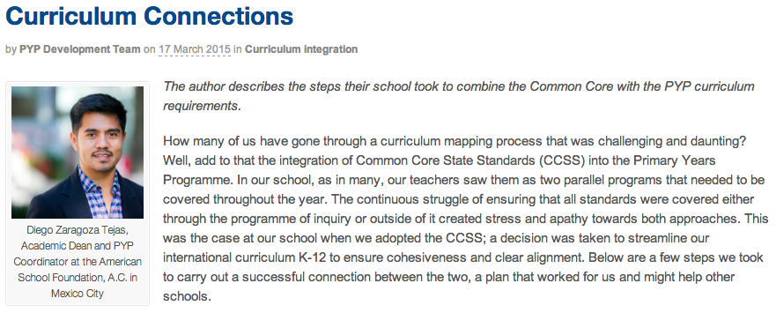
SharingPYPBlog
Article: Curriculum Connections – Integrating Common Core and PYP
Notes:
- Highlight that the full article can be found on the PYP blog.

Slide 23
Mainstream launch progress
Final materials in development
Predicted availability December 2016
Notes:
Predicted cost
The predicted cost structure is:
Tier 3 $4950 USD – Access to documents and videos, 25 hours remote support and two day in-school support visit. (all inclusive of flights and accommodation)
Tier 2 $1750 USD - Access to documents and videos, and 15 hours remote support
Tier 1 $0 USD – These materials will be made available to all school via the public website. Materials will be rotated on a regular basis.
IMAGE
http://www.adweek.com/socialtimes/facebook-announces-ad-targeting-based-on-bandwidth-connection/300645

Slide 24

Consultancy (for authorized schools)
Preparing for mainstream launch
Notes:
IMAGE
http://expertintegratedsystemsblog.com/2014/10/key-themes-from-ibm-insight-2014-migration-services-to-assist-with-data-warehouse-modernization/

Slide 25
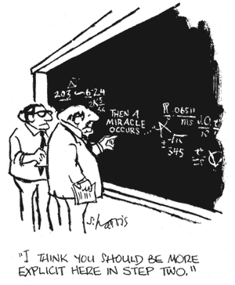
Why design consultancy for authorized schools?
Notes:
For a number of years schools across all programmes have asked for further support once authorized.
The development of this service has been driven by schools identifying a need for structured post-authorization consultancy.
Provides greater support for sustaining and growing IB programmes
Provides greater support for revising implementation in light of subject and programme changes.
Supports schools to strengthen their programme through receiving feedback and advise on areas such as; Focused strategies to build an authentic culture of collaborative planning, Integration and assessment of approaches to learning, A concept-based curriculum, A successful PYP Exhibition etc
IMAGE:
http://star.psy.ohio-state.edu/coglab/Miracle.html

Slide 26
What is consultancy for authorized schools?
The service provides consultancy and support to schools in the period between and in the lead up to evaluation visits. The consultation process can start at any point during this time and can overlap a school’s evaluation visit.
Throughout the consultation, the consultant will support and give advice based on information provided in the current IB publications and his/her professional knowledge of the programme.
Each school is unique and the service will be focused on guiding the school according to its particular identity and situation. The trained educator will focus on areas the school identifies as priorities. These priorities may be large Standard-wide areas; such as teaching and learning, assessment, philosophy etc., or much more specific areas of interest. In supporting the school, the trained educator will also act as a liaison in order to identify further professional development and learning opportunities (IB and non-IB) that support the school’s identified areas of focus.
Notes:
This service will have an overall structure, however schools can identify focus areas and customize the type of support they receive.
The consultant is their to provide feedback, support and advice. However, they will also act as a liaison in order to identify further professional development and learning opportunities (IB and non-IB) that support the schools identified areas of focus.
Currently looking at a tiered structure of support
Tier 1: Access to examples of good practice (documents, videos etc.)
Tier 2: Remote support through a consultant (15 – 20 hours over 12 months)
Tier 3: Remote support through a consultant (25 – 30 hours over 12 months) and a two day face to face consultation visit.

Slide 27

Progress – Design and development phase
A team of 39 experienced educators from newly authorized, established, long standing and foundation IB World Schools; the majority of which have previously been trained as pre-authorization consultants, engaged in design and development discussions for the service.
The culmination of these discussion was a four day meeting in late June where 8 of these educators in conjunction with internal representatives from Programme Development, School Services, Assessment, Development, IBEN and Professional Development worked towards finalizing the service.
Notes:
The team of 39 educators is currently engaging in design and development discussions.
The team is cross programme and cross regional
The team has already highlighted that many of the ongoing implementation issues schools are facing span across all regions
They identified 12 broad areas of support for this service
Schools will be able to customize and specialize their focus within these broad areas
IMAGE: http://www.oscarbarajas.com/images/infographic.png

Slide 28
Service focus areas
1. Strengthening standards and practices implementation
2. Programme implementation sustainability
3. Collaborative leadership
4. Collaborative planning
5. Philosophy integration
6. Unit planning/course planning
7. Assessment
8. Programme changes
9. Professional learning opportunities
10. Role of the coordinator
11. Approaches to learning and approaches to teaching
12. Curriculum Innovation
Notes:
The educators and staff working on the service have agreed on 12 overall focus areas for the service. Within these broad areas schools will be able to specify the support they are looking for. The school will then be paired with an IBE with experience and expertise in this area.

Slide 29
Mainstream launch progress
Final materials in development
Predicted availability December 2016
Notes:
What will the service cost?
The cost for this service will be determined once the service is finalized
IMAGE
http://www.adweek.com/socialtimes/facebook-announces-ad-targeting-based-on-bandwidth-connection/300645

Slide 30

Questions and further information
For further information on any of the School Enhancement Services please email
Sean Rankin – Global Head of School Enhancement Services: sean.rankin@ibo.org
Notes:
IMAGE: http://thecrowdedhouse.net.au/wp-content/uploads/2011/11/Screen-shot-2011-05-19-at-10.11.10-AM.png

Slide 31
Professional development news
2017 PYP Webinars:
Demystifying transdisciplinary learning
Creating inclusive learning environments
Technology and student agency
Self-assessment and peer feedback
Notes:
1. What does transdisciplinary learning mean in the PYP? How does disciplinary learning support and strengthen a transdisciplinary approach?
2. Discover how to evaluate the needs and plan for an inclusive learning environment for all stakeholders within your educational setting.
3. Technology enables all students to express themselves in multimodal ways and to be active participants in a variety of local and global communities.
4. Help learners assess how they think and learn and make judgments on the quality of their own work and the work of others. Explore strategies to encourage self-assessment and peer feedback to improve learning outcomes. Consider what high-quality self-assessment looks like, the important role of peer feedback (over peer assessment) and how to implement both into a PYP classroom.

Slide 32

Professional development news
New category 3 workshops
Transdisciplinary learning for subject specialists
The Teaching assistant, a vital role
New online workshops (coming soon)
Digital learning
The Role of Mathematics
Notes:
As for Category 1, all Cat 1 workshops now have a planner for early years and are being translated into Spanish and French
1- – this is the same workshop as Transdisciplinary learning but aimed at subject specialist from all specialist areas such as Art, Drama, Music, even Mathematics.
2 – a new workshop for teaching assistants, could be an in school, district or regional.

Slide 33
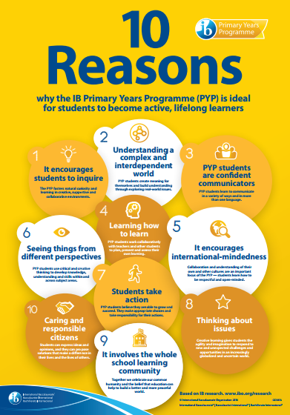
New in the IB Digital Toolkit
Videos
  The PYP in practice
  The PYP in an Early Years Setting
Brochures and Posters
  The PYP in an Early Years Setting
  10 Reasons PYP
PYP presentations, logos, banners
Check out www.ibo.org/digital-toolkit/

Slide 34


Slide 35

My School
Rollout Timeline
School Profile: Launched October 2015
Application for Candidacy: Launched April 2016
Application for Authorization: Projected launch Q1 2017
Evaluation Self Study Questionnaire:
Projected launch 2017

Slide 36
My School
Next Steps for Schools
Interested Schools
Sample Applications for Candidacy are available on IBO.org.
Follow instructions provided by your regional office to access the Application for Candidacy via My School at the appropriate time.
Contact IB Answers with questions:
    Email: ibid@ibo.org
    Web: https://ibanswers.ibo.org
    Skype ID: IBAnswers

Slide 37
My School
Next Steps for Schools
Candidate Schools
If you began candidacy in IB Docs (schools who applied in October 2015 and previously), you will complete authorization in IB Docs.
If you began candidacy in My School (schools who applied in April 2016 and after) you will complete authorization in My School.
Contact IB Answers with questions:
    Email: ibid@ibo.org
    Web: https://ibanswers.ibo.org
    Skype ID: IBAnswers

Slide 38
My School
Next Steps for Schools
Authorized Schools
Log in to My School and update your school’s information as needed.
Follow instructions provided by the IBA Regional Office regarding the completion and submission of your self study.
Contact IB Answers with questions:
    Email: ibid@ibo.org
    Web: https://ibanswers.ibo.org
    Skype ID: IBAnswers

Slide 39
PYP Evaluation News
Submission date | Self-study | Platform
1 December 2016 | Programme evaluation guide and self-study questionnaire – 2010 | IB Docs
1 June 2017 1 December 2017 | Programme evaluation guide and self-study questionnaire- (For use from January 2016) | IB Docs
Notes:
The Word version of the 2016 self-study document will be available on the OCC in August

Slide 40
PYP Academic Review

Slide 41
Five Areas of Focus
Programme Principles
Language
Transdisciplinary Framework
Structure and Articulation
Assessment
Notes:
Through consultation and educational research, 5 areas have been identified as needing
additional guidance.
Structure and articulation
Language
Programme Principles
Assessment
Transdisciplinary framework
The PYP development team is addressing these five areas through creating enhanced
guidance and support materials.

Slide 42
What can you expect?
Revised guidance that:
better addresses the needs of all students;
is easier for teachers to implement;
is more flexible for schools.
Notes:
Three considerations have emerged to guide these programme enhancements. We
need to better address the needs of all students, including a focus on early years and
students who are multilingual. The programme principles and practices need to be
clearer and easier to implement. Some of the ways we are doing this will be highlighted
in this and future updates. And finally, we need to consider more flexible solutions and
support to existing schools and for new schools interested in taking up the PYP.

Slide 43


Easier for teachers to access information
Digital One-Stop Shop
Notes:
One enhancement that will occur is the move away from separate PDF documents. You
can look forward to a digital interactive experience where you will be able to find all the
current information you need to implement the programme and links to access further
support.

Slide 44
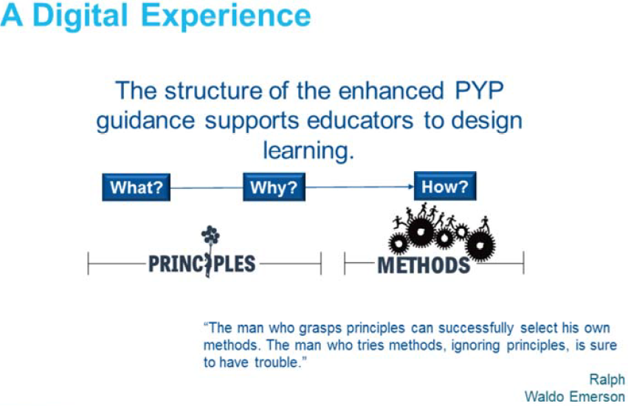
Notes:
This digital experience will allow for a clearer and more consistent explanation of the
what and why of the PYP (the philosophy and educational principles on which it is
based) and ensure that teachers will develop a better understanding of the programme.
As you navigate through and interact with this resource you will see illustrations of
practice to help you design learning and teaching for your context. You will be able to
chose your own pathway into and through the resource based on your needs.
7

Slide 45
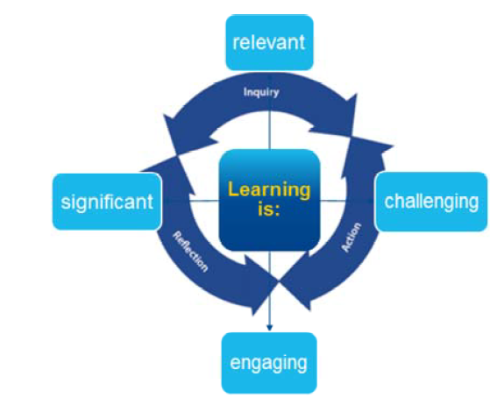
What is evolving?
Notes:
We talk about PYP learning as: relevant, challenging, significant, and engaging, but it is
hard to know what is meant by these descriptors—we realize that school communities
try to work it out for themselves.
In the new digital experience we will illustrate what we mean by these descriptors so
that we have a shared understanding across all PYP schools. Teachers and students will
take an active role in learning experiences by collaboratively activating the learning
process of inquiry, action and reflection.

Slide 46
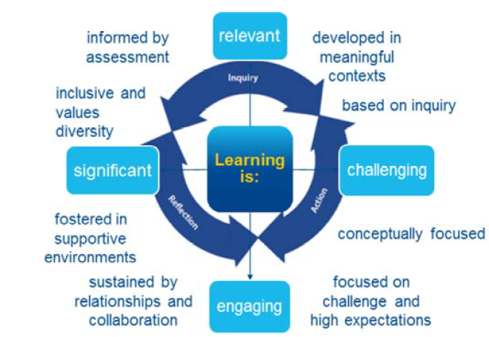
What is evolving?
Notes:
We talk about PYP learning as: relevant, challenging, significant, and engaging, but it is
hard to know what is meant by these descriptors—we realize that school communities
try to work it out for themselves.
In the new digital experience we will illustrate what we mean by these descriptors so
that we have a shared understanding across all PYP schools. Teachers and students will
take an active role in learning experiences by collaboratively activating the learning
process of inquiry, action and reflection.

Slide 47
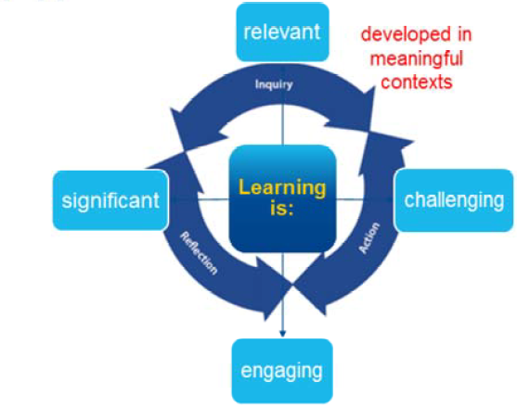
Principles for learning and teaching in the PYP
Notes:
A set of 8 principles for learning and teaching permeate the PYP. These principles have
always been part of PYP learning and teaching but not explicitly featured.
In the 2018 digital resource, you can expect these PYP principles to be clearly stated and
through applying them, teachers and students will design learning that is significant,
relevant, challenging and engaging.

Slide 48
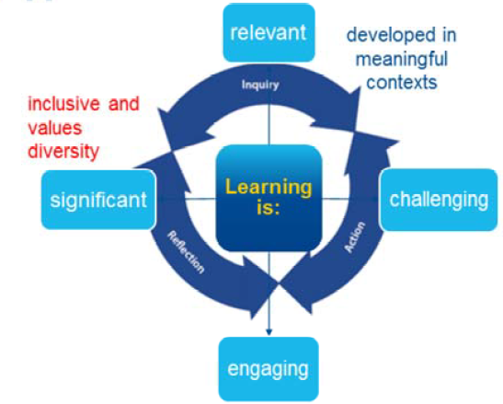
Principles for learning and teaching in the PYP
Notes:
Learning recognizes and values diversity and is sensitive to the characteristics, qualities
and capacities we bring to learning.

Slide 49
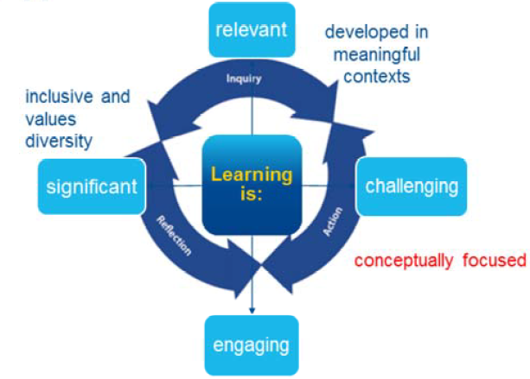
Principles for learning and teaching in the PYP
Notes:
Concepts and the development of conceptual understanding are at the core of the
design for learning and teaching in the PYP.
Conceptual learning is a process through which the learner constructs thinking
connecting to previous concepts (prior knowledge and experience) and applying new
concepts in creative and innovative ways.

Slide 50
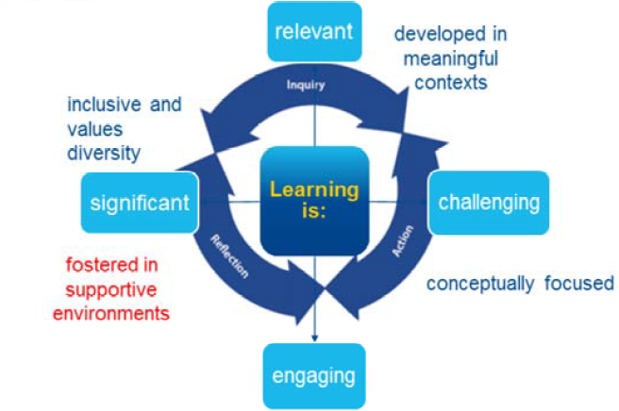
Principles for learning and teaching in the PYP
Notes:
Learning occurs in environments that promote collaboration and a shared sense of
purpose, inspire creativity and innovation, and allow for experimentation and failure.

Slide 51
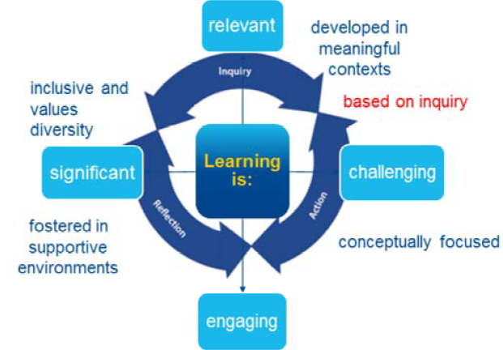
Principles for learning and teaching in the PYP
Notes:
Learning through inquiry builds on our innate curiosity to explore and investigate.
At the heart of inquiry, meaning is actively constructed and learning is seen as a social
process. This is a new feature we will be emphasizing.

Slide 52
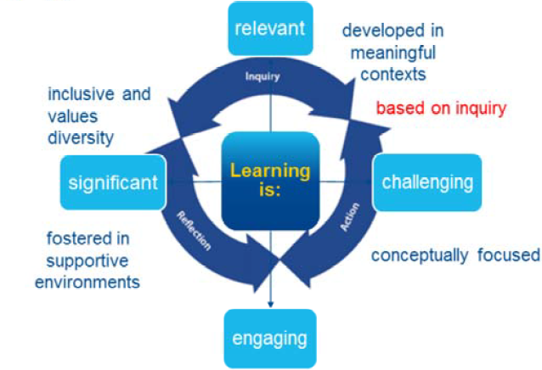
Principles for learning and teaching in the PYP
Notes:
Learning through inquiry builds on our innate curiosity to explore and investigate.
At the heart of inquiry, meaning is actively constructed and learning is seen as a social
process. This is a new feature we will be emphasizing.

Slide 53
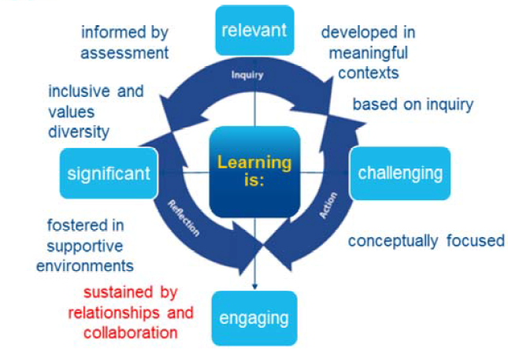
Principles for learning and teaching in the PYP
Notes:
Learning is a social practice generated through interactions and shared experiences
between students, with students and teachers, and within and beyond the learning
community.
Students demonstrate their capacity to take action as they work collaboratively with
teachers and other students to plan, present, review and assess their own learning.

Slide 54
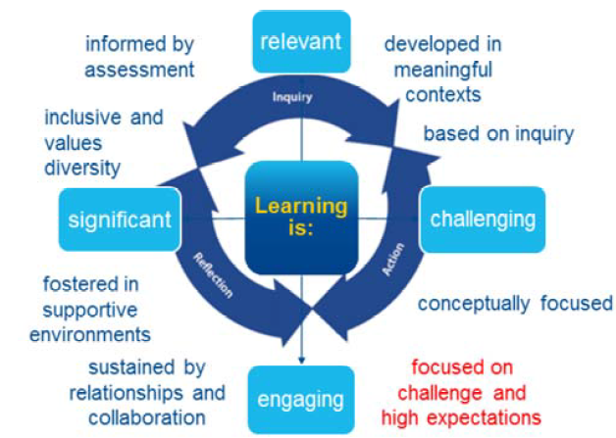
Principles for learning and teaching in the PYP

Slide 55
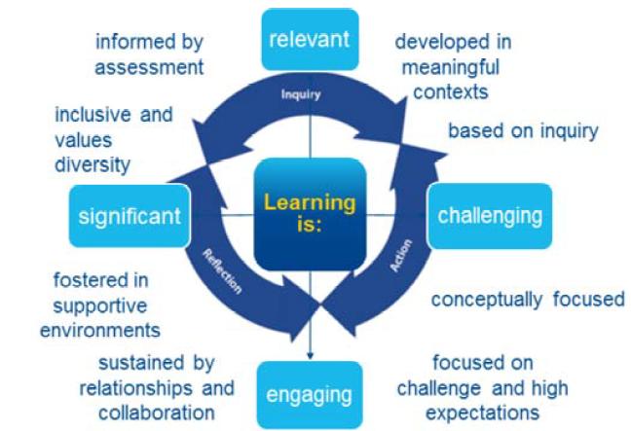
Eight Principles for learning and teaching in the PYP
Notes:
The understanding of how people learn has shaped a set of 8 principles that permeate
the PYP in a way that help design learning that is significant, relevant, challenging and
engaging and support the characteristics of an IB education.
We hope this update has helped you better understand the progress the PYP
development team has made in relation to the PYP principles to be outlined in the
upcoming 2018 launch of the digital, one‐stop resource.
Please keep in mind that PYP development work is ongoing and some information
provided in this presentation can be subject to change.

Slide 56

Notes:
And as the review moves towards finalization, the IB will also ensure to guide existing
PYP schools, IB Educators network members, teachers and school leaders throughout
the roll‐out process.
Relevant IB global divisions such as Schools Services, Professional Development and
Programme Development are working together to roll out the enhanced programme and
to develop support for existing PYP schools, workshop leaders and teachers.

Slide 57
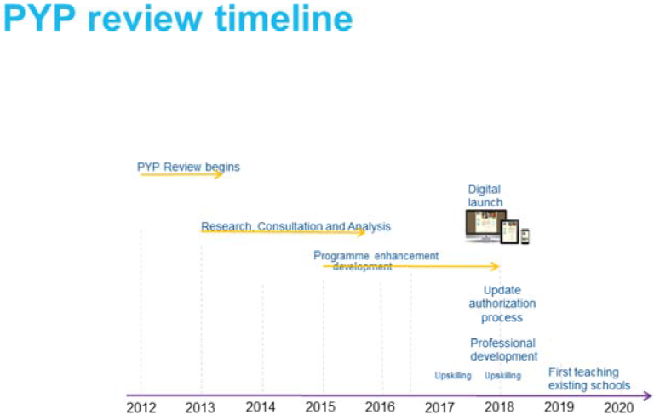
Notes:
You can look forward to IB Professional Development preparing educators for
enhancements in the curriculum so that you are ready for first teaching.
Once the programme development part of the review is complete and the PYP
programme requirements are confirmed, the IB will establish how schools will provide
evidence of implementation.

Slide 58

Notes:
We are committed to frequent and clear communication during this important period in
which the PYP continues to develop.
The SharingPYP blog is used to support communication about the PYP review; a full
overview of the PYP review process and Q&As have been published there, including
reports on consultation and collaborative activities that have taken place so far.
In addition, the IB will continue to communicate updates, activities and developments
relating to the PYP review through the online curriculum centre, IB eNewsletters and
direct emails.
Members of the PYP team are attending IB regional conferences in 2016. We would like
to invite all those attending the conferences to join our sessions and stop by the PYP
table to meet us and ask questions about the programme.
34

Slide 59

Keep in touch!
PYP Team iba.pyp@ibo.org​
IB Answers ibid@ibo.org
Questions?

