Slide 1
Case Study of School/University Initiatives
Creating Collaborative Partnerships
2016 IB Conference of the Americas,
Toronto, Canada
July 14-17, 2016

Slide 2
Presenters
Martha Lash, Ph.D., Associate Professor, early childhood education and IBPYP coordinator; coordinates partnerships with IB public schools, KSU Child Development, and Canadian PYP World School, KSU Director, Consortium for Overseas Student Teaching: mlash@kent.edu
Monica Miller Marsh, Ph.D., Associate Professor, KSU, and Director/Head, KSU CDC; teaches early childhood education program; co-editor of the Journal of Family Diversity in Education
Rochelle Hostler, M.A., Lecturer and PYP Coordinator, KSU Child Development Center (IB Candidate School): rhostler@kent.edu
Robin Dever, Ph.D., Assistant Professor, middle childhood education/MYP Coordinator; program coordinator of middle childhood education KSU-Geauga. President Ohio Middle Level Professors: rdever2@kent.edu

Slide 3
Participants will:
Learn about establishing and sustaining partnerships between universities, PreK-12 schools locally and internationally.
Have opportunities to examine how one university’s relationship with IB programs ranging from PreK through MYP has developed into a mutually beneficial relationship.
Explore options of how they can begin to form school/university partnerships with their own school context(s).

Slide 4


Introducing you to Kent State University. . .
Public school founded in 1910 as a Normal School.

Slide 5
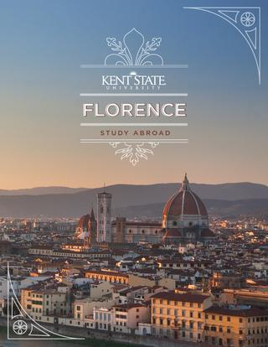
Kent State: Local and Global
Large presence in NE OHIO with 8 geographically dispersed campuses
Presence GLOBALLY with offices in Beijing and New Delhi
Academic centers in Florence, Italy and Geneva, Switzerland, as well as New York City.

Slide 6
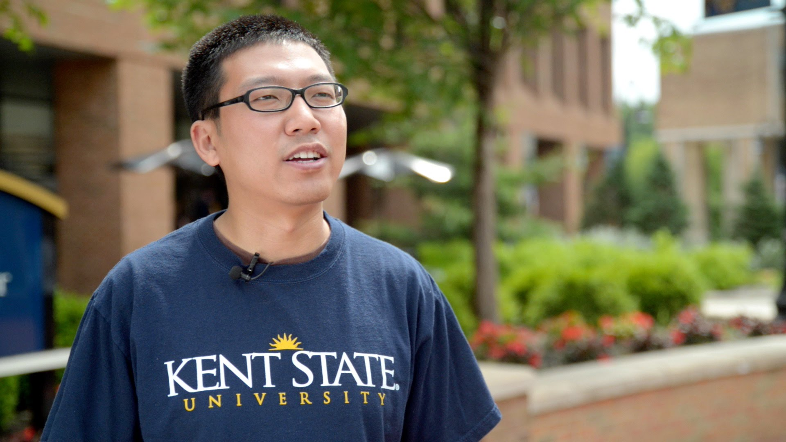
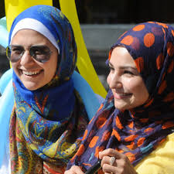
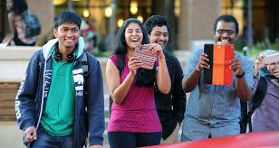
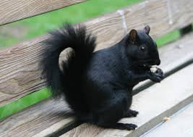
Kent State
45,892 students overall
28,981 students at the Kent Campus
3002 international students at the Kent Campus
Dozens of Black Squirrels from Canada

Slide 7
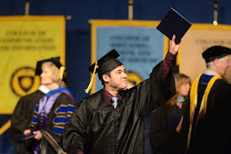
Academics at Kent State
Offers 280 bachelors’ degrees
50 master’s programs in 100 areas of specialization
23 doctoral programs in 50 areas of specialization
International Certificate in the Higher Education administration Program

Slide 8
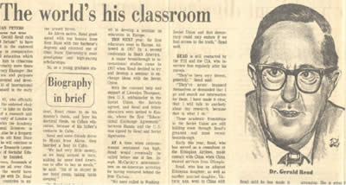
Legacy of International Education at KSU
Gerald H. Read, founding member of the Comparative and International Education Society & the World Congress of Comparative Education Societies
Center for International and Intercultural Education

Slide 9
Dr. Martha Lash
Associate Professor
PYP Program Coordinator
KSU Director, Consortium for Overseas Student Teaching

Slide 10

KSU Early Childhood Program
First in the Americas
To embed the IB PYP program into undergraduate education for all students in the program

Slide 11
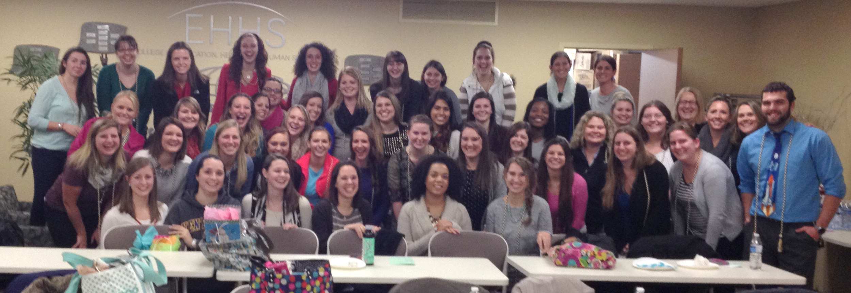
KSU ECED Graduates of 12/14 (and forward) earn IBPYP Certificate T& L --Awarded KSU/IB Graduation Cords.

Slide 12


Kent State IB-PYP Program
Selective admissions of 50 students/semester for 250-300 active students at any time; (plus two regional campuses in Appalachia counties of Salem and Tuscarawas)
Approximately 50% of all KSU students are first generation college students; mostly European-American.

Slide 13
Kent State IB-PYP Program
ECE is a five block (semester) program after students have finished Kent Core (basic university course requirements)
Blocks I and II are foundational and early years oriented; and Blocks III-V build on and expand this foundation in primary years focus
All blocks include intensive reading, writing, and field experience/student teaching to solidify the theory and practice.
~1400 field/student teaching hours in schools

Slide 14
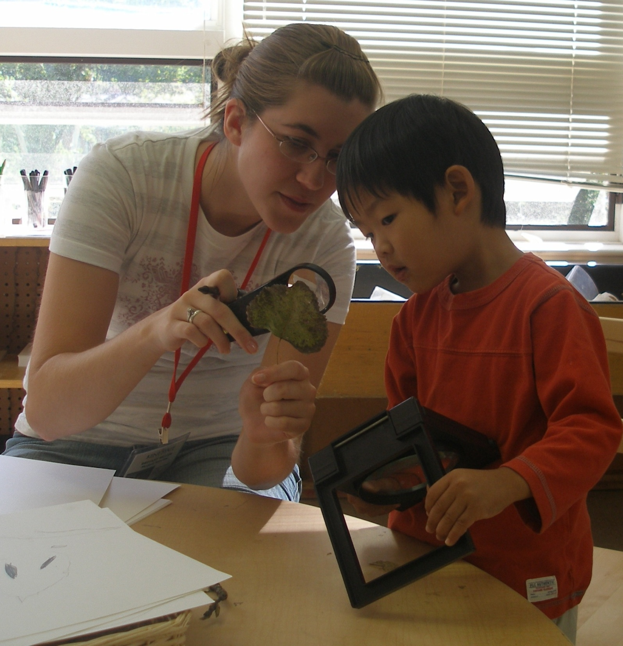
Partner and Collaborate for Field-based Learning
Collaborate with NE Ohio World Schools
Shaker Heights Schools
Akron Public Schools
Oberlin Public Schools*
Stow Monroe Falls-Indian Trail
KSU Child Development Center
And in Toronto, Canada
  Sunnybrook School
  The York School
  Branksome Hall
  Upper Canada College
  Harrison Public Elementary
  Cedarvale Public Elementary

Slide 15
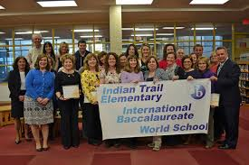
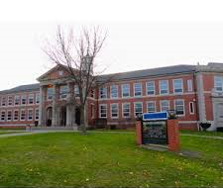
Thank You Ohio Network Schools

Slide 16

Early Childhood Education Short-term Study Abroad in Toronto, Canada, one of the most culturally diverse cities in the world!
Earn 3 credit hours: ECED 40123 Critical Inquiry into Integrated Curriculum in the Primary Years
Learn about the Canadian Education System as well as social, political, cultural and economic policies
Visit International Baccalaureate (IBPYP) World Schools
Tour cultural and ethnically diverse sites of the city
Visit Niagara Falls
Learn about our shared border and our shared resource: Water

Slide 17

International Field Trips to Canadian IB Schools
Harrison World School

Slide 18
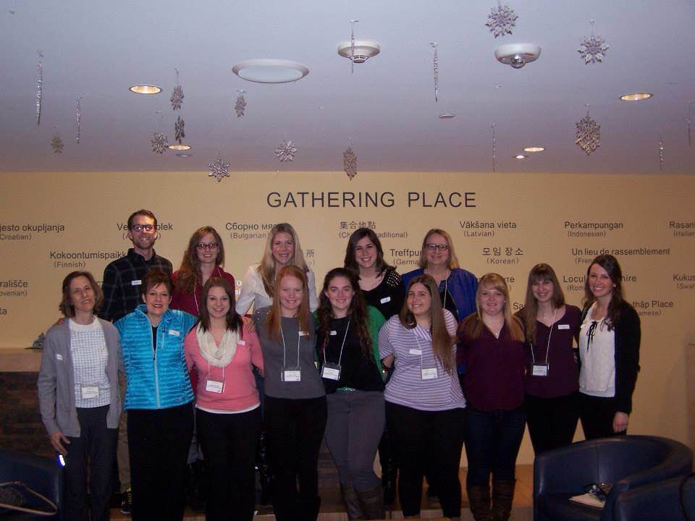
Learning from Experienced IBPYP Schools…..
…..and enjoying new experiences

Slide 19

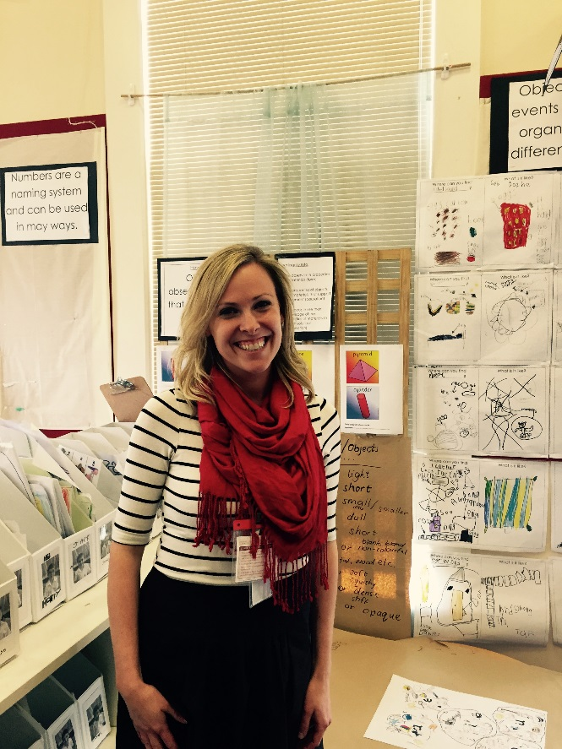
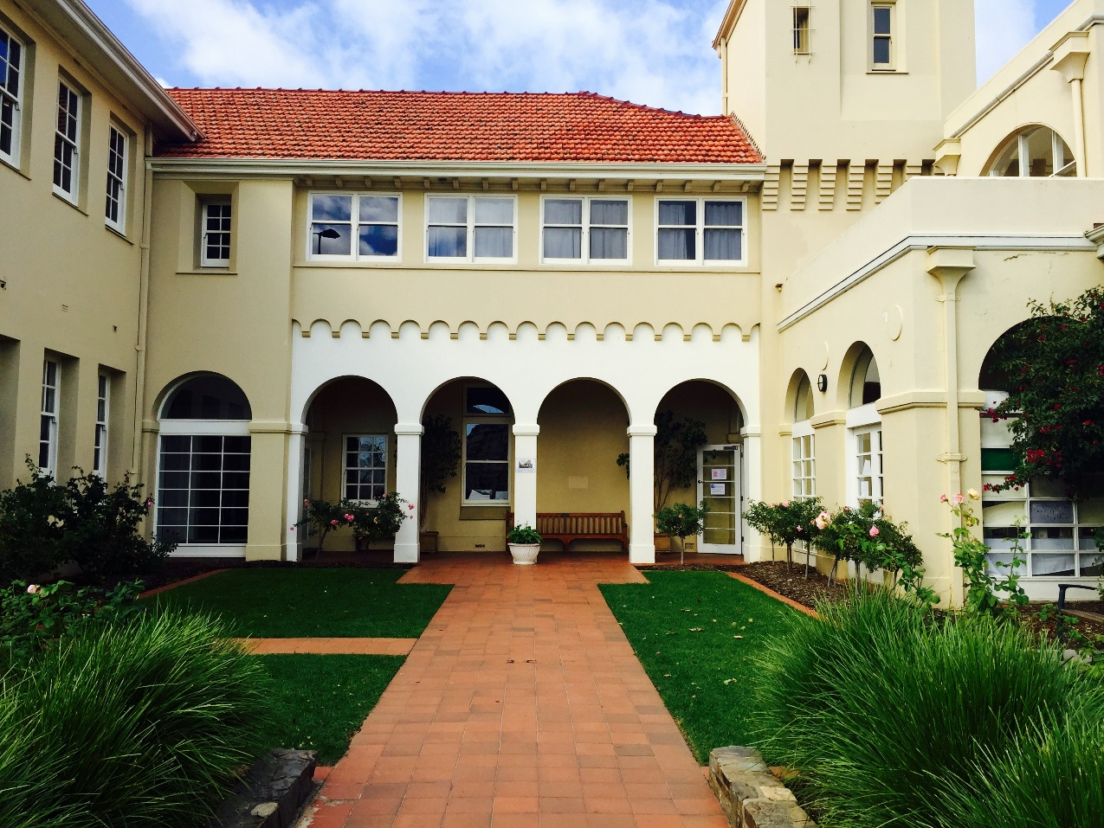
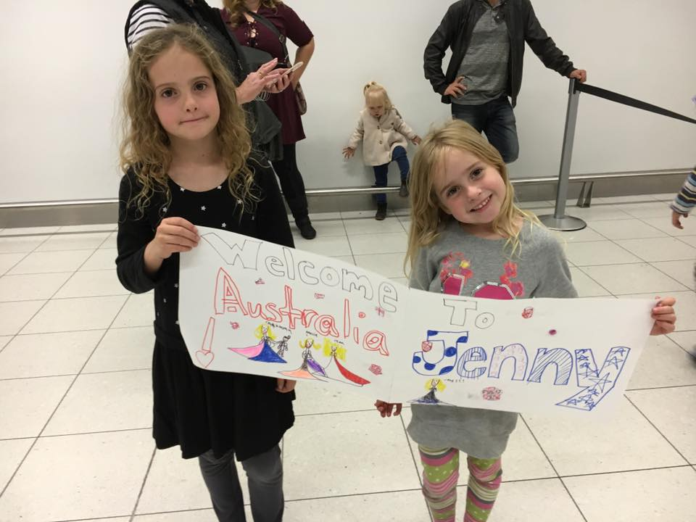
Student Teaching: PAC IB World School, Adelaide, Australia
Jenny, earning IBEC Certificate
Homestay Family Provides a Welcome!

Slide 20
Advantages to partnerships
Significant gains to understanding IBPYP from touring and having a field or student teaching experience in an IBPYP World School
Students connect to seeing the IBPYP curriculum framework in the written, taught, and assessed way that the schools enact.
Students appreciate talking to teachers, observing/participating in collaborative planning meetings, seeing inquiry in action
Talking to the mentor teachers about day to day, weekly, monthly, and school year principles and practices
Mentor teachers gain through articulation of the philosophy to the preservice teachers, sharing work, having a “knowledgeable” IBPYP student in their classrooms.
Get to experience a constructivist, inquiry-based school which matches the theory they are receiving in their early childhood educataion coursework.

Slide 21
Challenges Posed, Addressed, and Continuing
Location of PYP schools (distance/size)
Availability of PYP schools (# students in classroom/school)
Coordinating MANY placements for many students in a variety of schools
Getting the regional campuses to have the IB experiences
Getting the amount of hours/days in the schools as desired/required
Having appropriate assignments

Slide 22
Thanks our partner IB World Schools
who accept our students for
field experiences and student teaching.
Internationally and in the State of Ohio

Slide 23
Dr. Monica Miller Marsh
Associate Professor & Director
Kent State University Child Development Center
Rochelle Hostler, M.A.
Lecturer & IBPYP Coordinator
Kent State University Child Development Center

Slide 24
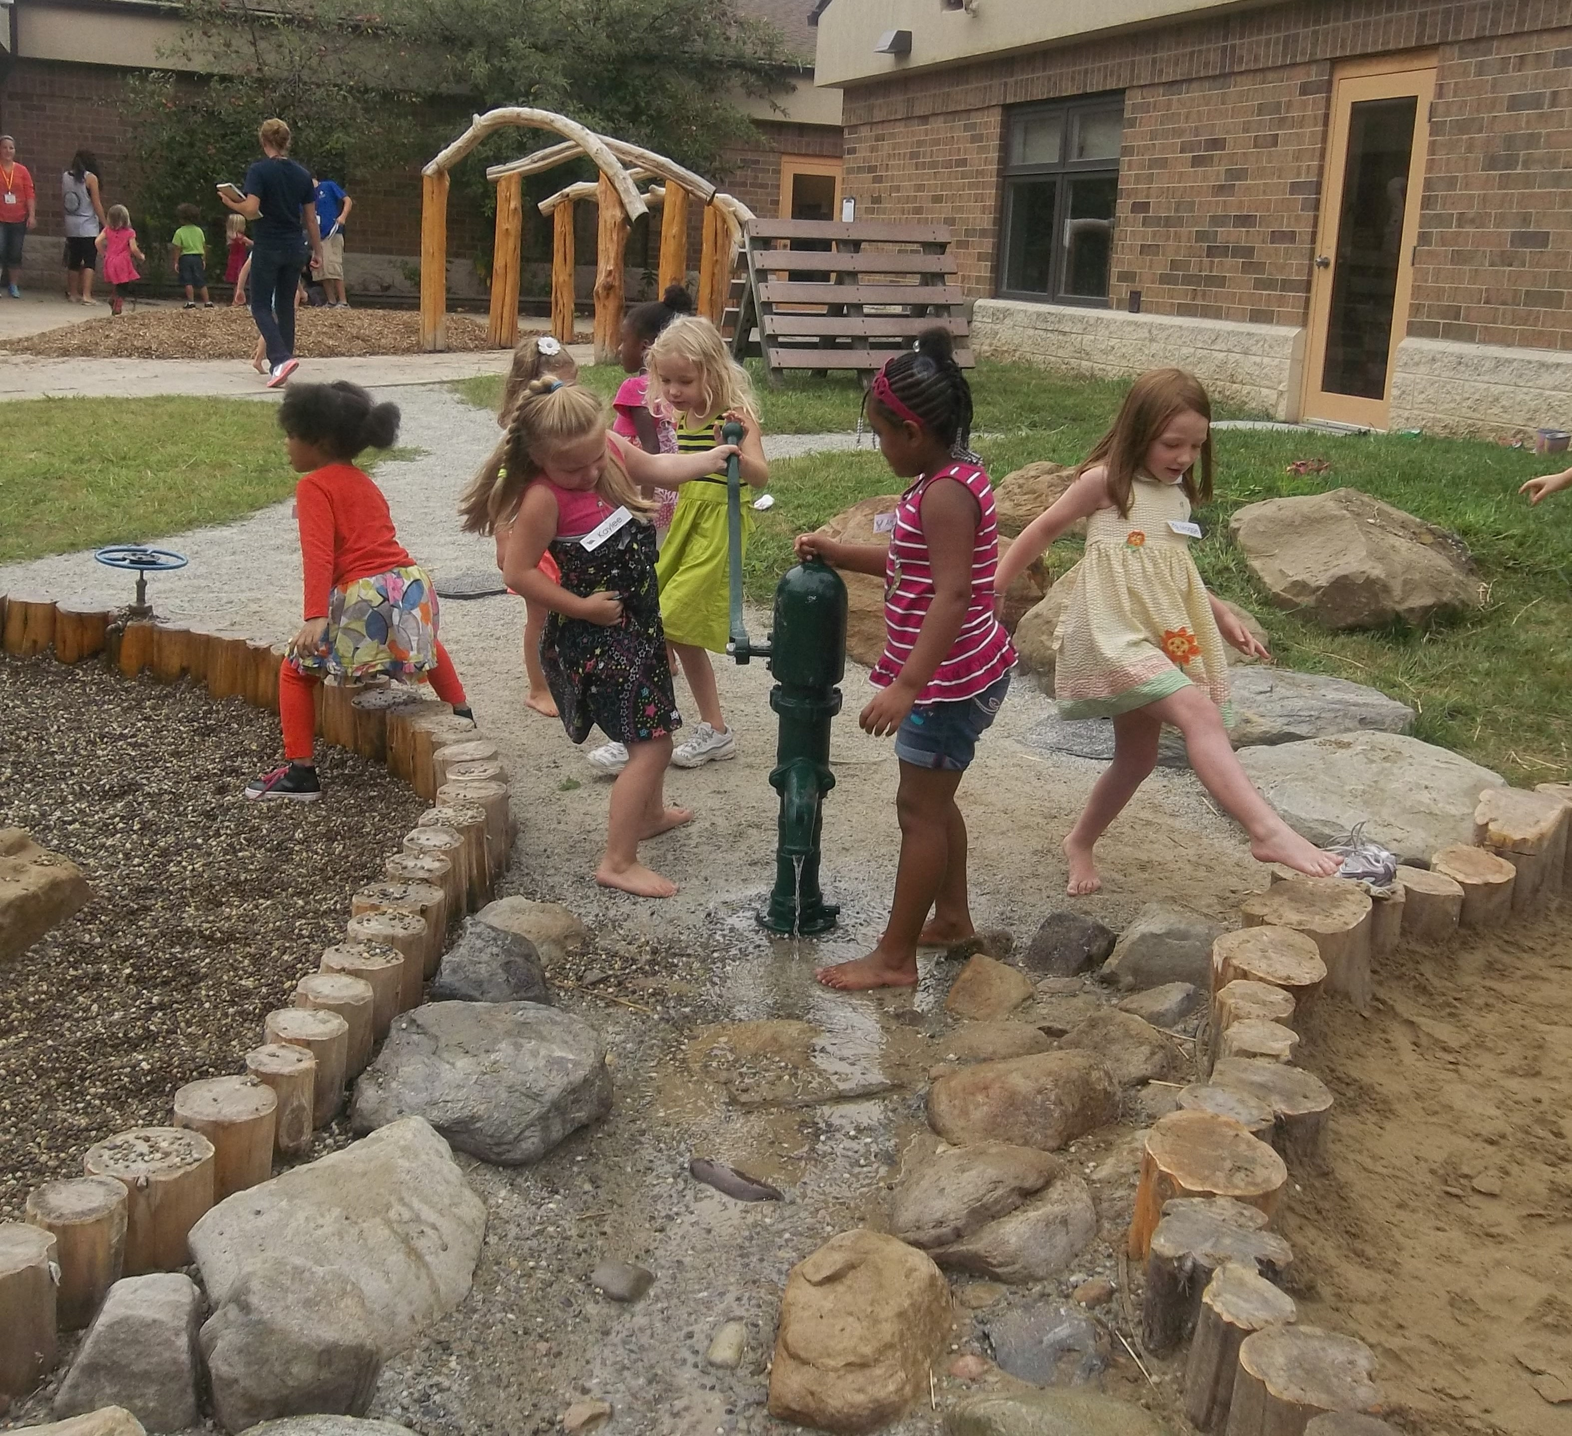
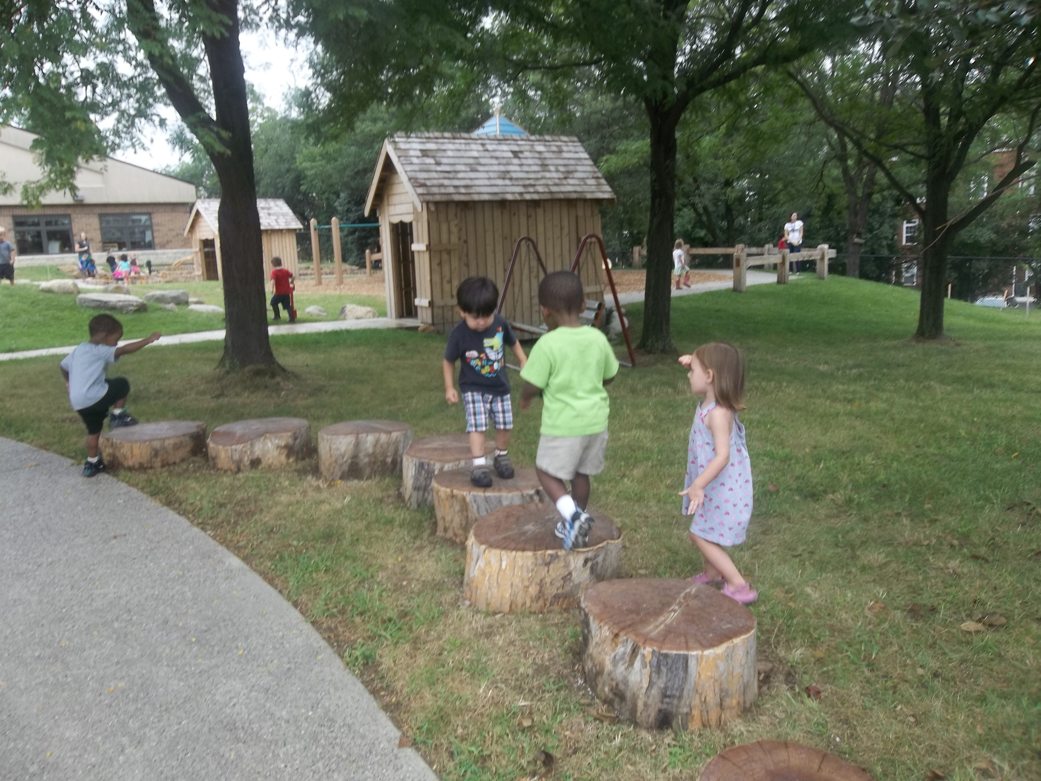
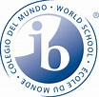
KSU Child Development Center
Early Years Program

Slide 25
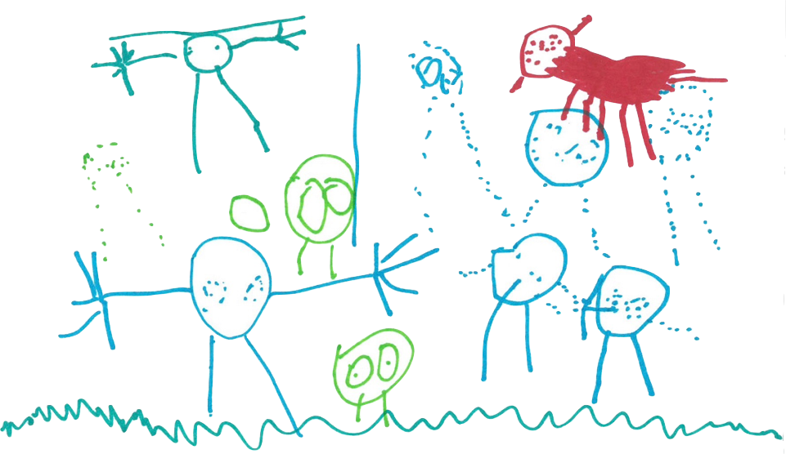
Implementation of the International Baccalaureate
Primary Years Program
Hired IBPYP Coordinator for 2015-2016 Academic Year
Submitted application for candidacy September 23, 2015
Achieved Candidacy status on January 12, 2016
KSU CDC will maintain candidacy status through the 2017-2018 academic year
Inquiring is...
“You ask so many questions, like, “How do people die?”
-Micah

Slide 26
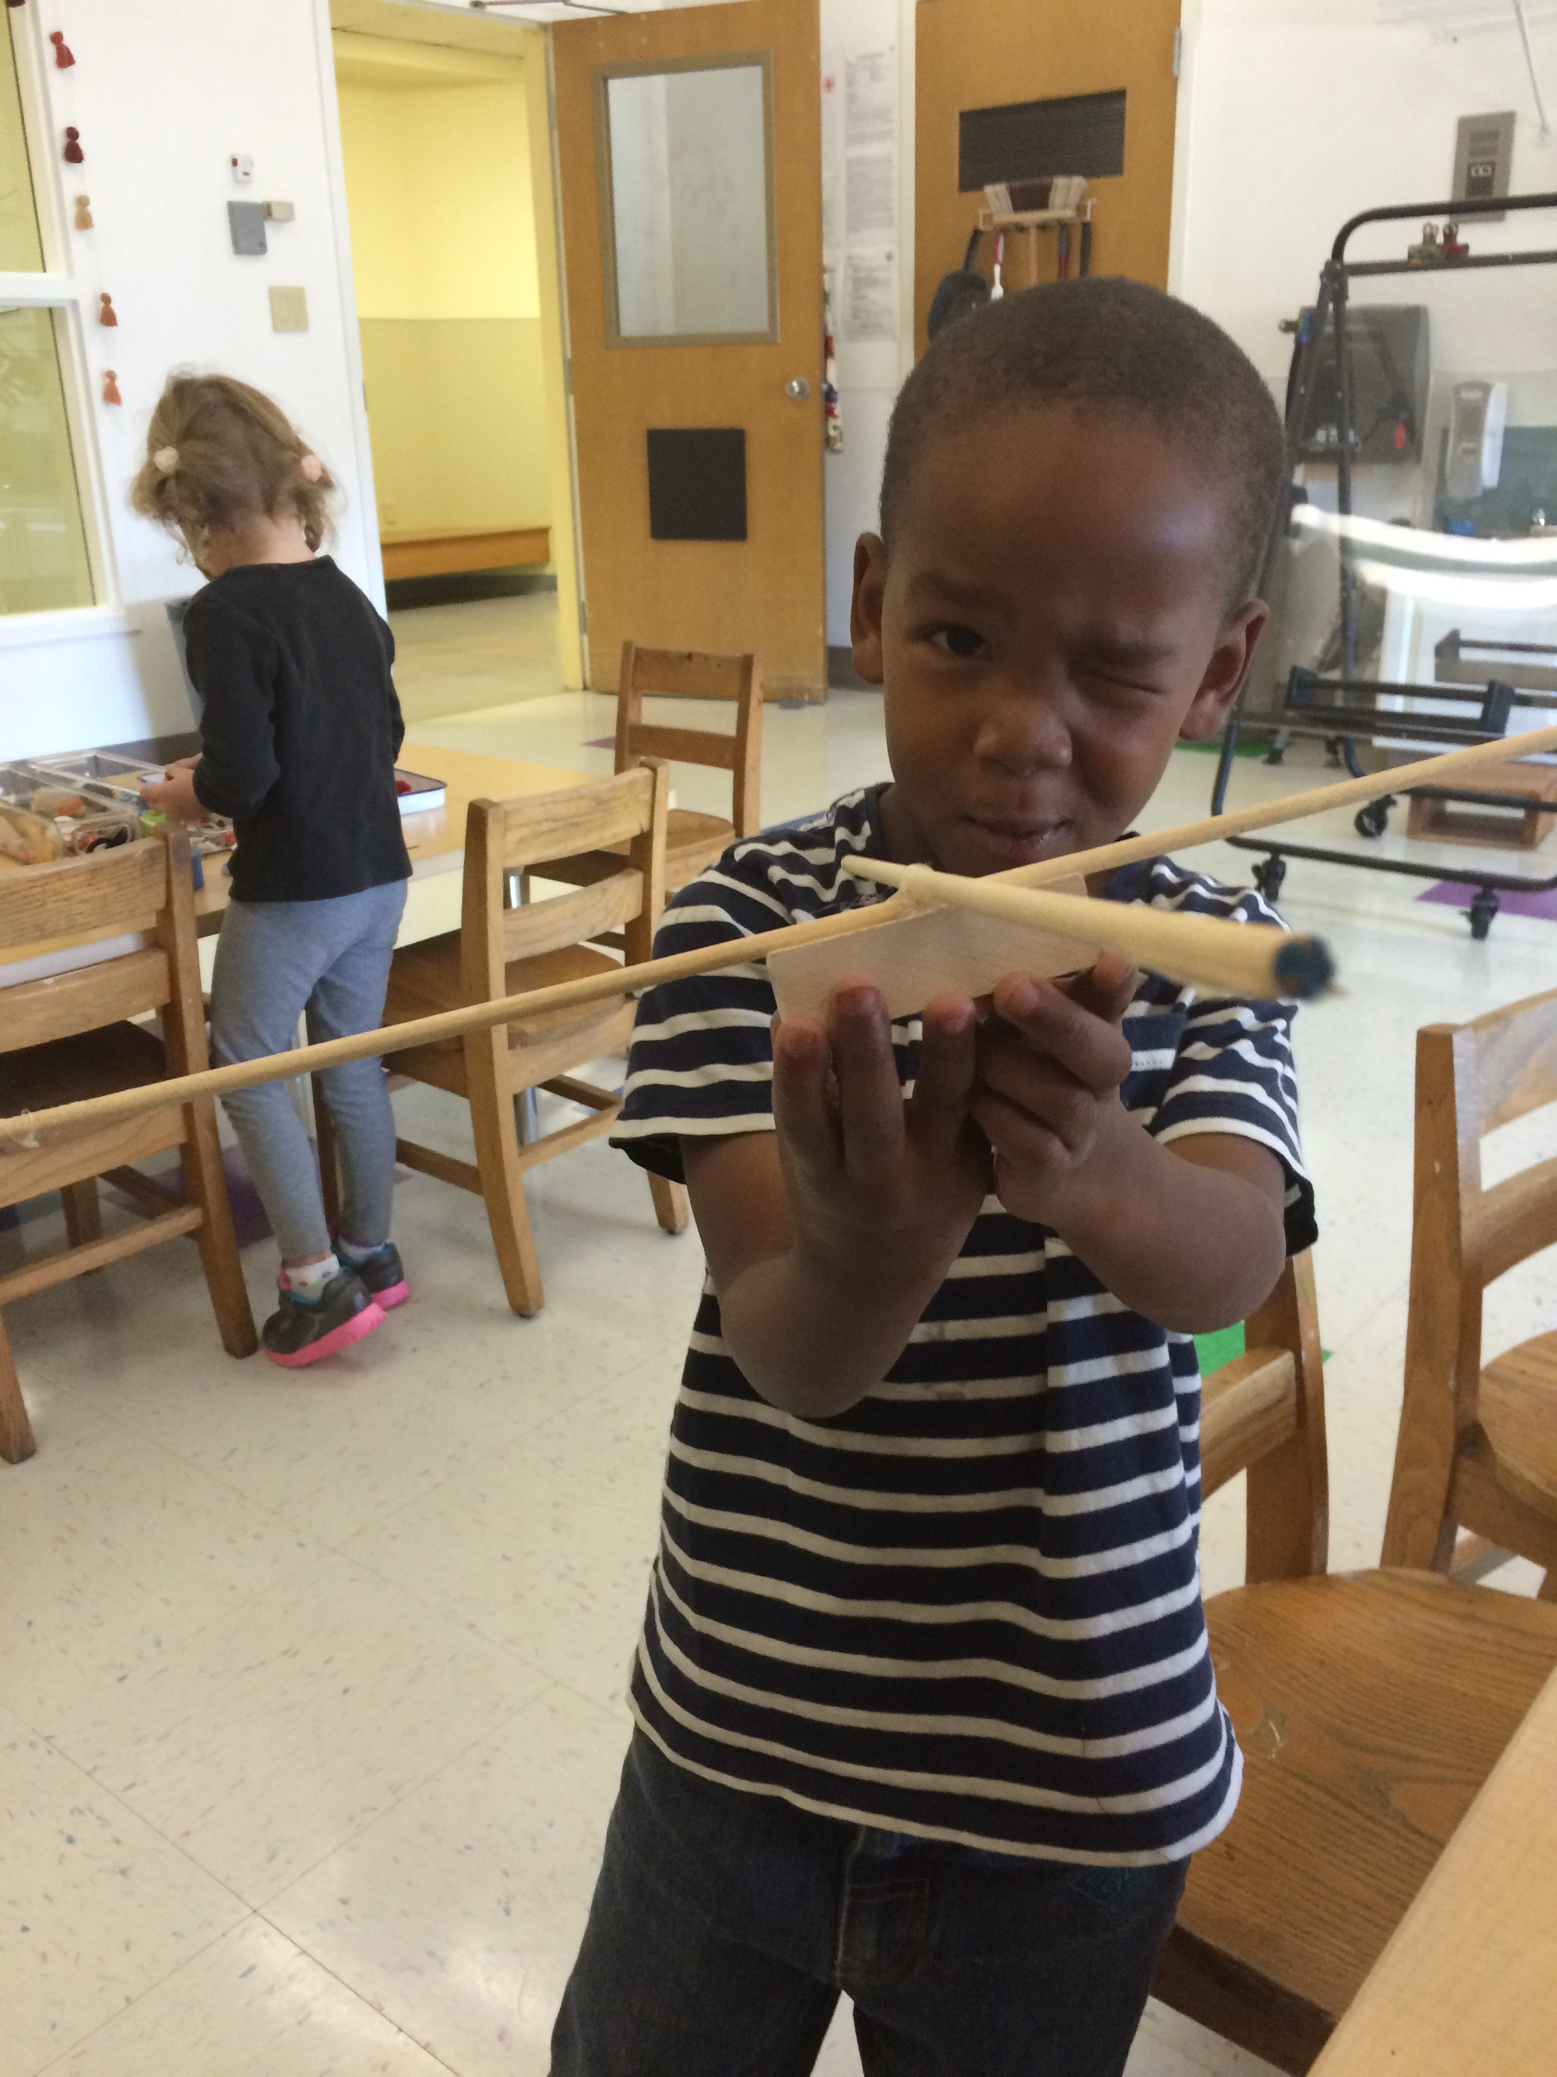
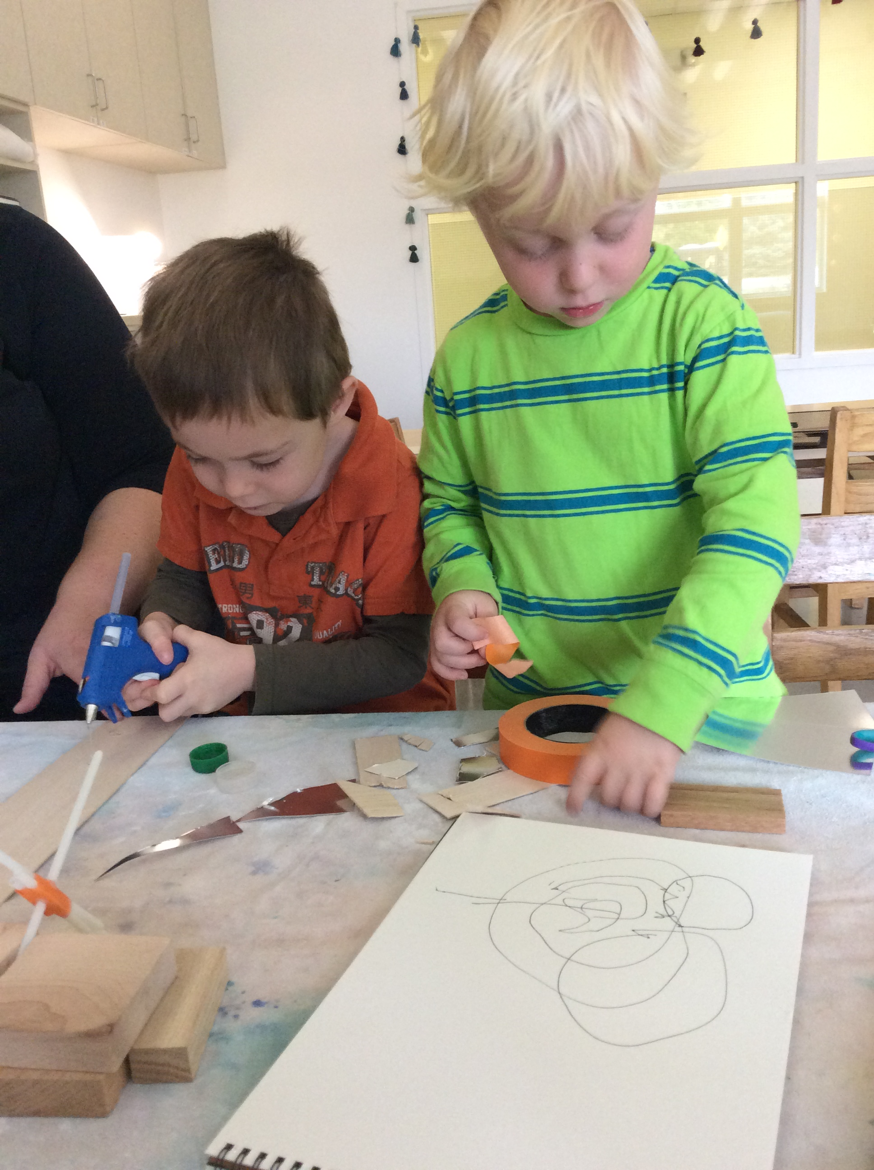
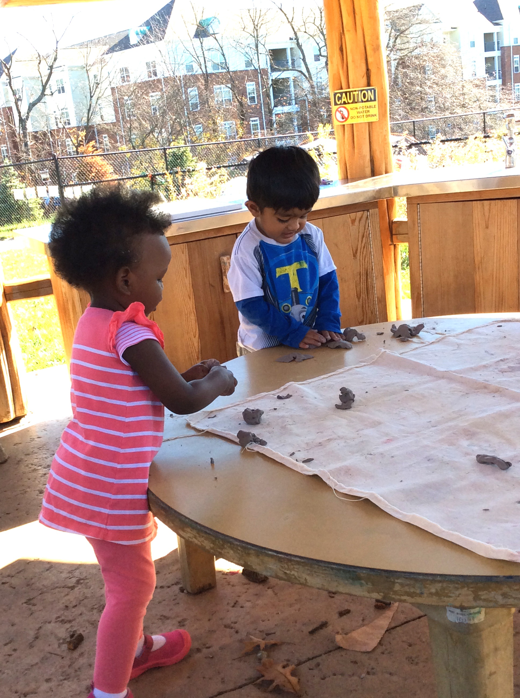
As an early years center, we enact an emergent curriculum that focuses on long-term, inquiry oriented investigations
for children from 18 months through 6 years old.

Slide 27
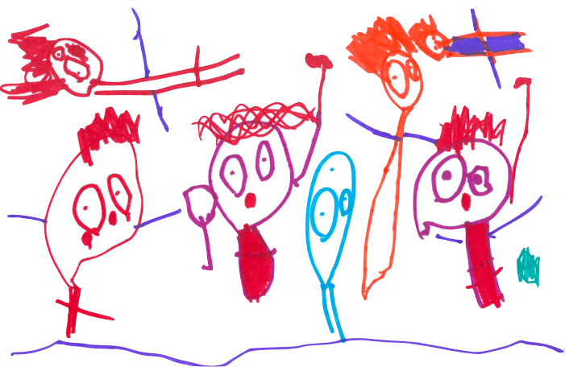
How does the IB PYP Framework support the curriculum and pedagogy of the CDC?
Utilizes a planning framework that focuses on long-term inquiry across age groups
Offers a set of open-ended skills, attitudes and attributes to aid in the study of the work of children and teachers
Emphasizes authentic assessment of young children through play-based, inquiry focused experiences
“Inquirer is things you don’t know. Porto is sitting right next to me. There’s Micah, Ruby, Carleigh, and Emma.”
-Claire

Slide 28
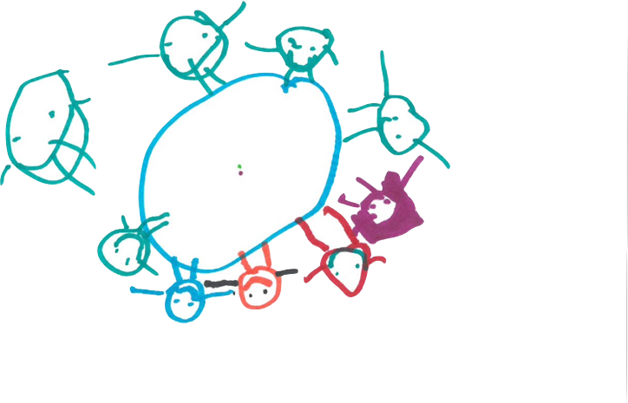
How does the IBPYP Framework more closely align the CDC with the Kent State community AND provide opportunities for collaborations beyond the KSU community?
Mirrors the Early Childhood Education Program
Reflects ideals identified in the University President’s mission – using local endeavors to create global impact
Creates opportunities for university collaborations with other departments within the university, e.g. the Office of Global Education and Gerald H. Read Center for International and Intercultural Education
Provides opportunities to share our work with others in an international context:
  KSU hosted the inaugural International Baccalaureate Educator’s Certificate Conference, May 2016
  Case study of school/university initiatives creating collaborative partnerships, IB of the America’s Conference, July 2016, Toronto, CA.
Inquiring is...
“you talk so much and you ask questions.”
-Becca

Slide 29
Dr. Robin Dever
Assistant Professor/Program Coordinator
Middle Childhood Education
MYP Coordinator

Slide 30
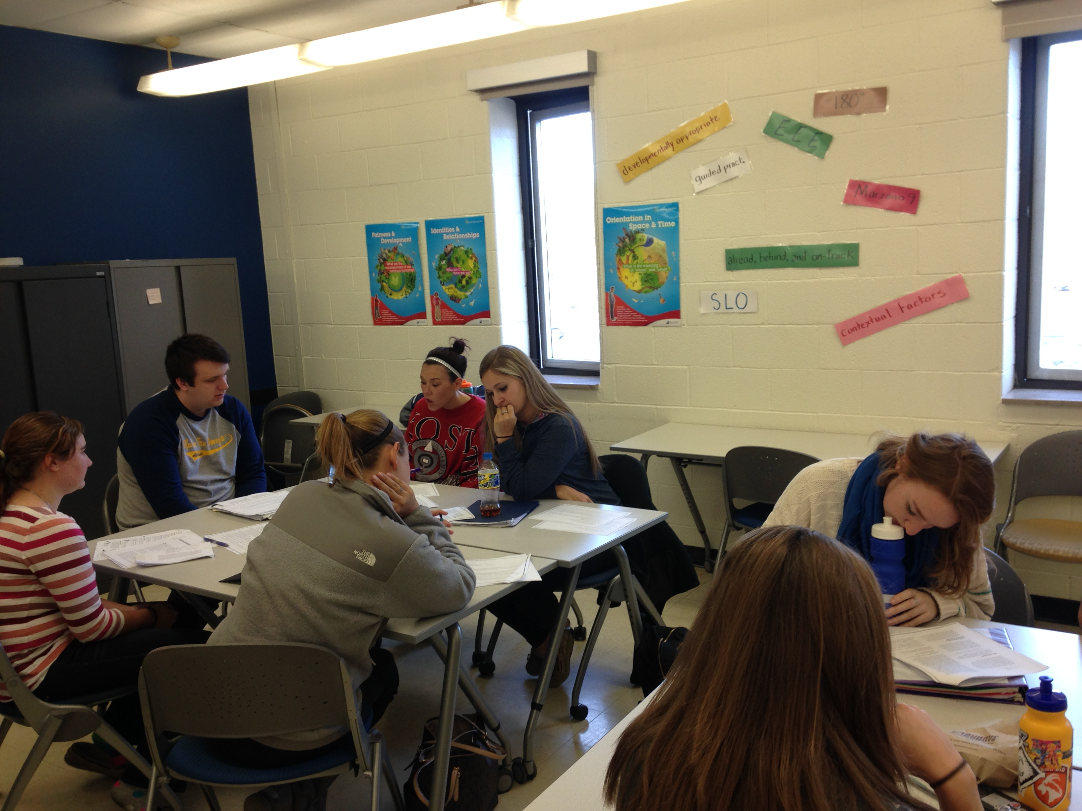
Middle Years Program
Grade 4-9 licensure
Two content areas
Reading focus
Located on 3 campuses

Slide 31
Middle Childhood Education Coursework
Fall Semester
  Reading and Writing in MC
  Math Methods
  Integrated Science/Social Studies
  Teaching & Learning in MC
  Weekly field experience in all content areas in grades 4-6 with focus on reading
Spring Semester
  Teaching Reading with Literature
  Curriculum & Organization in MC
  Content Specific Methods
    Social Studies
    Science
    Mathematics
  Weekly field experience in content area classrooms in grades 6-9.

Slide 32
Middle Childhood Clinical Partnerships
Litchfield MS
  Akron, OH
  IB Candidate School
  Year-long field placement
Shaker Heights MS
  Shaker Heights, OH
  IB World School
  “Field Trips” to observe teaching & planning
Langston MS
  Oberlin, OH
  IB World School

Slide 33
Challenges to Partnerships
Turn to a partner and discuss what challenges your institution faces in creating partnerships. Enter your responses in the poll.

Slide 34
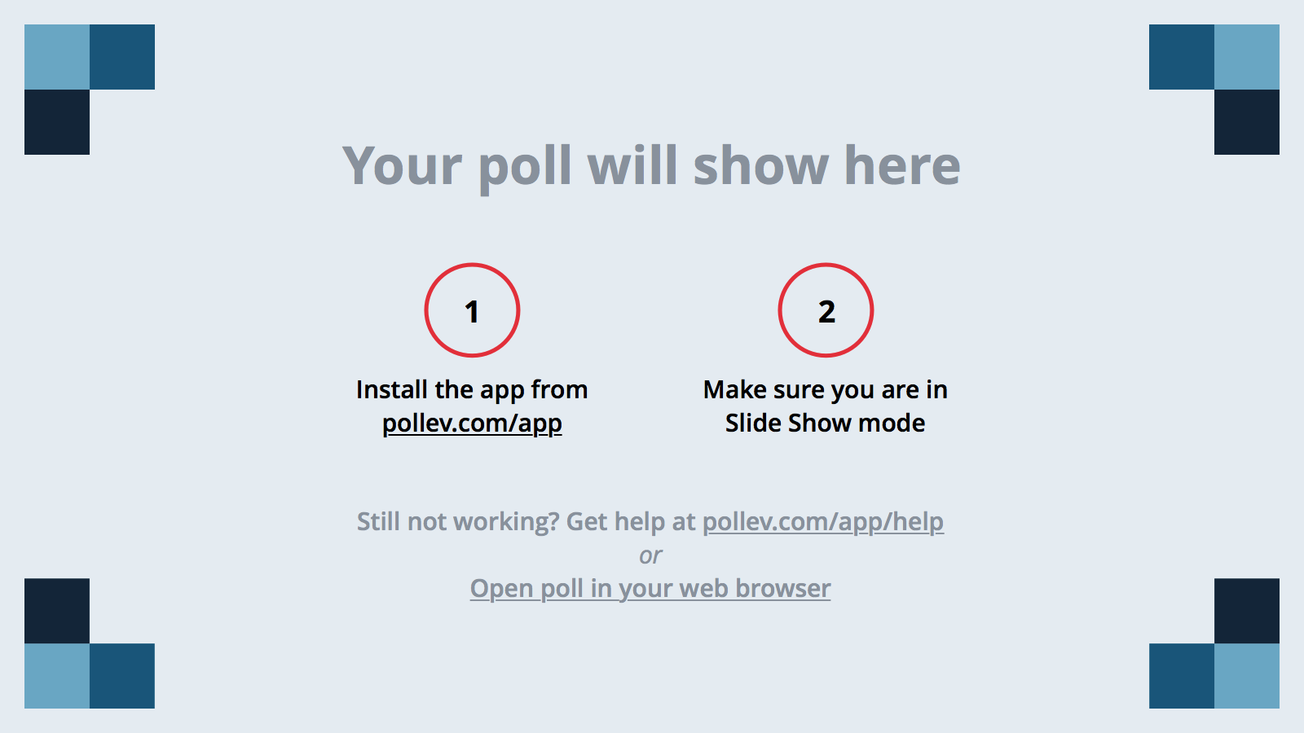
Notes:
What challenges have you faced in creating partnerships?
https://www.polleverywhere.com/free_text_polls/VQQTbsblsaaMt1B

Slide 35
Relationship, Relationship, Relationship!!!
Perseverance and Continuity

