Slide 2
Too Many Mandates? Using the IB as a Framework for Streamlining Success!
Michele Beard
Aimee Monticchio
Notes:
Who is in the room?
From Canada, USA, Caribbean, Mexico, anywhere else
Teacher, coordinators, building administrator, central administrator, other
IB journey: interested, candidate, authorized
Continuum: PYP, MYP, DP

Slide 3
Objectives and Outcomes
Validate competing mandates and make connections to IB principles and practices
Consider examples that could work for you
Assess current time constructs and resources
Analyze communication needs
Create first steps

Slide 4
Mandates?
List the mandates that dictate the work in your school.
i.e. Literacy, 21st Century Skills, teacher evaluation system, Common Core
Notes:
3 minutes

Slide 5
The Why Behind the Mandates
Why are these mandates? What are the intended outcomes of these directives?
Turn to a neighbor and brainstorm reasons why these mandates exist for schools.
All change is not growth, as all movement is not forward.
Ellen Glasgow, writer
Notes:
Jot ideas from audience, 5 minutes

Slide 6
Key Elements of IB
Standards and Practices:
Philosophy
Organization (Leadership and structure; Resources and support)
Curriculum (Collaborative planning; Written curriculum; Teaching and learning; Assessment)
Learner Profile Attributes
Balanced, Caring, Communicator, Inquirer, Knowledgeable,
Open-minded, Principled, Reflective, Risk-taker, Thinker
Approaches to Learning
Communication, Social, Self Management, Research, Thinking
Notes:
This begs the question, “Can IB be the framework under which all of the mandates are accomplished in your school?”

Slide 7

Langston Hughes Middle School
About our school
About 1000 students in grades 7-8
Advanced Academics Center
About 20% ESOL students
About 20% Special Ed students
About 40% Free or reduced meals
Notes:
Many competing mandates, short on time and how to best use it to increase achievement for all students. (closing gaps and raising the bar)-main focus in the beginning was student achievement due to performance on state tests

Slide 8
Too Many Mandates?
State and County Testing
School Improvement Plan - Closing the Gap Goal and Raising the Bar Goal
Literacy Initiative
Extended Learning Time Period
Professional Learning Communities
AVID
Teacher Performance Evaluation Program
Portrait of a Graduate
Notes:
Since taking over-these mandates have added to the plate-as principal, it’s my job to see that mandates are complied with while still ensuring a successful and engaging (invigorating/enjoyable) school experience for students and teachers

Slide 9

IB
State and County Testing
School Improvement Plan - Closing the Gap Goal and Raising the Bar Goal
Literacy Initiative
Extended Learning Time Period
Professional Learning Communities
AVID
Teacher Performance Evaluation Program
Portrait of a Graduate
Notes:
IB the main thing under which the other mandates could also be accomplished

Slide 10
Double Track Agenda
Upskilling staff while completing county and state mandates
Developing deeper understanding of IB to improve teaching and learning
Having coherence throughout the competing programs
Focus, focus, focus
Work smarter, not harder
Go slow to go fast

Slide 11
Mandate: State and County Testing
Virginia Standards of Learning standardized assessments
County benchmark standardized assessments
County performance assessments

Slide 12
Meeting the Mandate: State and County Testing
Shifting the focus of county benchmark and other standardized tests from summative to formative.
Aligning county performance assessments to IB criteria
Using the state standardized test as one piece of data and not THE piece of data

Slide 13
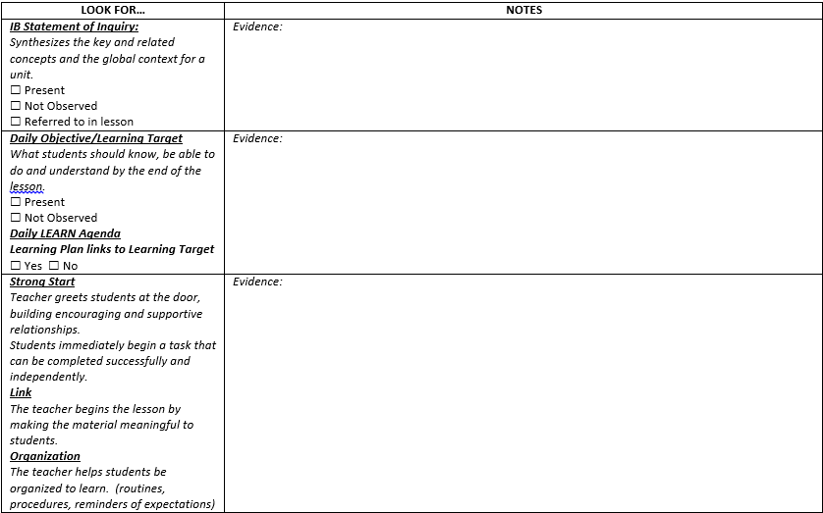

Slide 14
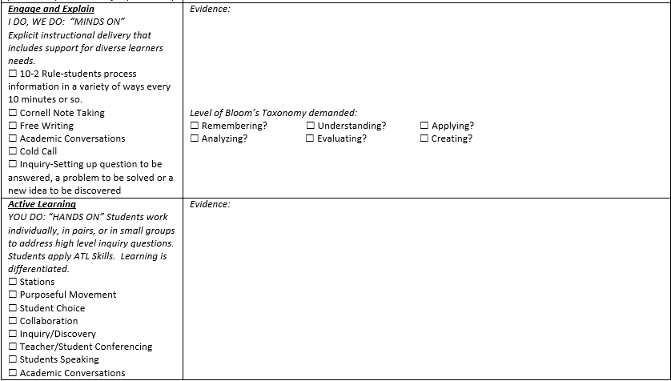

Slide 15
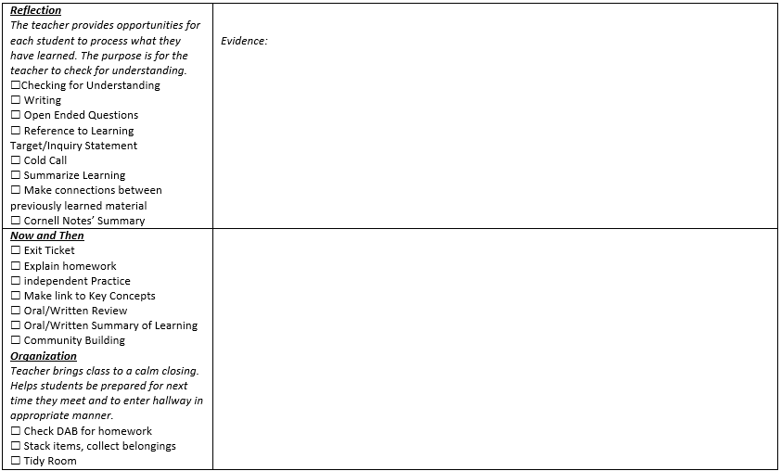

Slide 16
Mandate: School Improvement Plan Goals
Closing the gap goal
Raising the bar goal
Address areas of need

Slide 17
Meeting the Mandate: School Improvement Plan Goals
Closing the gap goal to decrease failure rate in subgroups on the state standardized test by using school-wide literacy and math strategies.
Raising the bar goal to increase student performance on assessments scored with MYP criteria. Collaborative teams participated in Building Quality Curriculum by reflecting on and submitting unit plans.

Slide 18
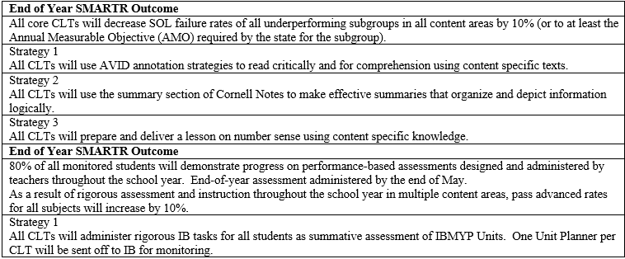
SIP Goals and Strategies

Slide 19
Mandate: Teacher Performance Evaluation Program
Evaluating teacher performance based on student progress

Slide 20
Meeting the Mandate: Teacher Performance Evaluation Program
Using IB MYP rubrics to show student growth in skills on performance assessments

Slide 21
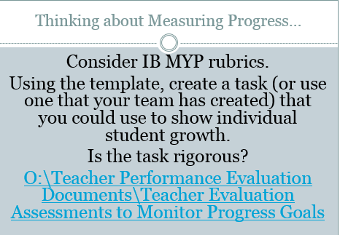

Slide 22
English 8 students will write to a series of prompts to focus on developing skills to organize their writing in a clear and logical manner around a central idea. They will also develop skills to use language accurately with appropriate and varied register, sentence structure, and vocabulary while using correct grammar, syntax, and spelling.
Student progress will be measured by assessing writing samples with IB MYP rubrics (with task-specific clarifications) for criteria B (Organization) and C (Style and Language Usage). Students will use possible SOL prompts to prepare them for reaching the highest levels of achievement on the SOL.
Individual achievement (as assessed with the IB MYP rubrics) will guide individual student progress goals.

Slide 23
By the end of April, all students will make measurable progress in writing a well-organized, well-developed essay with a central idea, supporting details, and a conclusion. For criteria B (Organizing) and C (Producing text), using the task-specific IBMYP rubric, all students will improve, at a minimum within each reporting criterion:
Students with a score of 1/2 will increase to a consistent score of 5/6 which include POS extensions.
Students with a score of 3/4 will increase to a consistent score of 7/8 which include POS extensions.
Students with a score of 5/6 will increase to a consistent score of 7/8 which include POS extensions.
Students with a score of 7/8 will i maintain a consistent score while performing tasks which include POS extensions and compare/contrast texts.

Slide 24
Mandate: Professional Learning Communities
Whole staff and collaborative learning teams focusing on four questions;
* What do we expect our students to learn?
* How will we know they are learning?
* How will we respond if they don’t learn?
* How will we respond if they already know it?

Slide 25
Meeting the Mandate: Professional Learning Communities
Developing structures and protocols for our work
Using staff meetings for collaborative work
IB planning days with collaborative teams
Using the unit planner and the assessments to drive the twice weekly collaborative team planning time
Monthly planning time for an interdisciplinary team
Notes:
(meeting agenda templates, OneNote and Google, classroom walkthrough form, LEARN lesson plan template and guiding document)

Slide 26
Meeting Agenda Template
Time | Topic | Outcomes/Products | Notes/Action Steps

Slide 27
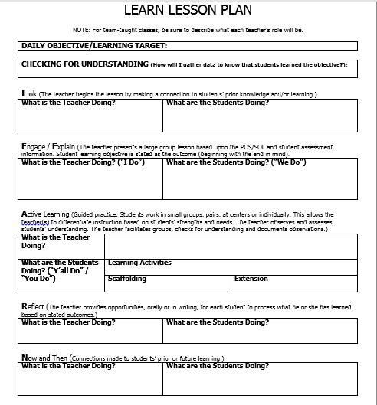

Slide 28
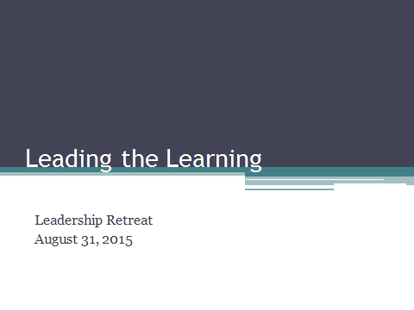

Slide 29
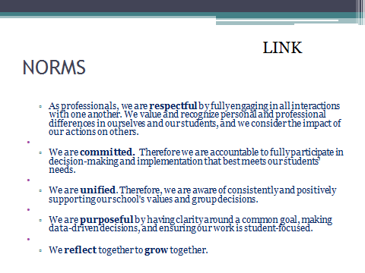

Slide 30
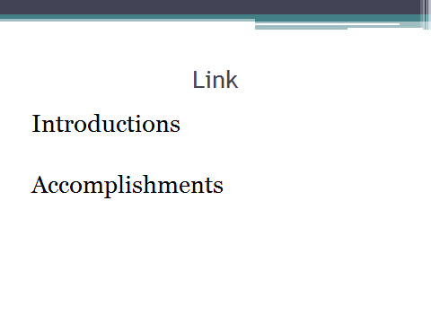

Slide 31
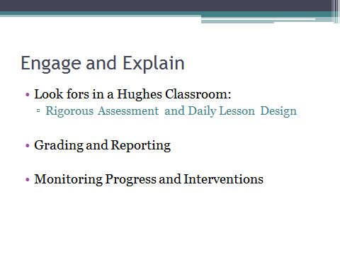

Slide 32
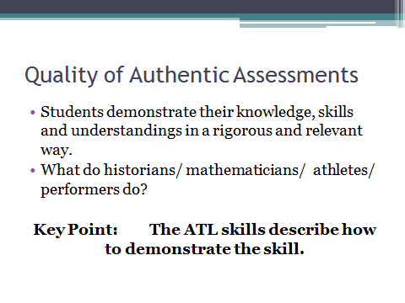

Slide 33
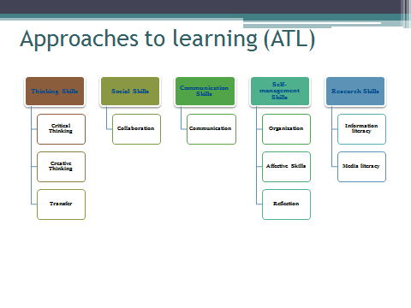

Slide 34


Slide 35
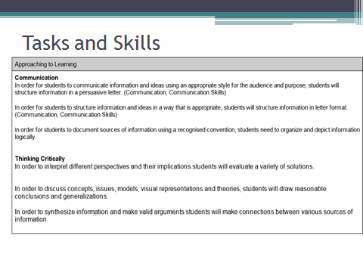

Slide 36
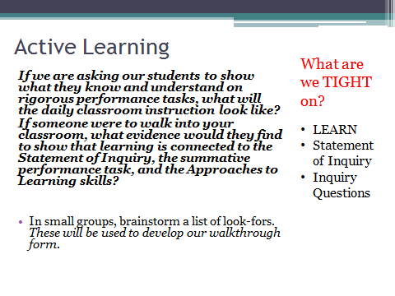

Slide 37
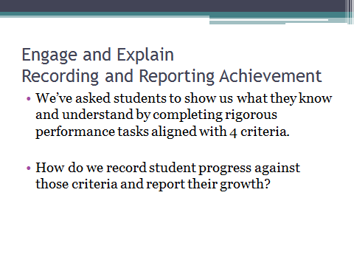

Slide 38
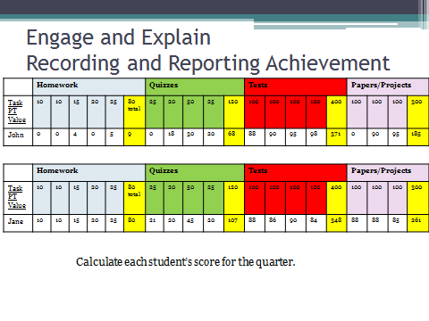

Slide 39
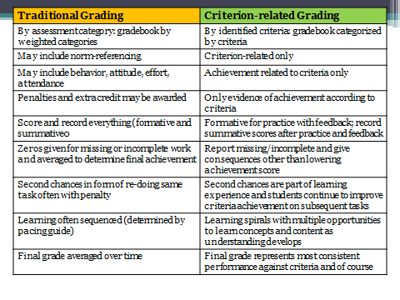

Slide 40
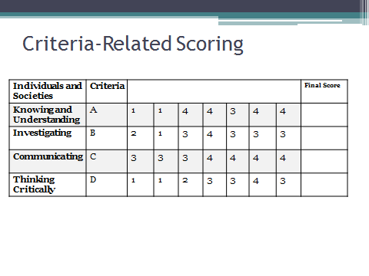

Slide 41
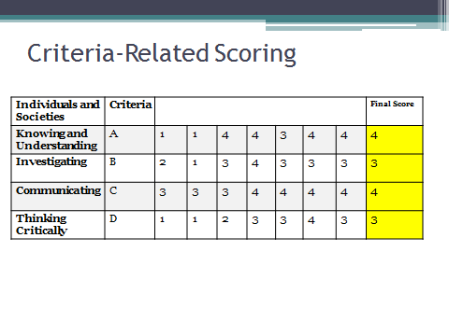

Slide 42
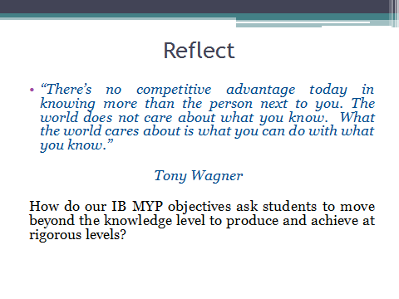

Slide 43
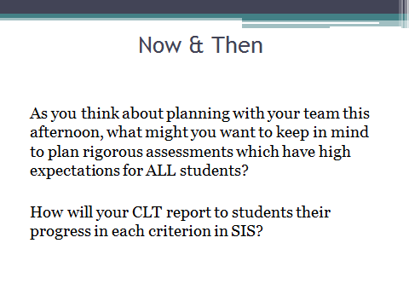

Slide 44
Time | Topic | Outcomes/Products | Notes/Action Steps
7:45 | Grounding/Review Agenda | todaysmeet - Share your response to the following: What does it mean to me to be an IB Middle Years Program teacher? DO NOT USE YOUR REAL NAME WHEN YOU CREATE A NAME! Shared understanding of the days' outcomes
8:00 | Unit Overview/Reflections | Briefly give an overview of the unit (CLT leader) and then share reflections (all members)
8:10 | Evaluating Unit Planners Overview | Use the Evaluating Unit Planners template to be sure that all parts are included/completed in the unit plan - Add any missing components - Google Doc
8:30 | Evaluating Unit Planners | Use the Evaluating Unit Planners template to self-assess the following: Statement of Inquiry Inquiry questions Summative assessment Approaches to learning skills Content Learning process Resources Reflections Google Doc
11:30 | Lunch
12:30 | Subject Overview | Use the Subject Overview template to outline/map units for the year - Google Sheet
1:30 | Unit Planning/Revision | Work session to create new unit plans and resources or revise existing plans and resources based on understanding of the Evaluating Unit Planners rubrics
2:10 | Next Steps | Identify next steps for team

Slide 45
Mandate: Literacy Initiative
Secondary literacy framework
Cris Tovani strategies
Asking students to connect deeply with text

Slide 46
Meeting the Mandate: Literacy Initiative
School-wide read aloud and literacy rich lessons
Leadership book study - I Read It But I Don’t Get It - Cris Tovani
Staff-wide professional development on annotation strategies
Collaborative teams developed lessons using annotation strategies

Slide 47


Slide 48
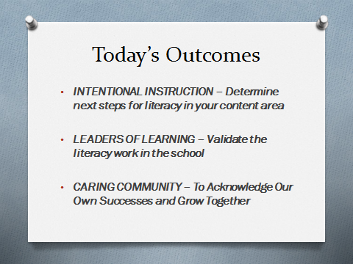

Slide 49


Slide 50
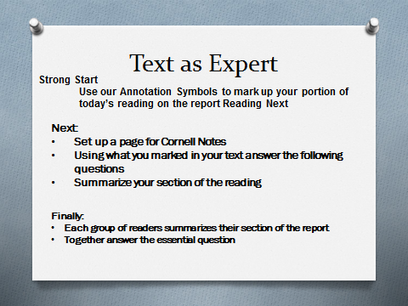

Slide 51
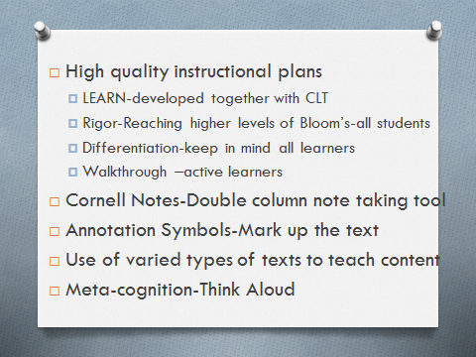

Slide 52
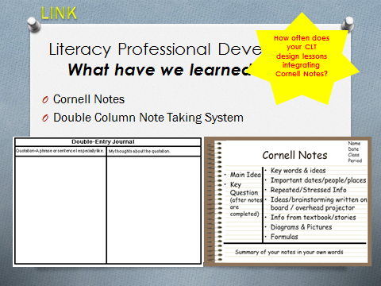

Slide 53
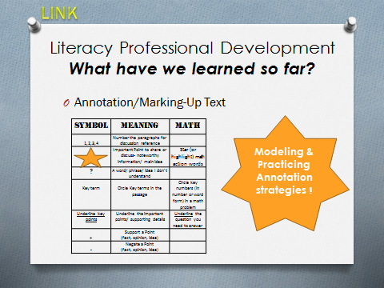

Slide 54
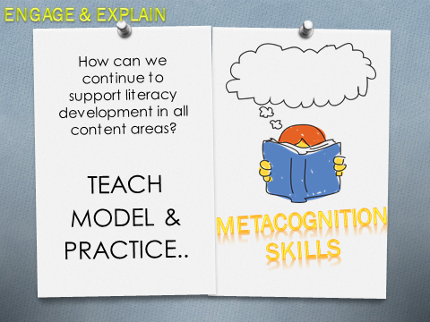

Slide 55
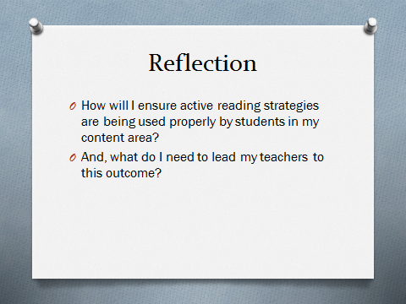

Slide 56


Slide 57
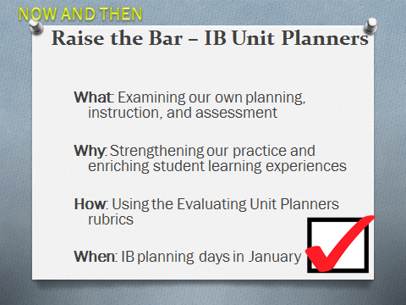

Slide 58


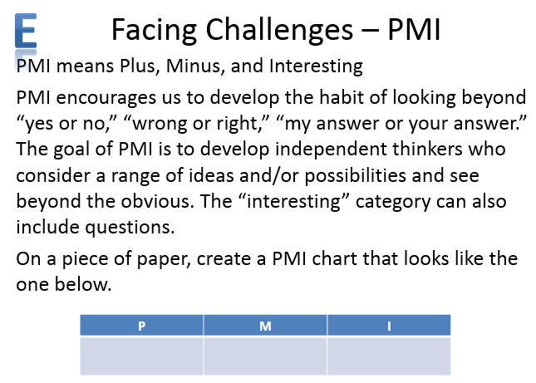

Slide 59
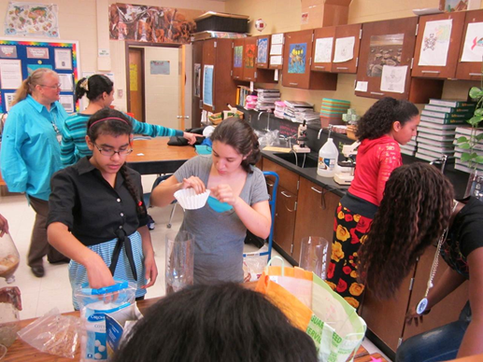

Slide 60
Mandate: AVID - Advancement Via Individual Determination
Pushing students toward rigor
Development of skills - especially in organization and communication
Whole-school strategies

Slide 61
Meeting the Mandate with IB: AVID
Staff-wide professional development on Cornell Notes (targeting summarizing), Socratic seminar, and higher level questions (aligning Costa’s level of questioning with factual, conceptual, and debatable questions)
Collaborative teams developed lessons using Cornell notes

Slide 62
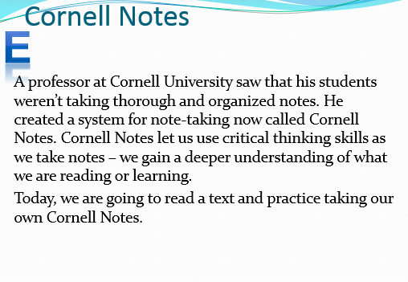
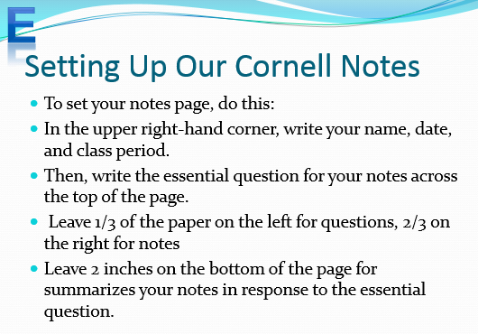

Slide 63
Mandate: Extended Learning Time
Support in literacy and math for targeted students
Additional learning opportunities for all
Building a community of learners

Slide 64
Meeting the Mandate: Extended Learning Time
English and math support classes three times a week
Approaches to learning lessons (focusing on developing ATL skills and the learner profile attributes) for all students

Slide 65
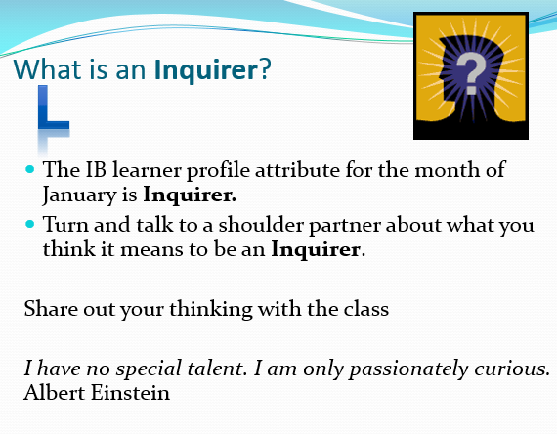
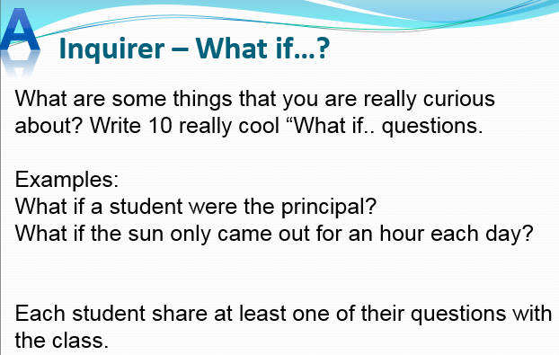

Slide 66

Mandate: Portrait of a Graduate
Communicator
Collaborator
Global Citizen
Creative and Critical Thinker
Goal Directed and
Resilient Individual

Slide 67
Meeting the Mandate: Portrait of a Graduate
Connections to the IB learner profile attributes and the ATL skills
Interdisciplinary units

Slide 68

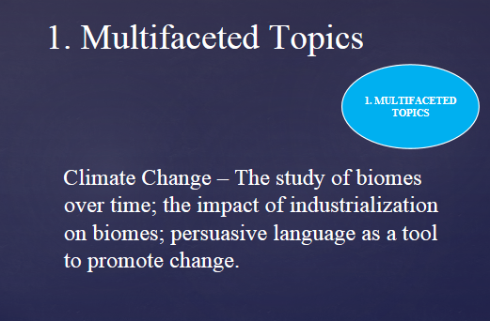

Slide 69
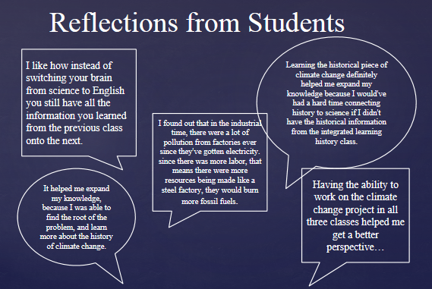

Slide 70
Reflections and First Steps
Look back at your list. What connections can you make to the following:
Standards and Practices
IB Learner Profile Attributes
Approaches to Learning Skills

Slide 71
IB
State and County Testing
School Improvement Plan - Closing the Gap Goal and Raising the Bar Goal
Literacy Initiative
Extended Learning Time Period
Professional Learning Communities
AVID
Teacher Performance Evaluation Program
Portrait of a Graduate

Slide 72
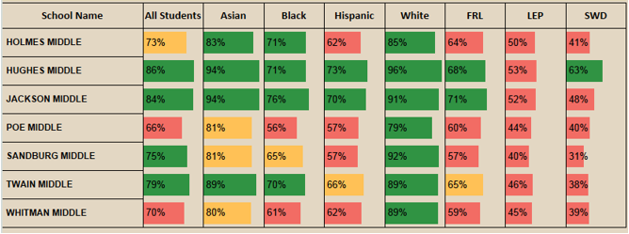

Slide 73
Our Results
Math 7 has raised the overall pass rate from 2 years ago by more than 20%.
Math 8 has raised the overall pass rate and pass rates in subgroups by 10%-20% over the past three years.
Algebra raised its pass-advanced pass rate by almost 10%.
Civics has closed gaps in special ed, Black, and Hispanic performance. Over the past 4 years, pass rates in those areas have gone up between 10 and 20%.
Science pass rates have gone up for overall performance and they have raised pass rates for black, Hispanic, and special ed students by about 10% over the past two years.
Interdisciplinary: We saw that students on the Interdisciplinary 7 team saw SOL much larger gains in reading scores than the other English honors classes! Interdisciplinary 8 also saw students perform higher than other honors Reading 8 students.

Slide 74

What are your desires/possibilities?

Slide 75
Connect Your Dots
What?
When?
Who?
How?

Slide 76
Next Step: Communication
Communicate the why to staff
Influence “up” by asking permission or forgiveness
To become a master at any skill, it takes the total effort of your heart, mind and soul working together in tandem.
Maurice Young, rapper and producer

